Slide 1
Code Search and Idiomatic Snippet Synthesis
Mukund Raghothaman
University of Pennsylvania
(Joint work with Yi Wei and Youssef Hamadi)

Slide 2
“How do I match a regular expression in C#?”

Slide 3
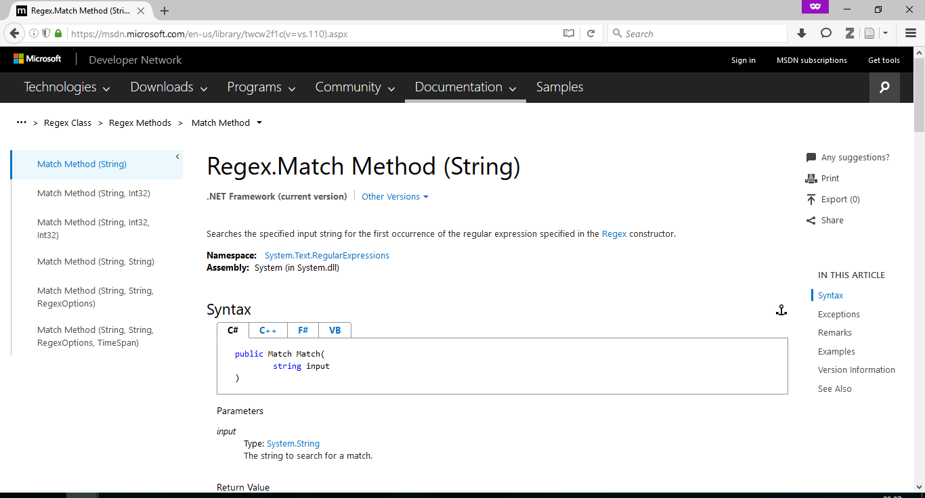
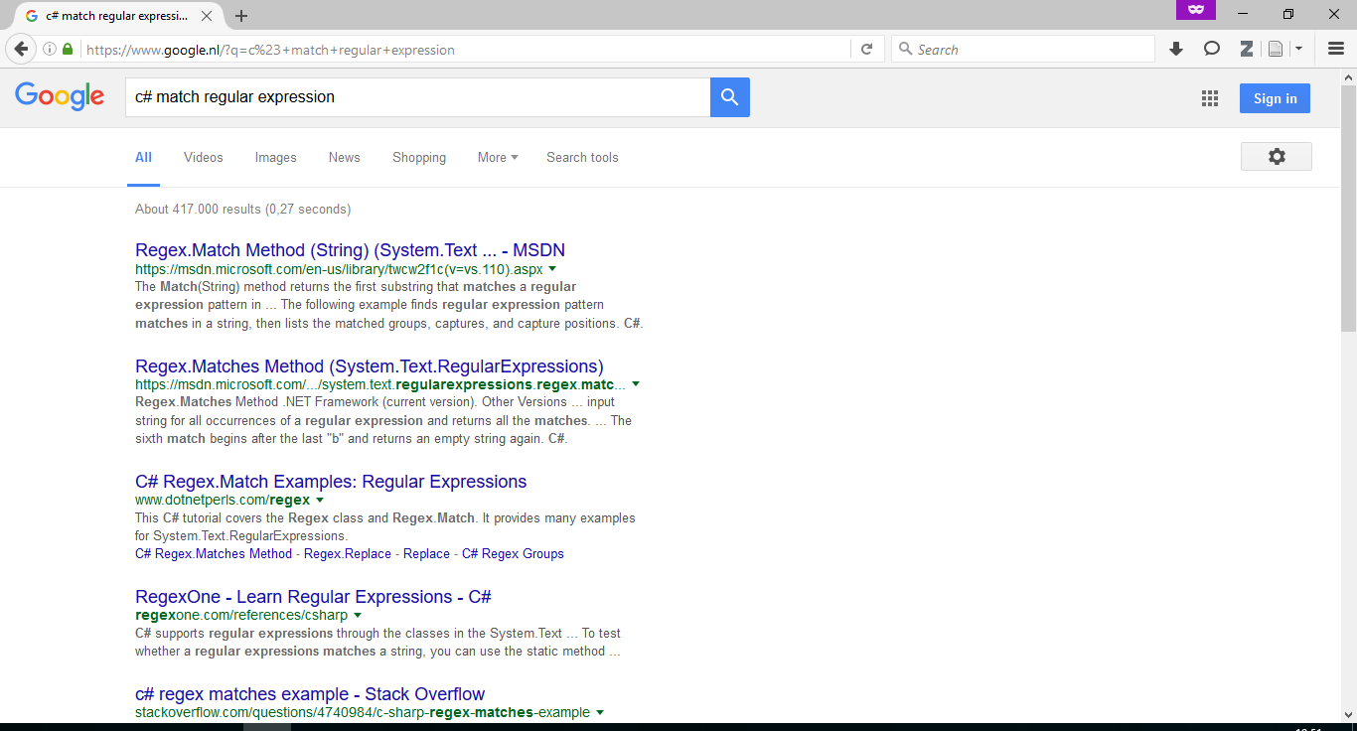
“How do I match a regular expression in C#?” (Now)
Ask Google / Bing / ⋯
Read returned web pages
Repeat Step 2
…
“Match.Success is what we need!”
…
Write code

Slide 4
“How do I match a regular expression in C#?” (Us)
Descriptive variable names
Enter query “match regular expression”
Get answer: string pattern; RegexOptions options; var regex = new Regex(pattern, options); string input; var match = regex.Match(input); if (match.Success) { var groups = match.Groups; }
Branches and loops synthesized
Notes:
1. Answers the query.
2. Includes conditional and repeated access patterns. Not just type inhabitation.
3. Variables are given descriptive names.

Slide 5
“Download file from URL”
var wc = new WebClient();
string address;
string fileName;
wc.DownloadFile(address, fileName);
Method returns void
Unintuitively named API classes
Possibly uninitialized variables

Slide 6
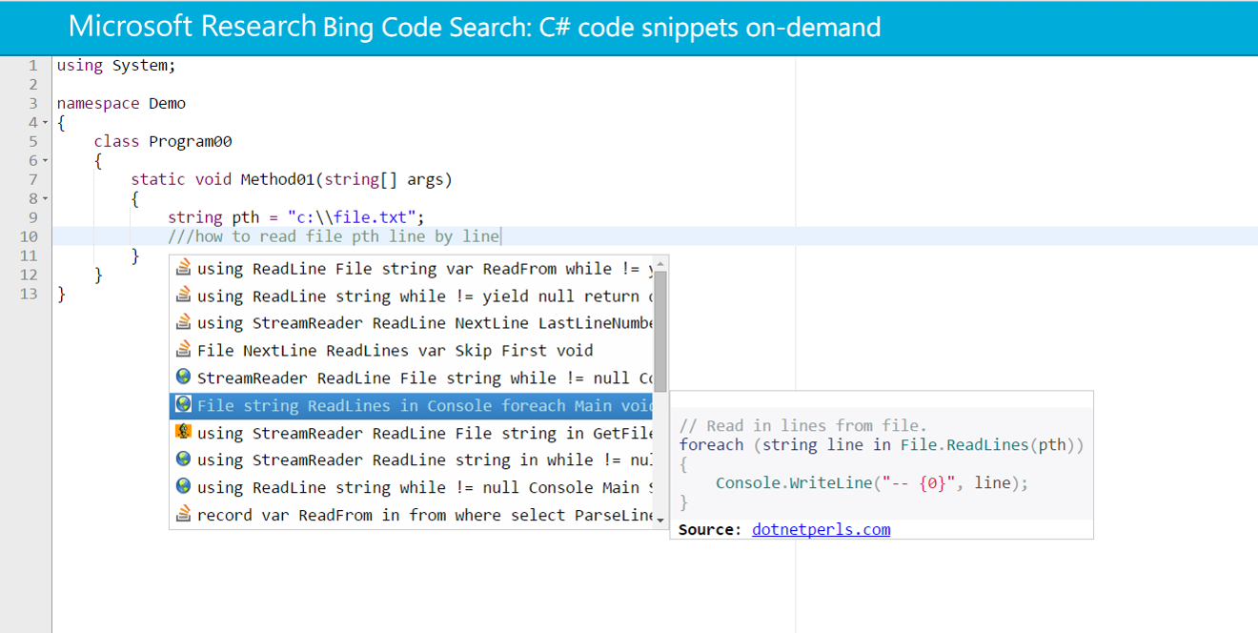
SWIM: Synthesize What I Mean
Notes:
Queries are written in English, as one would enter them into Google.
Does not require any knowledge of the framework.

Slide 7
SWIM: Synthesize What I Mean
Input: API-related query (“How do I play a sound?”)
Output: Idiomatic C# code snippet
Requirements:
Speed
No user annotations
We do not answer: “C# class static member initialization order”
Or: “C# lambda”

Slide 8
SWIM: Synthesize What I Mean
Input: API-related query (“How do I play a sound?”)
Output: Idiomatic C# code snippet
Requirements:
Speed
No user annotations
This talk: How do we build SWIM?
Question 1: Given a natural language query, what code do we synthesize?
Question 2: What are code idioms? How do we recognize them? How do we synthesize from them?
Notes:
Question 2 is double-dipping!

Slide 9
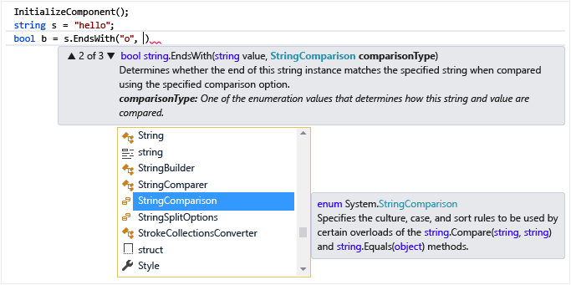
IntelliSense

Slide 10
Type Inhabitation
Type inhabitation is a very powerful technique
Prospector [Mandelin et al, 2005]: Given an input object of type $T_{\text{in}}$, how to build an output object of type $T_{\text{out}}$?
InSynth [Gvero et al, 2013]: Type inhabitation for Simply Typed Lambda Calculus
CodeHint [Gaelson et al, 2014]: Type inhabitation and snippet generation at debug-time
All require some knowledge of the API framework

Slide 11
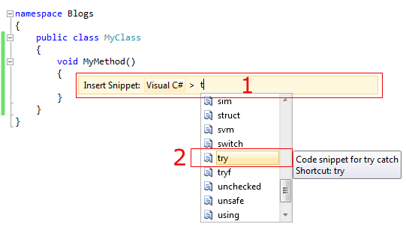
Visual Studio Code Snippets
Slava Agafonov, http://agafonovslava.com/post/2010/11/26/Visual-Studio-2010-code-snippets
Notes:
Visual Studio Code Snippets allows software companies, API developers, etc. to create a set of “labelled” code snippets.
High quality solutions, but require a lot of labor to create, and can only answer questions the authors originally thought of.

Slide 12
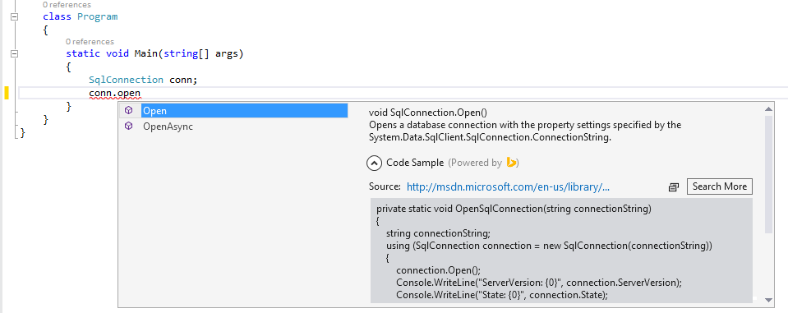
Bing Developer Assistant
Notes:
“Look for conn.open in the code corpus and show me citations.”
Still requires knowledge of the framework: that a database is queried with a SqlConnection object, etc.

Slide 13
anyCode
Synthesizes expressions; SWIM synthesizes code snippets
Aware of developer context: local variables etc.
Code idioms expressed as Probabilistic Context Free Grammars
anyCode parses the user input; SWIM uses a bag-of-words
Notes:
Can anyCode handle completely unexpected queries? Cf. Allamanis and Jason’s work?
anyCode guarantees type-correctness, SWIM doesn’t
SWIM just wants to know which method the user wants to call

Slide 14
Structured Call Sequences

Slide 15
Structured Call Sequences
Regex.Match(string)
Many code snippets in the corpus similar to: var match = regex.Match(…); if (match.Success) { var groups = match.Groups; … }

Slide 16
Structured Call Sequences
Code seen: var match = regex.Match(…); if (match.Success) { var groups = match.Groups; … }
Corresponding structured call sequence: ■ := Regex.Match(string); if ([■.Success]_{get}) { [■.Groups]_{get}; }

Slide 17
Structured Call Sequences
Code seen
Structured call sequence
var dialog = new OpenFileDialog(); dialog.Title = ...; dialog.InitialDirectory = ...; if (dialog.ShowDialog()) { var var1 = dialog.FileName; }
■ := new OpenFileDialog(); [■.Title]_{set}; [■.InitialDirectory]_{set}; if (■.ShowDialog()) { [■.FileName]_{get}; }

Slide 18
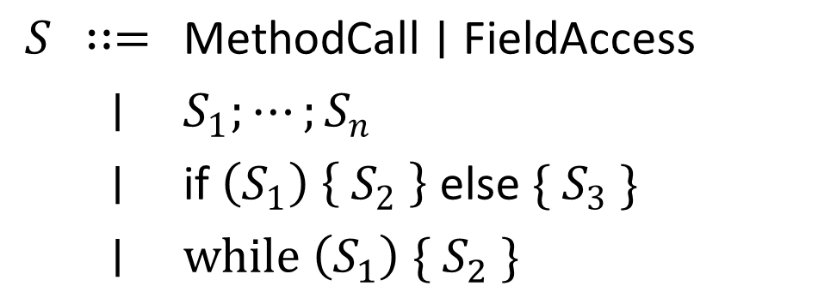
Structured Call Sequences
Syntactic construct: Method calls + Control flow
$\text{Assignment} ;S$, where:
$$S$$ | $$∷=$$ | $$\text{MethodCall}∣\text{FieldAccess}$$
 | $$∣$$ | $$S_{1};⋯;S_{n}$$
 | $$∣$$ | $$\text{if} \left(S_{1}\right) \left\{ S_{2} \right\} \text{else} \{ S_{3} \}$$
 | $$∣$$ | $$\text{while} \left(S_{1}\right) \{ S_{2} \}$$
Simple imperative proto-language
Exceptions, generics, first-class functions, anonymous classes, … not (yet) included
Notes:
Simple imperative proto-language
Conditional and repeated patterns
More to idiomatic API usage than just sequences of method calls
Not yet complete: constructs such as exceptions not yet included

Slide 19
Structured Call Sequences: Thesis
Capture API usage patterns
Easy to extract and straightforward synthesis targets

Slide 20
Big Picture
Question 1: Given a natural language query, what code do we synthesize? Given a natural language query, which structured call sequence do we pick for synthesis?
Question 2: What are code idioms? How do we recognize them? How do we synthesize from them?
Question 2.1: How do we extract SCS from the corpus?
Question 2.2: How do we synthesize code from SCS?

Slide 21
Structured Call Sequences: Extraction
Scan code corpus for all usages of $T$, for each type $T$
Best-effort analysis using Roslyn Building projects hard: dependencies, syntax errors etc.
Extracted at the level of individual methods
Grouped by syntactic equality, frequency measured
Notes:
Project forks raise tricky questions
No inter-procedural analysis (yet)
No alias analysis (yet)

Slide 22
Structured Call Sequences: Synthesis
How do we get a Regex object to invoke Regex.Match(string)?
What argument do we pass to the Regex.Match(string) method?
What do we name “■”?
■ := Regex.Match(string); if ([■.Success]_{get}) { [■.Groups]_{get}; }

Slide 23
Q1: Object Creation
How do we get a Regex object to invoke Regex.Match(string)?
Perform a recursive lookup!
Use the same NLP method to find the best structured call sequence for Regex, which also happens to invoke Regex.Match(string)
■ := Regex.Match(string); if ([■.Success]_{get}) { [■.Groups]_{get}; }

Slide 24
Q2: Method Arguments
What argument do we pass to the Regex.Match(string) method?
What we did:
For basic types (int, double, etc.), use the value 0
For all other types, use null
Use formal name of argument to reflect intent var input = default(string); regex.Match(input);
More intelligent solutions certainly possible
■ := Regex.Match(string); if ([■.Success]_{get}) { [■.Groups]_{get}; }

Slide 25
Q3: The Variable Name Model
What do we name “■”?
For every occurrence of Regex.Match(string) in the code corpus, note down variable name
Build histogram $H$ of name frequencies
When synthesizing code, use top-ranked feasible name in $H$
Captures practice, but we actually want to capture intent
■ := Regex.Match(string); if ([■.Success]_{get}) { [■.Groups]_{get}; }

Slide 26
SWIM Tool Architecture
GitHub code corpus mined for API usage patterns
Query-to-API translation done using Bing clickthrough data

Slide 28
Ranked APIs
Convenient hand-off point between NLP experts and synthesis experts
Input query: “append strings”
Ranked APIs: StringBuilder.Append(string) StringBuilder.AppendLine(string) …

Slide 29
Query-to-API Mapping

Slide 30
Query-to-API Mapping
Several potential ways:
Search for matches using C# documentation [SNIFF, Chatterjee et al, 2009]
Pass query to Bing, and look at code snippets within search results
Clickthrough data more reliable

Slide 31
Clickthrough Data
“match regular expression” → https://msdn.microsoft.com/en-us/library/system.text.regularexpressions.regex.match

Slide 32
Clickthrough Data
https://msdn.microsoft.com/en-us/library/system.text.regularexpressions.regex.match → Regex.Match(string)
https://msdn.microsoft.com/en-us/library/system.text.regularexpressions.regex.match → Regex.Match(string, int)
…

Slide 33
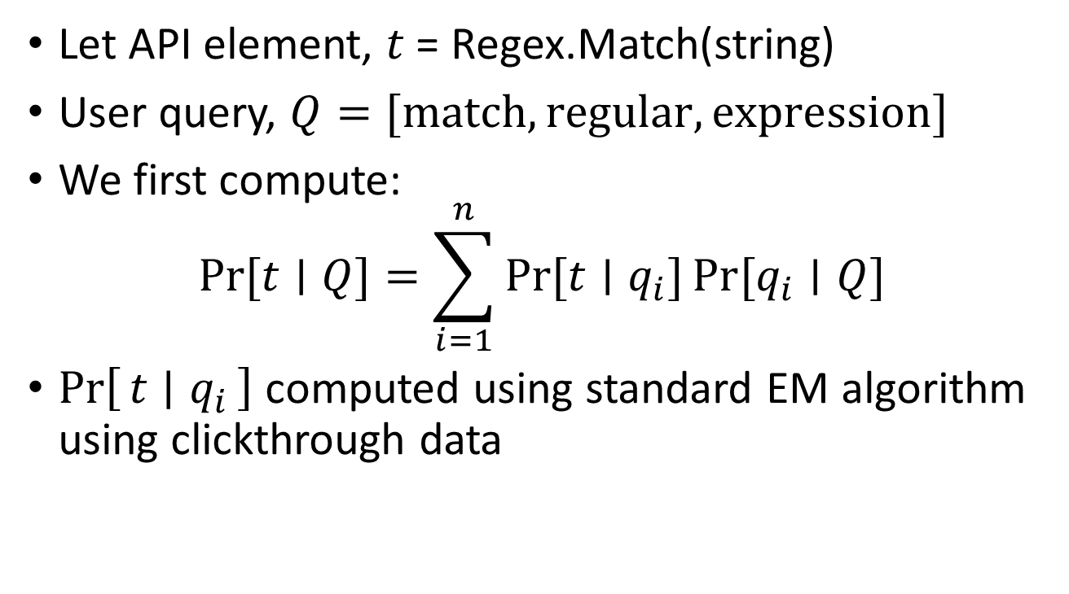
Query-to-API Mapping
Let API element, $t$ = Regex.Match(string)
User query, $Q=[\text{match},\text{regular},\text{expression}]$
We first compute: $\operatorname{Pr}{[t∣Q]}=\sum_{i=1}^{n}{Pr⁡[t∣q_{i}]}\operatorname{Pr}{[q_{i}∣Q]}$
$\operatorname{Pr}\left[t ∣ q_{i}\right]$ computed using standard EM algorithm using clickthrough data

Slide 35
Picking Structured Call Sequences for Synthesis
Structured call sequences extracted from GitHub code corpus, grouped by syntactic equality, placed into Lucene database
SCS database queried given API element ranking, $\operatorname{Pr}\left[t ∣ Q\right]$

Slide 36
Picking Structured Call Sequences for Synthesis
Lucene internally uses a cosine similarity function to rank documents
$N$ API elements
API element ranking, $A_{i}=\operatorname{Pr}\left[t_{i} ∣ Q\right]$, $1≤i≤N$
$B∈{\left[0,1\right]}^{N}$ is the document signature $B_{i}=\left\{\begin{matrix}1 & \text{if} t_{i} \text{appears} \text{in} \text{the} \text{SCS}\text{, }\text{and} \\ 0 & \text{otherwise}\text{.}\end{matrix}\right.$
$\text{Similarity}\left(A,B\right)=\frac{\sum_{i}{A_{i}×B_{i}}}{\left\|A_{i}\right\|×‖B_{i}‖}$

Slide 37
Evaluation

Slide 38
Evaluation Queries
30 common API-related queries from the Bing query log
append strings | execute sql statement | parse xml
append text file | generate md5 hash code | play sound
binaryformatter | get current directory | random number
connect to database | get files in folder | read binary file
convert int to string | launch process | read text file
convert string to int | load bitmap image | send mail
copy file | load dll | serialize xml
create file | match regular expression | string split
current time | open file dialog | substring
download file from url | parse datetime from string | test file exists
Notes:
First solution snippet marked relevant for black queries.
First solution snippet irrelevant for orange queries.

Slide 39
Evaluation
10 solution snippets generated for each query
Graded manually by a human programmer: Relevant / Irrelevant
Top solution relevant in 70% of the cases
At least one relevant solution in each case
Variable name selection: Appropriate / Inappropriate
Average of 2.5 variable names required per snippet
88% of chosen names marked appropriate
Very responsive: 1.5 seconds per generated snippet

Slide 40
Evaluation: Oops! (1)
Query 1: “convert string to int”
Query 2: “convert int to string”
Same generated snippet for both
var value = default(string); System.Convert.ToInt32(value);
Because query-to-API translator uses bags-of-words

Slide 41
Evaluation: Oops! (2)
Query: “open file dialog”
Filter property specifies types of files to be chosen
Special syntax for correct values
For example: "Text Files (.txt)|*.txt"
Generated snippet is unhelpful
var dlg = new OpenFileDialog(); dlg.Title = null; dlg.InitialDirectory = null; dlg.Filter = null; dlg.FilterIndex = 0; if (dlg.ShowDialog()) { var fName = dlg.FileName; }

Slide 42
Evaluation: Oops! (2)
Query: “open file dialog”
Filter property specifies filetypes to be chosen
Special syntax for correct values
For example: "Text Files (.txt)|*.txt"
Generated snippet is unhelpful
Similar examples: regular expressions, date-time format strings (“dd-mm-yyyy"), etc.

Slide 43
Evaluation: Oops! (3)
Query: “launch process”
First relevant snippet ranked 8th
var startInfo = new ProcessStartInfo(); startInfo.FileName = null; var process = Process.Start(startInfo); process.WaitForExit();
var startInfo = new ProcessStartInfo(); startInfo.FileName = null; startInfo.CreateNoWindow = false; startInfo.RedirectStandardOutput = false; startInfo.RedirectStandardError = false; startInfo.UseShellExecute = false;

Slide 44
Evaluation: Oops! (3)
Query: “launch process”
First relevant snippet ranked 8th
ProcessStartInfo is ranked very highly by the query-to-API model
If code synthesizer starts with a ProcessStartInfo object, then it will never call Process.Start()
Can we somehow require that every ProcessStartInfo object is destined to be fed into Process.Start()?
Joint probability distributions, perhaps?

Slide 45
Conclusion
Presented SWIM, a code search tool powered by the GitHub code corpus and Bing clickthrough data

Slide 46
Future Work
Open-source code corpuses are a great resource for programming language researchers
(Traditionally used as) Benchmarks
Anomaly detection
Program synthesis
Consciously consider statistics and uncertainty in program analysis
Clustering runtime values: overloaded types such as strings
Inferring types in dynamic languages
Notes:
Also compare with systems like Daikon and SAGE: single program, many runs

