Slide 1
SWIM: Synthesize What I Mean
Code Search and Idiomatic Snippet Synthesis
Mukund Raghothaman, Yi Wei, Youssef Hamadi
University of Pennsylvania
Microsoft Research, Cambridge
École Polytechnique, Palaiseau

Slide 2
“How do I match a regular expression in C#?”

Slide 3
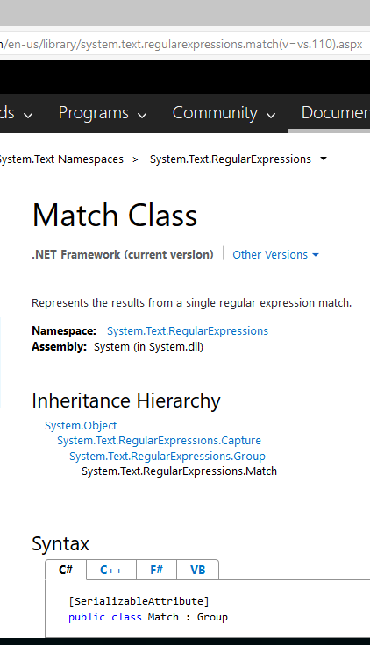
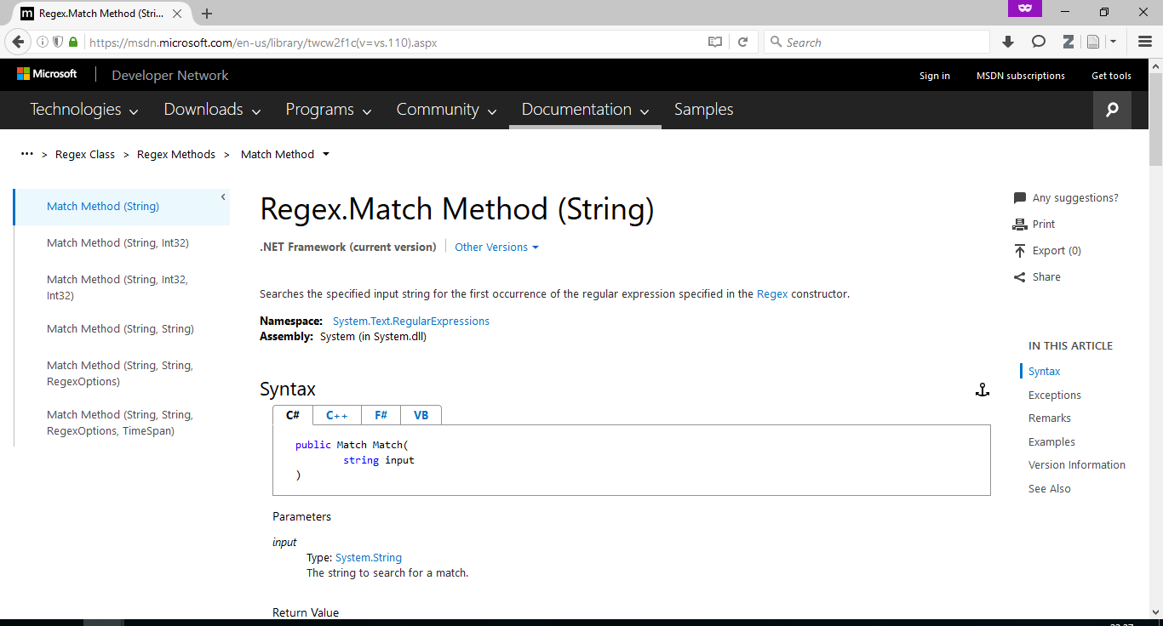
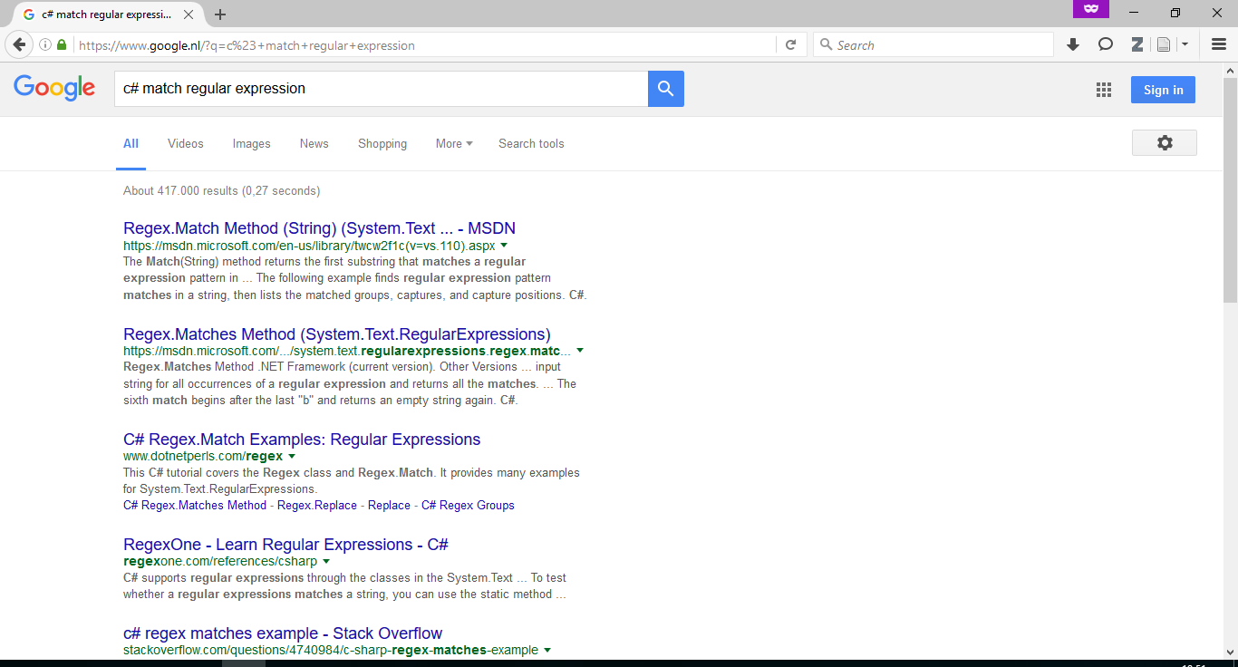
“How do I match a regular expression in C#?” (Now)
Ask Google / Bing / ⋯
Read returned web pages
Repeat Step 2
…
“Match.Success is what we need!”
…
Write code

Slide 4
“How do I match a regular expression in C#?” (Us)
Descriptive variable names
Enter query “match regular expression”
Get answer:
string pattern;
RegexOptions options;
var regex = new Regex(pattern, options);
string input;
var match = regex.Match(input);
if (match.Success) {
var groups = match.Groups;
}
Branches and loops synthesized

Slide 5
“Download file from URL”
var wc = new WebClient();
string address;
string fileName;
wc.DownloadFile(address, fileName);
Method returns void
Unintuitively named API classes
Possibly uninitialized variables

Slide 6
SWIM: Synthesize What I Mean
Input: API-related query (“How do I play a sound?”)
Output: Idiomatic C# code snippet
Requirements:
  Speed
  No user annotations
This paper: How do we build SWIM?
Question 1: Given a natural language query, what code do we synthesize?
Question 2: What are code idioms? How do we recognize them? How do we synthesize from them?
Using clickthrough data from Bing
Extracted from GitHub

Slide 7
Structured Call Sequences

Slide 8
Structured Call Sequences
Regex.Match(string)
Many code snippets in the corpus similar to:
var match = regex.Match(…);
if (match.Success) {
var groups = match.Groups;
…
}
Corresponding structured call sequence:
■ := Regex.Match(string);
if ([■.Success]_{get}) {
[■.Groups]_{get};
}

Slide 9
Structured Call Sequences
Code seen
Structured call sequence
var dialog = new OpenFileDialog();
dialog.Title = ...;
dialog.InitialDirectory = ...;
if (dialog.ShowDialog()) {
var var1 = dialog.FileName;
}
■ := new OpenFileDialog();
[■.Title]_{set};
[■.InitialDirectory]_{set};
if (■.ShowDialog()) {
[■.FileName]_{get};
}

Slide 10
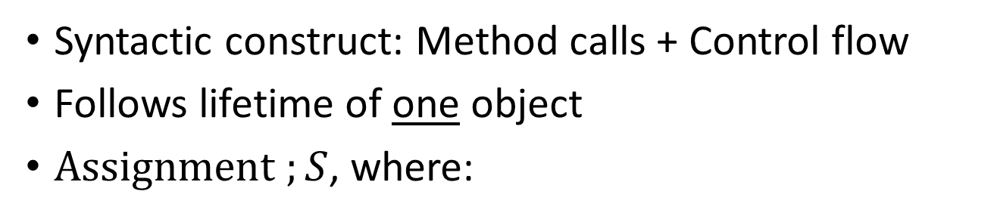
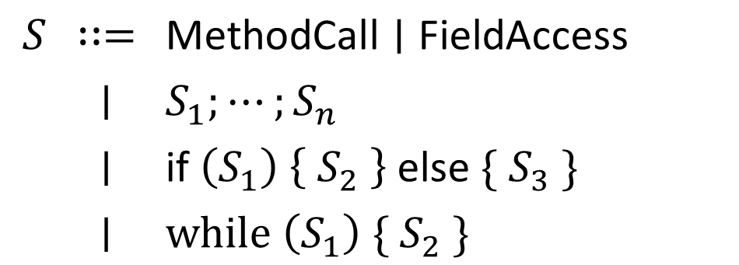
Structured Call Sequences
Syntactic construct: Method calls + Control flow
Follows lifetime of one object
$\text{Assignment} ;S$, where:
$$S$$ | $$∷=$$ | $$\text{MethodCall}∣\text{FieldAccess}$$
 | $$∣$$ | $$S_{1};⋯;S_{n}$$
 | $$∣$$ | $$\text{if} \left(S_{1}\right) \left\{ S_{2} \right\} \text{else} \{ S_{3} \}$$
 | $$∣$$ | $$\text{while} \left(S_{1}\right) \{ S_{2} \}$$
Exceptions, generics, first-class functions, anonymous classes, … not yet included
Simple imperative proto-language

Slide 11
Structured Call Sequences: Thesis
Capture API usage patterns
Easy to extract and straightforward synthesis targets

Slide 12
Query-to-API Mapping

Slide 13
Clickthrough Data
“match regular expression” → https://msdn.microsoft.com/en-us/library/system.text.regularexpressions.regex.match

Slide 14
Clickthrough Data
https://msdn.microsoft.com/en-us/library/system.text.regularexpressions.regex.match → Regex.Match(string)
https://msdn.microsoft.com/en-us/library/system.text.regularexpressions.regex.match → Regex.Match(string, int)
…

Slide 15
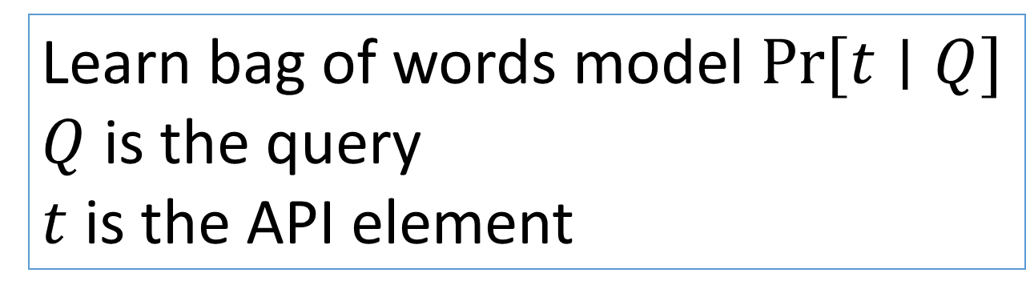
Clickthrough Data
“match regular expression” → Regex.Match(string)
“match regular expression” → Regex.Match(string, int)
“download file from URL” → WebClient.DownloadFile(string, string)
…
Learn bag of words model $Pr⁡[t∣Q]$
$Q$ is the query
$t$ is the API element

Slide 16
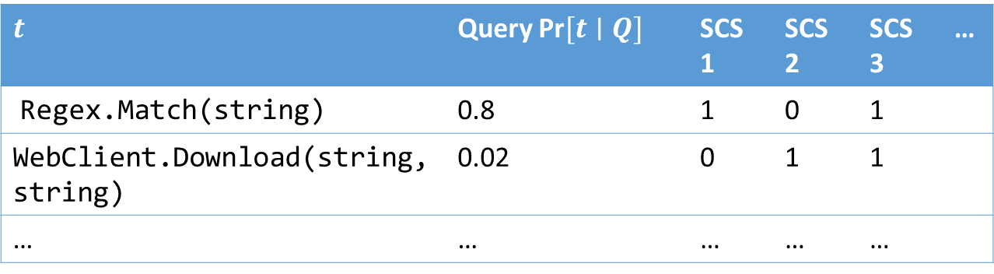
Query-to-API Mapping
$$t$$ | Query $\text{Pr}[t∣Q]$ |  | SCS 1 | SCS 2 | SCS 3 | …
Regex.Match(string) | 0.8 |  | 1 | 0 | 1
WebClient.Download(string, string) | 0.02 |  | 0 | 1 | 1
… | … |  | … | … | …
Find structured call sequence which best matches query

Slide 17
Evaluation

Slide 18
Evaluation Queries
30 common API-related queries from the Bing query log
append strings | execute sql statement | parse xml
append text file | generate md5 hash code | play sound
binaryformatter | get current directory | random number
connect to database | get files in folder | read binary file
convert int to string | launch process | read text file
convert string to int | load bitmap image | send mail
copy file | load dll | serialize xml
create file | match regular expression | string split
current time | open file dialog | substring
download file from url | parse datetime from string | test file exists

Slide 19
Evaluation
10 solution snippets generated for each query
Graded manually by a human programmer: Relevant / Irrelevant
  Top solution relevant in 70% of the cases
  At least one relevant solution in each case
Variable name selection: Appropriate / Inappropriate
  Average of 2.5 variable names required per snippet
  88% of chosen names marked appropriate
Very responsive: 1.5 seconds per generated snippet

Slide 20
Conclusion
Presented SWIM, a code search tool powered by the GitHub code corpus and Bing clickthrough data

Slide 21
Future Work
Integration with an actual search engine / IDE
Better natural language processing to address shortcomings of current tool
Making structured call sequences more expressive
Open-source code corpora are a great resource for programming language researchers
  (Traditionally used as) Benchmarks
  Anomaly detection
  Program synthesis

Slide 22
SWIM Tool Architecture
GitHub code corpus mined for API usage patterns
Query-to-API translation done using Bing clickthrough data

Slide 24
Structured Call Sequences: Extraction and Synthesis

Slide 25
Big Picture
Question 1: Given a natural language query, what code do we synthesize?
Given a natural language query, which structured call sequence do we pick for synthesis?
Question 2: What are code idioms? How do we recognize them? How do we synthesize from them?
  Question 2.1: How do we extract SCS from the corpus?
  Question 2.2: How do we synthesize code from SCS?

Slide 26
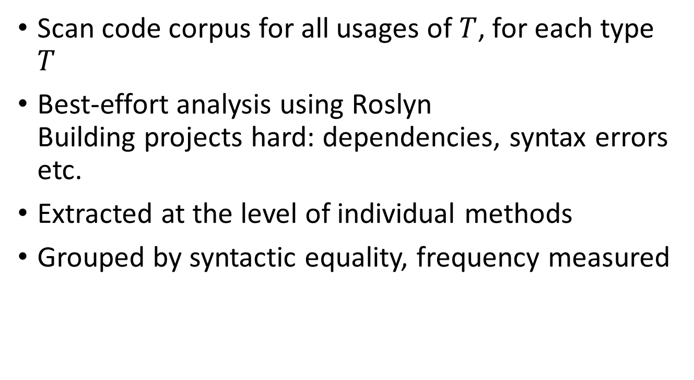
Structured Call Sequences: Extraction
Scan code corpus for all usages of $T$, for each type $T$
Best-effort analysis using Roslyn
Building projects hard: dependencies, syntax errors etc.
Extracted at the level of individual methods
Grouped by syntactic equality, frequency measured

Slide 27
Structured Call Sequences: Synthesis
■ := Regex.Match(string);
if ([■.Success]_{get}) {
[■.Groups]_{get};
}
Q1. From where do we get a Regex object?
Q2. What argument do we pass here?
Q3. What do we name “■”?

Slide 28
Q1: Object Creation
■ := Regex.Match(string);
if ([■.Success]_{get}) {
[■.Groups]_{get};
}
How do we get a Regex object to invoke Regex.Match(string)?
Perform a recursive lookup!
Find a structured call sequence for Regex, which also happens to invoke Regex.Match(string)
■ := new Regex(string, RegexOptions);
■.Match(string);
■.Dispose();
■ := new Regex(string, RegexOptions);
■ := ■.Match(string);
if ([■.Success]_{get}) {
[■.Groups]_{get};
}
■.Dispose();

Slide 29
Q2: Method Arguments
What argument do we pass to method calls?
Use formal argument names to reflect intent
■ := new Regex(string, RegexOptions);
■ := ■.Match(string);
if ([■.Success]_{get}) {
[■.Groups]_{get};
}
■.Dispose();
string pattern;
RegexOptions options;
■ := new Regex(pattern, options);
string input;
■ := ■.Match(input);
if ([■.Success]_{get}) {
[■.Groups]_{get};
}
■.Dispose();
More intelligent solutions certainly possible

Slide 30
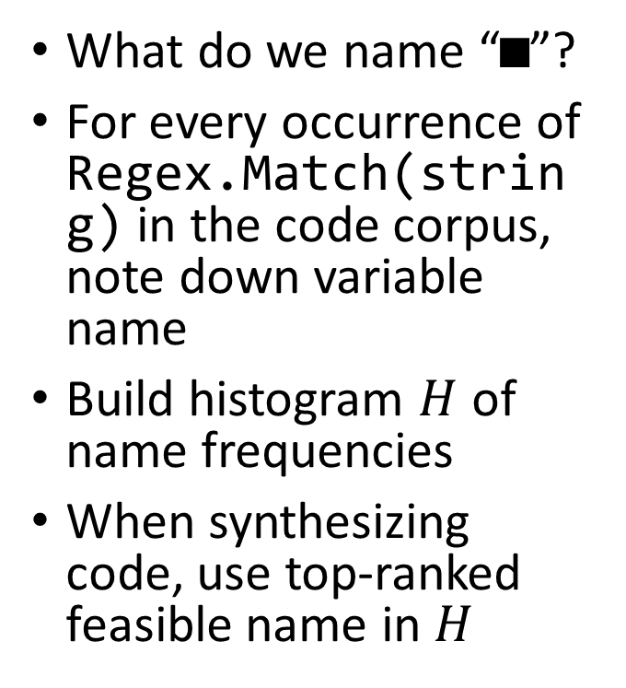
Q3: The Variable Name Model
What do we name “■”?
For every occurrence of Regex.Match(string) in the code corpus, note down variable name
Build histogram $H$ of name frequencies
When synthesizing code, use top-ranked feasible name in $H$
string pattern;
RegexOptions options;
■ := new Regex(pattern, options);
string input;
■ := ■.Match(input);
if ([■.Success]_{get}) {
[■.Groups]_{get};
}
■.Dispose();
string pattern;
RegexOptions options;
■ := new Regex(pattern, options);
string input;
var match = ■.Match(input);
if ([match.Success]_{get}) {
[match.Groups]_{get};
}
■.Dispose();
Captures practice, but don’t we actually want to capture intent?

Slide 31
Query-to-API Model

Slide 32
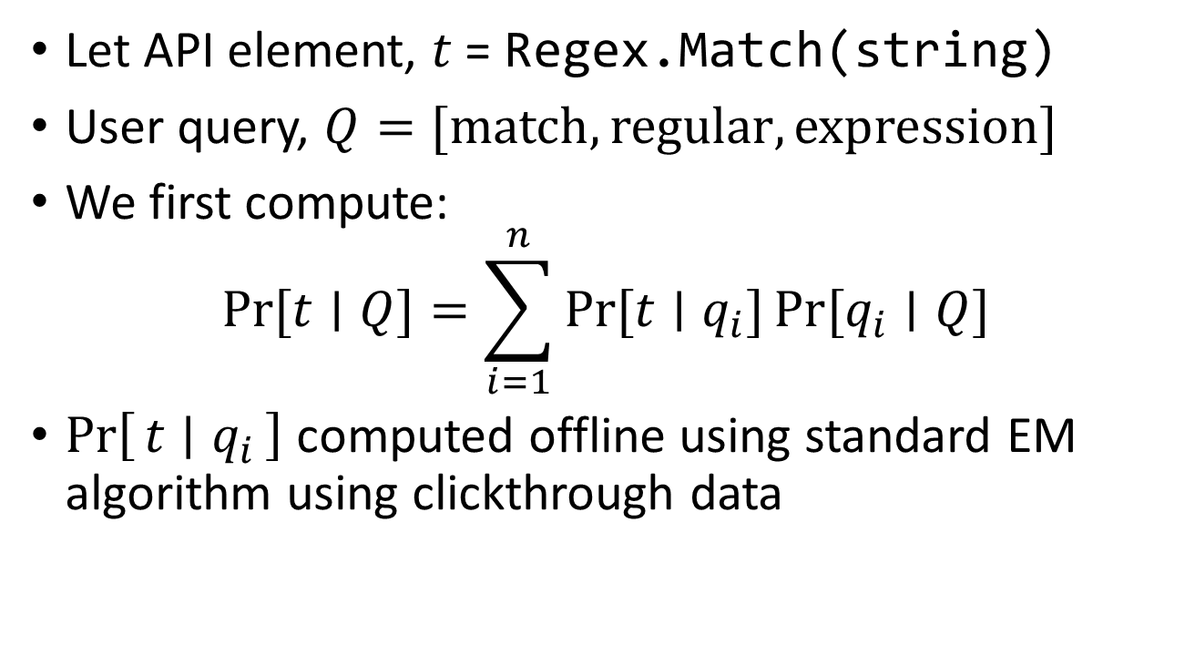
Query-to-API Mapping
Let API element, $t$ = Regex.Match(string)
User query, $Q=[\text{match},\text{regular},\text{expression}]$
We first compute:
$\operatorname{Pr}{[t∣Q]}=\sum_{i=1}^{n}{Pr⁡[t∣q_{i}]}\operatorname{Pr}{[q_{i}∣Q]}$
$\operatorname{Pr}\left[t ∣ q_{i}\right]$ computed offline using standard EM algorithm using clickthrough data

Slide 33
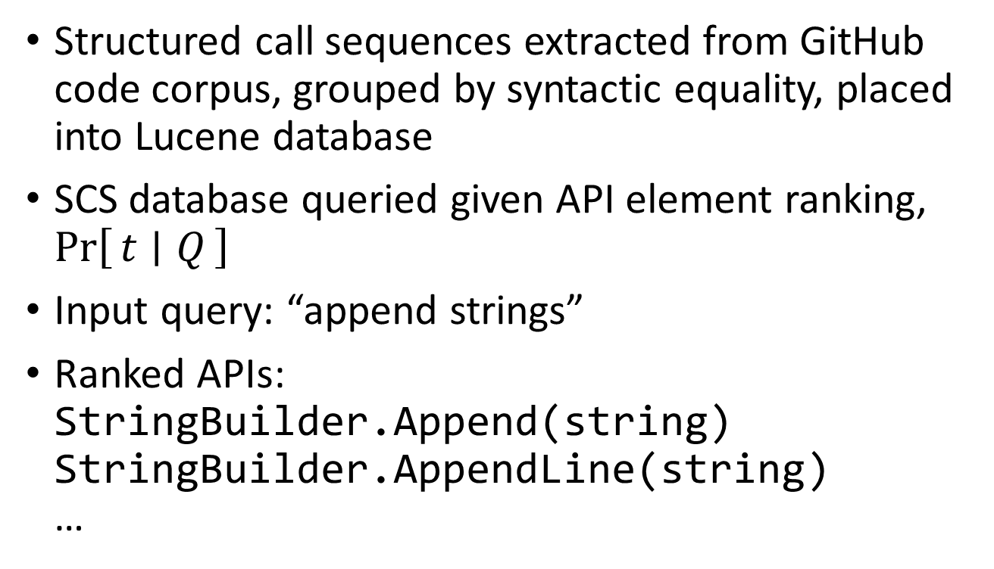
Picking Structured Call Sequences for Synthesis
Structured call sequences extracted from GitHub code corpus, grouped by syntactic equality, placed into Lucene database
SCS database queried given API element ranking, $\operatorname{Pr}\left[t ∣ Q\right]$
Input query: “append strings”
Ranked APIs:
StringBuilder.Append(string)
StringBuilder.AppendLine(string)
…

Slide 34
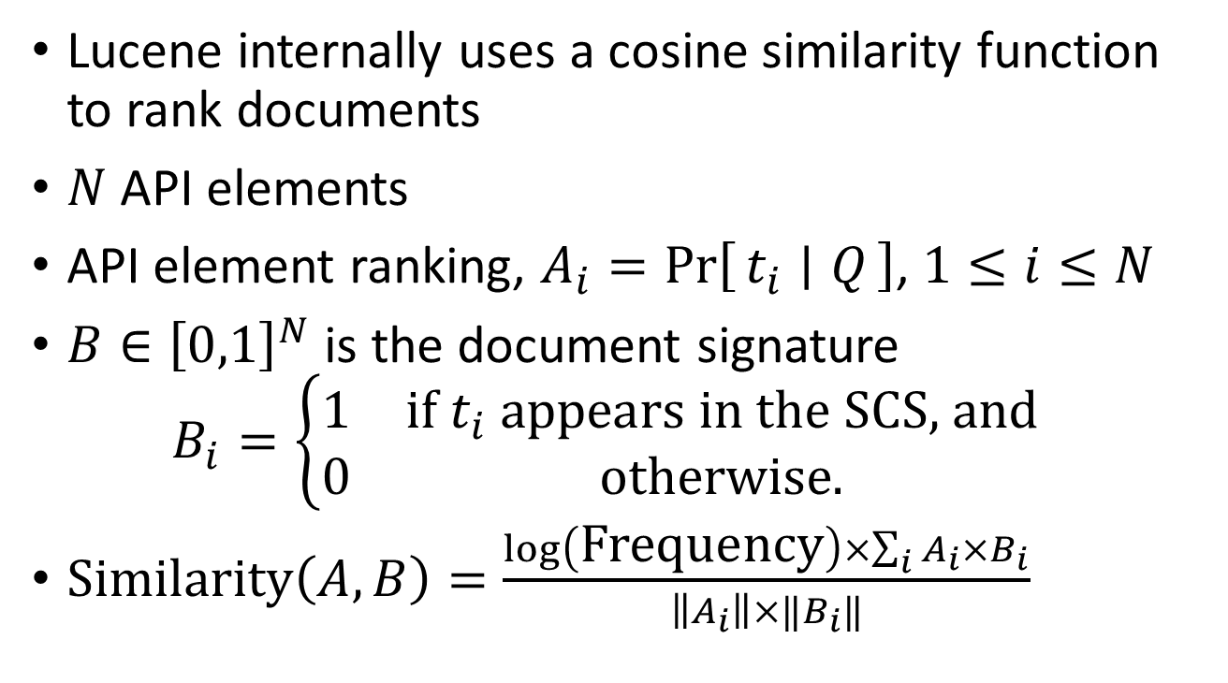
Picking Structured Call Sequences for Synthesis
Lucene internally uses a cosine similarity function to rank documents
$N$ API elements
API element ranking, $A_{i}=\operatorname{Pr}\left[t_{i} ∣ Q\right]$, $1≤i≤N$
$B∈{\left[0,1\right]}^{N}$ is the document signature
$B_{i}=\left\{\begin{matrix}1 & \text{if} t_{i} \text{appears} \text{in} \text{the} \text{SCS}\text{, }\text{and} \\ 0 & \text{otherwise}\text{.}\end{matrix}\right.$
$\text{Similarity}\left(A,B\right)=\frac{\log\left(\text{Frequency}\right)×\sum_{i}{A_{i}×B_{i}}}{\left\|A_{i}\right\|×‖B_{i}‖}$
Convenient hand-off point between NLP experts and synthesis experts

Slide 35
Evaluation: Oops!

Slide 36
Evaluation: Oops! (1)
Query 1: “convert string to int”
Query 2: “convert int to string”
Same generated snippet for both
var value = default(string);
System.Convert.ToInt32(value);
Because query-to-API translator uses bags-of-words

Slide 37
Evaluation: Oops! (2)
Query: “open file dialog”
Filter property specifies types of files to be chosen
Special syntax for correct values
For example:
"Text Files (.txt)|*.txt"
Generated snippet is unhelpful
var dlg = new OpenFileDialog();
dlg.Title = null;
dlg.InitialDirectory = null;
dlg.Filter = null;
dlg.FilterIndex = 0;
if (dlg.ShowDialog()) {
var fName = dlg.FileName;
}

Slide 38
Evaluation: Oops! (2)
Query: “open file dialog”
Filter property specifies filetypes to be chosen
Special syntax for correct values
For example: "Text Files (.txt)|*.txt"
Generated snippet is unhelpful
Similar examples: regular expressions, date-time format strings (“dd-mm-yyyy"), etc.

Slide 39
Evaluation: Oops! (3)
Query: “launch process”
First relevant snippet ranked 8th
var startInfo = new ProcessStartInfo();
startInfo.FileName = null;
var process = Process.Start(startInfo);
process.WaitForExit();
var startInfo = new ProcessStartInfo();
startInfo.FileName = null;
startInfo.CreateNoWindow = false;
startInfo.RedirectStandardOutput = false;
startInfo.RedirectStandardError = false;
startInfo.UseShellExecute = false;

Slide 40
Evaluation: Oops! (3)
Query: “launch process”
First relevant snippet ranked 8th
ProcessStartInfo is ranked very highly by the query-to-API model
If code synthesizer starts with a ProcessStartInfo object, then it will never call Process.Start()
Can we somehow require that every ProcessStartInfo object is destined to be fed into Process.Start()?
Joint probability distributions, perhaps?

Slide 41
Related Work

Slide 42
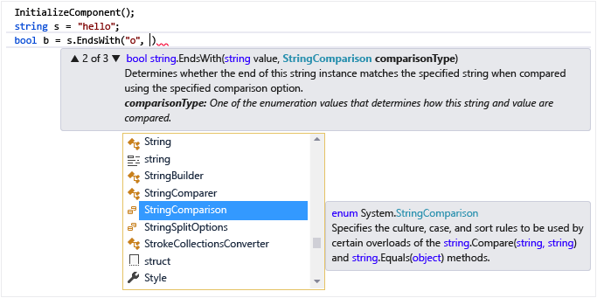
IntelliSense

Slide 43
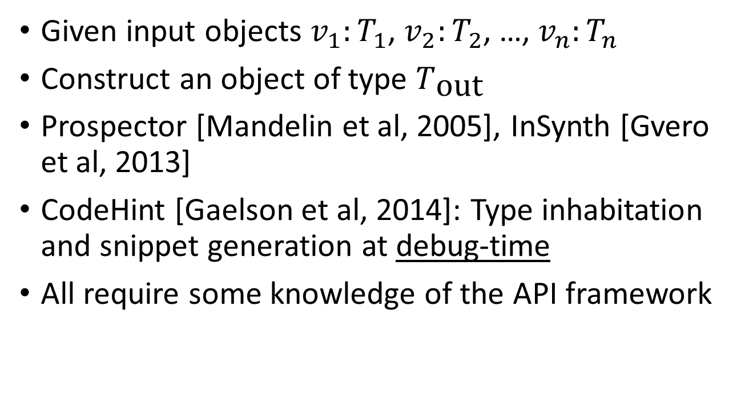
Type Inhabitation
Given input objects $v_{1}:T_{1}$, $v_{2}:T_{2}$, …, $v_{n}:T_{n}$
Construct an object of type $T_{\text{out}}$
Prospector [Mandelin et al, 2005], InSynth [Gvero et al, 2013]
CodeHint [Gaelson et al, 2014]: Type inhabitation and snippet generation at debug-time
All require some knowledge of the API framework

Slide 44
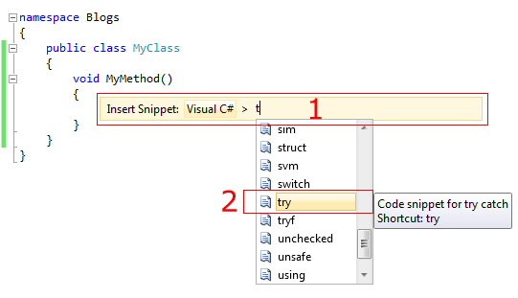
Visual Studio Code Snippets
Slava Agafonov, http://agafonovslava.com/post/2010/11/26/Visual-Studio-2010-code-snippets

Slide 45
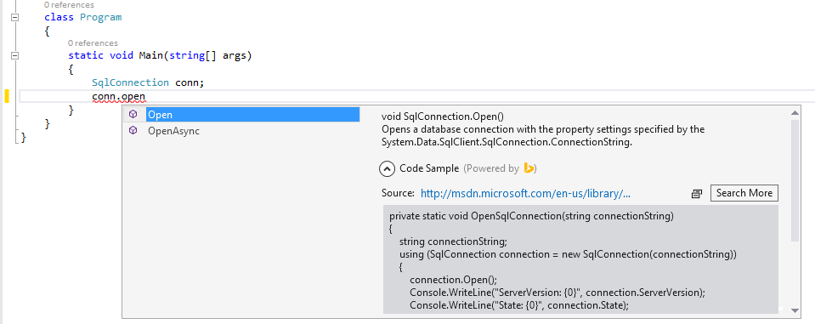
Bing Developer Assistant

