Slide 1
Regular Programming over Data Streams
Mukund Raghothaman
Advisor: Rajeev Alur
Notes:
Thank you for coming!
TODO!
Finalize color scheme!
Stream elements: white box with blue outline
Distinguished stream elements: Red box
Processing elements: Blue box with dark outline
…
In the thesis, fix the basic DReX combinators! $φ↦ε$ is not a basic combinator right now! Perhaps add $φ↦d$ itself.
Clear up assumptions about how quickly terms can be evaluated!

Slide 2
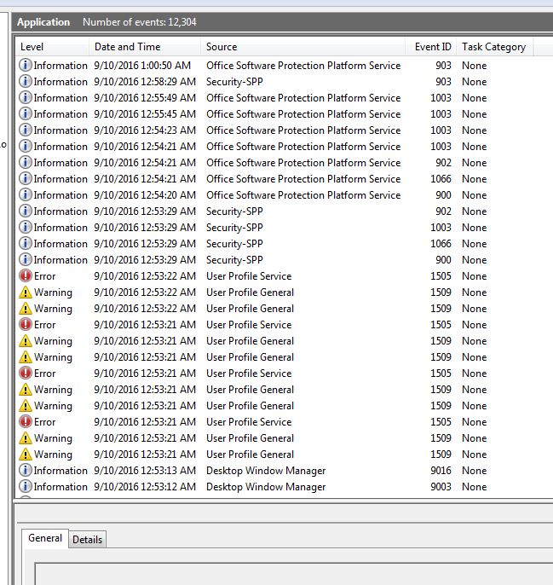
Regular Programming over Data Streams
Sequential data: Strings, streams
Streams are everywhere
Program logs
Sensors, medical devices
Financial markets
Clickstreams from websites
Notes:
At the broadest level, my dissertation is about processing sequential data.
Programmers are intimately familiar with strings as a data structure, since the earliest days of computing.
Increasingly, streams are becoming commonplace: program logs---like this picture of the Windows Event Viewer---event feeds from financial markets, data from sensors and medical devices, etc.

Slide 3
Regular Programming over Data Streams
Transformations over strings
Insert substrings
Extract substring according to pattern
Apply function to each element
Queries over streams
Compute some simple quantitative statistic
Count number of occurrences of a pattern
Mean time between events
DReX
QRE
Notes:
Programmers often want to do some simple processing over such data:
Mangling filenames, escaping characters, extracting substrings according to some pattern, etc.
Over streams, we are concerned with simple numerical queries: how often did an event occur, what was the average intensity of an event, what was the mean time between occurrences, and so on.
In the dissertation, we propose two formalisms: DReX for transformations, and QREs for quantitative functions.

Slide 4
Regular Programming over Data Streams
Domain-specific abstractions for stream processing
Better programmer support
Automatic static analysis
Query optimization, parallel evaluation
Notes:
Better programmer support
Reduces cognitive gap
Closer to level at which programmers think
Limitations of existing models + Desired properties of a high-level language
Full programming languages lack of a small core for analysis / optimization
sed, AWK closer to Python / Java than to regular expressions: difficult performance profiles, and unintuitive computational models
Streaming database languages such as CQL focus on the relational abstraction: we focus on hierarchically imparting structure to the underlying stream

Slide 5
Patient monitored for recurring medical condition
“How bad was today’s most severe episode?”
$g=\text{split}(r,f,D,π_{2})$
$f=\text{iter}(e,\text{max})$
$e=\text{split}\left(B,d,E,π_{2}\right)$
$d=\text{iter}\left(v∈ℝ↦v,\text{avg}\right)$
$$\text{max}$$
$$\text{avg}$$
$$\text{avg}$$
B
3
E
D
⋯
B
2
5
E
D
B
1
4
E
B
9
E
D
$$r={\left({\left(BM^{+}E\right)}^{+}⋅D\right)}^{∗}$$
Notes:
Let us consider a simple example.
Imagine a patient in a hospital for some chronic recurring condition.
What you see here is an event stream from a monitoring device:
There are many episodes, beginning with a ‘B’, and ending with an ‘E’
During each episode, the device makes some measurements: those are the numbers
‘D’ is the end-of-day marker.
Say the doctor asks: “How bad was today’s most severe episode?”
It depends on how you define the “severity” of an episode: say it is the average of all meter readings.
So ideally, we want to say:
Summarize each individual episode with the function “d”: iterate over the measurements, return the average.
Summarize each day with the function “f”: iterate over all episodes, return the maximum.
Individual episodes are delimited by ‘B’ and ‘E’.
We are only interested in the last day: ignore the prefix which matches $r$.

Slide 6
Simple text transformations
u
s
e
r
@
d
o
m
a
i
n
$$e$$
$$@↦ε$$
$$f$$
d
o
m
a
i
n
$\text{split}(e,@↦ε,f)$
$e=\text{iter}(x≠@↦ε)$
$f=\text{iter}(x≠@↦x)$

Slide 7
Regular Programming over Data Streams
Combinator-based formalisms
Omit mechanics of parsing
Quantitative Regular Expressions (QRE)
$g=\text{split}(r,f,D,π_{2})$
$f=\text{iter}(e,\text{max})$
$e=\text{split}\left(B,d,E,π_{2}\right)$
$d=\text{iter}\left(v∈ℝ↦v,\text{avg}\right)$
DReX
$\text{split}(e,@↦ε,f)$
$e=\text{iter}(x≠@↦ε)$
$f=\text{iter}(x≠@↦x)$
ActiveSheets
sed, AWK, Perl
Succinct, modular query descriptions
Regular expressions
Relational algebra
Full programming
languages
Automatically generate fast streaming evaluators
Notes:
None of these queries is difficult to directly implement
Better programmer support
Reduces cognitive gap
Closer to level at which programmers think
Limitations of existing models + Desired properties of a high-level language
Full programming languages lack of a small core for analysis / optimization
sed, AWK closer to Python / Java than to regular expressions: difficult performance profiles, and unintuitive computational models
Streaming database languages such as CQL focus on the relational abstraction: we focus on hierarchically imparting structure to the underlying stream

Slide 8
Regular Programming over Data Streams
We propose DReX and QREs as a:
practical, and
theoretically well-understood
framework to express functions over data streams.

Slide 9
Main Technical Results
Expressiveness
DReX can express exactly the class of regular string transformations
QREs can express exactly the class of regular cost functions
Evaluation: Given expression $e$, input stream $w$, $⟦e⟧(w)$ can be computed:
with one pass over $w$,
each element processed in $O({\left|e\right|}^{2})$ time, and
with $O\left({\left|e\right|}^{3}\left|w\right|\right)$ memory
Sometimes with $\text{poly}\left(\left|e\right|,\log\left(\left|w\right|\right)\right)$ memory
Notes:
TODO! Summarize contents of thesis
TODO! Streaming!
1. Correspond broadly to the two parts of the thesis: expressiveness, and evaluation

Slide 10
Regular Programming over Data Streams
Regular Combinators for String Transformations. CSL-LICS 2014.
DReX: A Declarative Language for Efficiently Evaluating Regular String Transformations. POPL 2015.
Regular Programming for Quantitative Properties of Data Streams. ESOP 2016.
StreamQRE: Modular Specification and Efficient Evaluation of Quantitative Queries over Streaming Data. In submission, 2016.
Notes:
TODO! Cleanup this slide!

Slide 11
Function Combinators
Notes:
Let us ground the discussion at this point
In the next few slides, I will define the function combinators in QREs and DReX. Informally.

Slide 12
Basic Expressions
$φ↦λ$ | $\text{isVowel}\left(x\right)↦\text{toUpperCase}(x)$ $x≥5↦x−5$
$φ↦d$ | $$x≠\text{′@′}↦\text{′}\text{V}\text{′}$$
$ε↦d$ | $$ε↦\text{′@′}$$
$\text{bot}$
Each expression $e$ defines a partial function $⟦e⟧ :Σ^{∗}→Γ^{∗}$
Notes:
This is the list of basic expressions
If the stream is a single element long, $x$, and $x$ satisfies $φ$, then output $λ(x)$.
If the stream is a single element long, $x$, and $x$ satisfies $φ$, then output $d$.
If the input stream is empty, produce $d$.
So these are all partial functions. In all other cases, the function is undefined.
TODO! Perhaps talk about symbolic predicates?

Slide 13
Choice
$$⟦e \text{else} f⟧(w)=\left\{\begin{matrix}⟦e⟧\left(w\right) & \text{if} ⟦e⟧\left(w\right)≠⊥, \\ ⟦f⟧(w) & \text{otherwise}\text{.}\end{matrix}\right.$$
$${\left[0−9\right]}^{∗}↦\text{′}\text{Number}\text{′} \text{else} {\left[a–z\right]}^{∗}↦\text{′}\text{Name}\text{′}$$
Notes:
The simplest combinator is choice: if $⟦e⟧(w)$ is defined, then output $⟦e⟧(w)$, otherwise output $⟦f⟧(w)$.
If the stream matches ${\left[0−9\right]}^{∗}$, output number, otherwise if it matches ${\left[a−z\right]}^{∗}$, output name.

Slide 14
Combine
$⟦\text{combine}\left(e,f\right)⟧\left(w\right)=⟦e⟧\left(w\right)⋅⟦f⟧(w)$
Over numerical domains:
$⟦e+f⟧\left(w\right)=⟦e⟧\left(w\right)+⟦f⟧\left(w\right)$
$⟦\text{max}(e,f)⟧\left(w\right)=\text{max}(⟦e⟧\left(w\right),⟦f⟧\left(w\right))$
⋮
$⟦\text{op}(e,f)⟧\left(w\right)=\text{op}(⟦e⟧\left(w\right),⟦f⟧\left(w\right))$
Domain intersection!
Notes:
The second combinator is $\text{combine}$: Apply both expressions to the whole stream. Produce $⟦e⟧\left(w\right)⋅⟦f⟧(w)$.
Over numerical domains: we can produce:
$⟦e⟧\left(w\right)+⟦f⟧(w)$,
$\text{max}(⟦e⟧\left(w\right),⟦f⟧\left(w\right))$,
…
Basically $\text{op}(⟦e⟧\left(w\right),⟦f⟧\left(w\right))$, for your choice of operator $\text{op}$. No assumptions: doesn’t need to be commutative, associative, or even binary.
Freely mix data types: function $\text{avg}$ takes a multiset as input and produces a number as output.
The choice combinator is essentially union from regular expressions. This is domain intersection.

Slide 15
$$\text{split}(e,f)$$
$$\text{left}\text{−}\text{split}(e,f)$$
$$e$$
$$f$$
$$e$$
$$f$$
$$\text{split}(e,f,\text{op})$$
Defined only if split is unambiguous
$$e$$
$$f$$
$$\text{op}$$
Notes:
What about non-commutative and non-binary operations?
Only form the operator we use in examples, but conceptually limited

Slide 16
Iteration: $\text{iter}(e)$
⋯
⋯
⋯
$$⟦e⟧$$
$$⟦e⟧$$
⋯
$$⟦e⟧$$
⋯
⋯
⋯
Notes:
TODO! Talk about id and string reversal functions
1. $e$ implicitly defines a split on the input stream

Slide 17
Iteration: $\text{left}\text{‐}\text{iter}(e)$
⋯
⋯
⋯
⋯
⋯
⋯

Slide 18
Iteration: $\text{iter}(e,\text{op})$
⋯
⋯
⋯
$\text{iter}(e,+)$
$\text{iter}\left(e,\text{min}\right)$
⋯
$$\text{op}$$
$\text{iter}(e,−)$?
Non-associative operations
Notes:
Among the most useful idiomatic variations of $\text{iter}$.
Still, conceptually limited

Slide 19
Iteration: $\text{fold}(c,e,\text{op})$
⋯
⋯
⋯
$$⟦e⟧$$
$$⟦e⟧$$
$$⟦e⟧$$
$$c$$
$$\text{op}$$
$$\text{op}$$
⋯
⋯
$$\text{op}$$
Notes:
What about non-binary operations?

Slide 20
Term-Valued Expressions
Generally: QREs output terms, not just concrete values
Compare:
$t=min⁡(p+3,5)$, and
$v=219$
Compare:
$\text{split}(e,f,\text{op})$, and
$\text{split}(e→^{p}f)$
Named hole
$$p$$
$$e$$
$$f$$

Slide 21
Term-Valued Expressions
Compare:
$\text{split}(e,f,\text{op})$, and
$\text{split}(e→^{p}f)$
$f^{′}=\text{op}(\text{Dom}\left(f\right)↦p,f)$
$\text{split}\left(e,f,\text{op}\right)≡\text{split}(e→^{p}f^{′})$
$$p$$
$$e$$
$$f$$

Slide 22
Term-Valued Expressions
$\text{split}\left(e→^{p}f\right)$
$\text{split}(e←^{q}f)$
$\text{iter}(e→p)$
$$p$$
$$e$$
$$f$$
⋯
⋯
⋯
$$e$$
$$p$$
$$e$$
$$p$$
$$p$$
$$e$$
⋯
⋯

Slide 23
Quantitative Regular Expressions
Parsing operators
Cost operators

Slide 24
Expressiveness
DReX can express exactly the class of regular string transformations
QREs can express exactly the class of regular cost functions
Notes:
We will now discuss the first major result of the thesis: that DReX and QREs can express can exactly the class of regular string transformations / regular cost functions.
But first, we must define these objects: what are regular string transformations?

Slide 25
Expressiveness
Languages | $$Σ^{∗}→\text{Bool}$$ | $$≡$$ | Regular expressions
Transformations | $$Σ^{∗}→Γ^{∗}$$ | $$≡$$ | DReX
Quantities | $$Σ^{∗}→ℝ$$ | $$≡$$ | QREs
Regular expressions $≡$ Finite automata $≡$ Formulas in MSO
Practical: simple, quick to parse
Theoretically appealing: robust closure properties, decidable analysis problems
Notes:
One important sub-text running through the dissertation is that DReX and QREs are to functions what regular expressions are to languages.
“Regularity” is a well-understood concept with respect to languages:
Regular languages have many equivalent representations: as regexes, as finite automata, as logical formulas in MSO
They are simple to understand, expressively powerful, and algorithmically easy to parse
And, to a theoretician, they have solid closure properties and most analysis problems are decidable.
So the question is: What is an equivalent conceptual benchmark for transformations?

Slide 26
From finite state acceptors to finite state transducers
Folk knowledge: Two-way transducers are strictly more powerful than one-way transducers
String reversal: $w↦w^{\text{rev}}$
String copying: $w↦ww$
$$a/bba$$
Notes:
A completely reasonable approach is to move from finite state acceptors to finite state transducers
We’re then talking about Mealy machines and similar devices
Back in the case of acceptors, one of the properties is that if the machine can go left- and right on the input tape, there is no increase in expressive power
That result immediately breaks down in the case of transducers, and for rather “simple” functions: if a finite state machine makes a single left-to-right pass on the input string, then it cannot reverse the string. A two-way machine can go to the end, and make a backwards pass over the tape.

Slide 27
Deterministic two-way finite state transducers
Closed under composition | [Chytil, Jákl 1977]
Decidable equivalence checking | [Gurari 1980]
Equivalent to MSO-definable string transformations | [Courcelle 1992] [Engelfriet, Hoogeboom, 2001]
Equivalent to Streaming String Transducers (SST) | [Alur, Černý, 2011]
These are regular string transformations
Notes:
Okay, so what’s known about two-way finite state transducers?
Turns out that these machines have a lot of the same appealing properties as DFAs.
Closed under composition, regular lookahead, and equivalence checking is decidable.
One of the classical results of regular language theory is that they can be expressed as formulas in MSO: in the early 90s, Courcelle introduced the idea of specifying graph transformations as logical formulas. Engelfriet and Hoogeboom showed that when you’re looking at strings, these coincide with what two-way FSTs can compute. So, by analogy, they said that “These are regular string transformations.”
Later, a few years ago, Rajeev and Pavol Cerny introduced the equivalent one-pass operational model of streaming string transducers.

Slide 28
Streaming String Transducers (SST)
Finitely many control states $Q=\{q_{1},q_{2},…\}$
Deterministic transitions $δ:Q×Σ→Q$
Finite set of write-only registers $V=\{x,y,…\}$
Syntactically copyless updates
$$a$$
$$\begin{matrix}x≔x⋅a⋅y \\ y≔b\end{matrix}$$
$$y⋅x$$
Notes:
Let me explain what SSTs are in one slide
The machines essentially operate on a DFA sub-structure: so a finite space of control states, and transitions are deterministic
But…! They also have a finite set of registers: these can hold intermediate results, and updated on each transition. Potentially concatenated.
Two important restrictions
They are write only: transitions cannot be conditioned on their contents
Updates are syntactically copyless: if I look at register $y$, it appears at most once on the right side of an update expression in this transition

Slide 29
Regular Cost Functions
Generalized to numerical functions [Alur et al, 2013]
Model parameterized by cost operations
MSO-definable string-to-term transformations
Cost register automata (CRA)
Emerging theory
Notes:
In 2013, we extended this idea of regular string transformations to numerical functions
We got a model which was parameterized by the set of operations on the cost domain
Has some of the same appealing properties as the previous two classes: they coincide with MSO-definable string-to-term transformations, are equivalent to the operational model of CRAs and so on
The underlying theory is still work-in-progress: there are problems related to register minimization, computing shortest paths, …

Slide 30
DReX can express exactly the class of regular string transformations
QREs can express exactly the class of regular cost functions
Function expression $e$
SST / SSTT $M$
Notes:
In the dissertation, we show that DReX can express exactly those functions that SSTs can
Going from function expressions to transducers, the left-to-right direction of the proof, is more-or-less straightforward: quite similar to going from regexes to DFAs
The backward direction is more interesting: if you’re given a transducer, how do you construct an equivalent function expression?

Slide 31
Summarizing Paths
1
$■=Σ^{∗}↦b$
$▼=\text{iter}(a↦a \text{else} b↦ε)$
$◧=\text{iter}(Σ↦ε)$
$▬=Σ^{∗}↦b$
“Expression Vector”
$$x$$ |  | $$x$$
$$y$$ |  | $$y$$
“Shape”
$$a$$
$$b$$
2
$$\begin{matrix}x≔x⋅a⋅y \\ y≔b\end{matrix}$$
$$\begin{matrix}x≔y⋅x \\ y≔b\end{matrix}$$
$$∀w∈L$$
$$a⋅b$$
$$\begin{matrix}x≔■_{w}⋅x⋅▼_{w}⋅y⋅{\text{◧}}_{w} \\ y≔▬_{w}\end{matrix}$$
$$\begin{matrix}x≔b⋅x⋅a⋅y \\ y≔b\end{matrix}$$
Notes:
1. The construction is technically challenging: I will only describe the major waypoints

Slide 32
Preorder over the Shapes
“Cannot-appear as sub-path”
$$x$$
$$y$$
1
$$x$$
$$y$$
$$x$$ |  | $$x$$
$$y$$ |  | $$y$$
2

Slide 33
From SSTs to DReX
Register updates are syntactically copyless So: space of shapes is finite
For each $i∈\{0,1,2,…, n\}$,
for each shape $S$ in order,
build expression vector for paths $q→^{w}q′$
with shape $S$, and
only visiting intermediate states $\{q_{1},q_{2},…,q_{i}\}$
$$Q=\{q_{1},q_{2},…,q_{n}\}$$

Slide 34
Evaluating Function Expressions
Given expression $e$, input stream $w$, $⟦e⟧(w)$ can be computed:
with one pass over $w$,
each element processed in $O({\left|e\right|}^{2})$ time, and
with $O\left({\left|e\right|}^{3}\left|w\right|\right)$ memory
Notes:
We will now switch gears.
The second major technical question is about computation: compute $⟦e⟧(w)$ given $e$ and $w$.

Slide 35
Matching Regular Expressions
Convert $r$ into NFA $A$
Play board game on $A$
$$b$$
$$◉_{2}$$
$$b$$
$$◉_{5}$$
$$◉_{4}$$
$$a$$
$$◉_{1}$$
$$a$$
$$◉_{3}$$
$w=ab$

Slide 36
Evaluating Function Expressions
Main problems:
Confirming unique parse trees for $\text{split}$ / $\text{i}\text{ter}$
Domain complementation for $\text{e}\text{l}\text{se}$
Handle product construction for $\text{combine}(e,f)$
Suggestion: Explore states lazily
Machine $M$ with operations:
Insert token $◉$
$\text{Process}(a)$
Returns $(γ,◉)$ whenever $◉$ reaches accepting state

Slide 37
Evaluating Function Expressions
Convert $r$ into NFA $A$
Play board game on $A$
Tokens encode partial parse trees
Memory usage bounded: colliding tokens can be arbitrarily dropped
Merging colliding tokens: some parse tree, not all parse trees
Erroneous behavior for $\text{combine}(e,f)$
$$b$$
$$◉_{4}$$
$$b$$
$$◉_{5}$$
$$a$$
$$a$$
$w=ab$

Slide 38
Consistency Rules
Resolved to lazily explore state space
But… token dropping erroneous
Main problems:
Confirming unique parse trees for $\text{split}$ / $\text{iter}$
Domain complementation for $\text{else}$
Handle product construction for $\text{combine}(e,f)$
So… we restrict the space of expressions:
For $\text{combine}(e,f)$, require $\text{Dom}\left(e\right)=\text{Dom}(f)$
For $\text{else}(e,f)$, require $\text{Dom}\left(e\right)$ and $\text{Dom}(f)$ disjoint
For $\text{split}(e,f)$, require $\text{Dom}\left(e\right)$ and $\text{Dom}(f)$ unambiguously concatenable

Slide 39
Evaluating Function Expressions
Given expression $e$, input stream $w$, $⟦e⟧(w)$ can be computed:
with one pass over $w$,
each element processed in $O({\left|e\right|}^{2})$ time, and
with $O\left({\left|e\right|}^{3}\left|w\right|\right)$ memory

Slide 40
Evaluating Function Expressions
Notes:
TODO! Fix this graph, please!

Slide 41
Given expression $e$, input stream $w$, $⟦e⟧(w)$ can be computed:
with one pass over $w$,
each element processed in $O({\left|e\right|}^{2})$ time, and
with $O\left({\left|e\right|}^{3}\left|w\right|\right)$ memory
Intermediate results can be big
Quantitative Approximate Terms
Notes:
Recall that QREs output terms, not just concrete values
Combination of two rather simple ideas

Slide 42
Quantitative Approximate Terms
Positive reals $ℝ^{+}$ and $\text{Multiset}(ℝ^{+})$

Slide 43
Term Compression
$$\text{min}\left(p+2,5\right)+3$$
$$≡\text{min}\left(p+2+3,5+3\right)$$
$$≡\text{min}\left(p+5,8\right)$$
Term with $k$ parameters is of size $O(k)$
If $e$ is a QRE built of the operations $+$, $−$, $\text{min}$, $\text{max}$, $\text{avg}$, then the streaming evaluator requires $O({\left|e\right|}^{4})$ memory, irrespective of the stream length $|w|$.

Slide 44
Quantitative Approximate Terms
Positive reals $ℝ^{+}$ and $\text{Multiset}(ℝ^{+})$

Slide 45
Multisets as Approximate Histograms
Range | #
$[1,1+ε)$ | 2
$[1+ε,{\left(1+ε\right)}^{2})$ | 13
$[{\left(1+ε\right)}^{2},{\left(1+ε\right)}^{3})$ | 4
⋯
$[{\left(1+ε\right)}^{n−1},{\left(1+ε\right)}^{n})$ | 9
If $e$ is a QRE built of the operations $+$, $−$, $\text{min}$, $\text{max}$, $\text{avg}$, $\text{median}$, then the streaming evaluator requires $\text{poly}(\left|e\right|,ε^{−1},\text{log}(|w|))$ memory.
$$n∝ε^{−1}\text{log}(U)$$
Notes:
Going back to the motivation: we claimed to offer better programmer support.
Here is an example: given the original query $e$ and an error tolerance $ε$, we can automatically implement an approximate evaluator.
This would be harder to do, if for e.g., the query was written in a full Turing-complete programming language.
More broadly speaking, we hope that improvements in the streaming algorithms literature can automatically be ported to improved QRE evaluation algorithms.

Slide 46
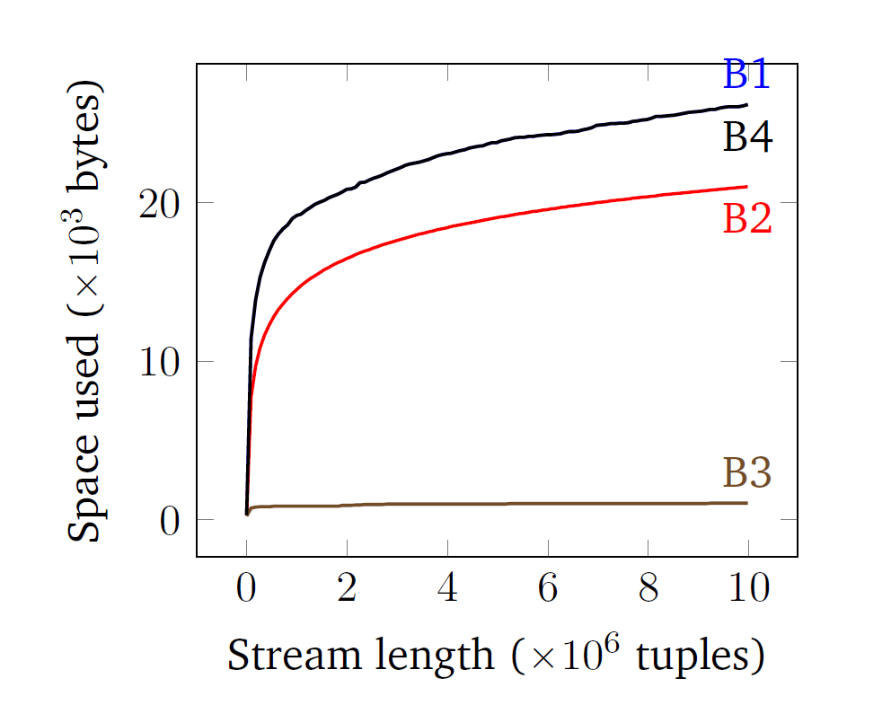
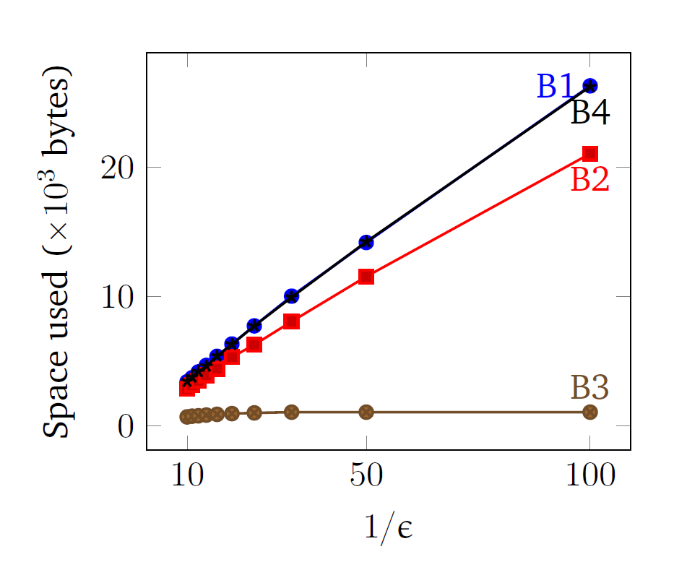
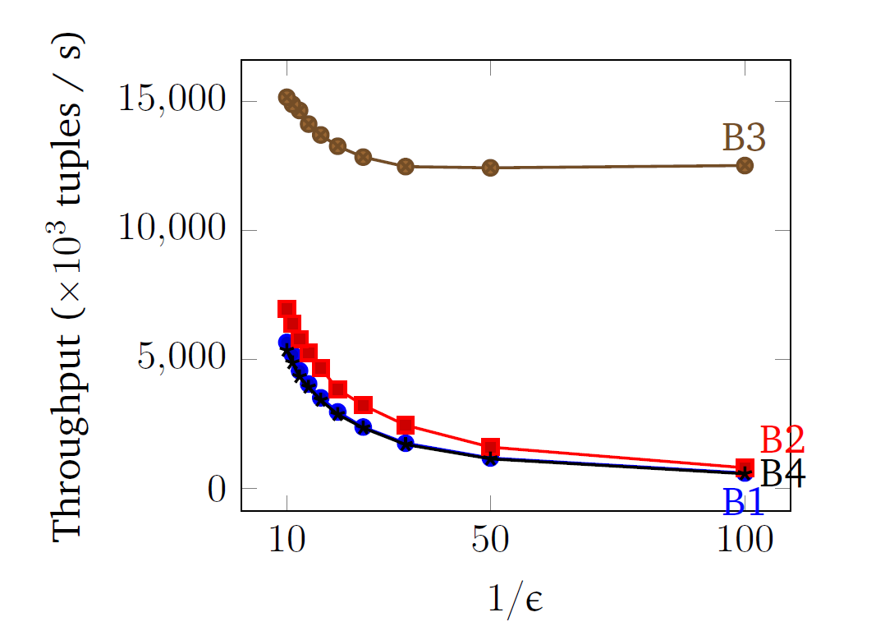
Notes:
1. Another interesting trend is that increasing the error tolerance $ε$ results in higher throughputs: this is because the approximate histogram is smaller, and updates during evaluation require less copying overhead.

Slide 47
User Experience
NEXMark data stream [Tucker et al, 2002] Simulated event stream from online auction
Linear Road [Arasu et al, 2004] Events from vehicle traffic simulation
Sequence of events from a hypothetical bank
Able to write several non-trivial queries
Performance consistently ≈100k tuples/s
Consistency check helped to identify bugs in queries
Unable to express some benchmark queries
“What is the average time spent by a car on the road?”

Slide 48
Related Work
Notes:
Hope to describe broadly the other relevant literature.
Necessarily omit many individual pieces of work.

Slide 49
Parsing Technologies
Sed / AWK / Perl / … Powerful string processing languages Can express many queries inexpressible by DReX Lack of small core makes analysis / query optimization difficult
Parsing expression grammars [Ford, 2004] Parser combinators, etc. Focus on building parse trees rather than transformations / computation Language intersection: $\text{combine}$ operator difficult to express

Slide 50
Streaming Databases
Tapestry for email messages: [Terry et al, 1992]
Aurora / Borealis: [Abadi et al, 2003], [Abadi et al, 2005] Network of stream processors: filter, project, join, etc.
STREAM: [Arasu et al, 2004] Three operator types:
stream-to-relation,
relation-to-relation (SQL),
relation-to-stream
QREs add stateful structure to the stream!

Slide 51
Complex Event Processing
NiagaraCQ [Chen et al, 2000]
Applications in RFID data processing [Wu et al, 2006]
Cayuga [Demers et al, 2006], [Demers et al, 2007], [Brenna et al 2007]
Survey: [Cugola, Margara, 2012]
Publish/subscribe models based on complex event patterns
Notes:
Server produces events, client specifies pattern on which to be notified
Focus on notification rather than computation

Slide 52
Streaming Algorithms
Online selection [Munro, Paterson, 1978] Distinct elements [Flajolet, Martin, 1985] Frequency moments [Alon, Matias, Szegedy, 1996]
Textbooks [Muthukrishnan, 2005]
Mostly orthogonal goals to ours Algorithms for specific challenging problems vs framework to specify large class of simple queries

Slide 53
Conclusion

Slide 54
Introduced combinator-based formalism for stream processing
Expressiveness
DReX can express exactly the class of regular string transformations
QREs can express exactly the class of regular cost functions
Evaluation: Given expression $e$, input stream $w$, $⟦e⟧(w)$ can be computed:
with one pass over $w$,
each element processed in $O({\left|e\right|}^{2})$ time, and
with $O\left({\left|e\right|}^{3}\left|w\right|\right)$ memory
Notes:
In this thesis, we proposed combinator-based formalisms for stream processing
Potential for great tool support: automatic parallelization, query optimization
Studied two foundational questions
Logical: Expressiveness
Algorithmic: Function evaluation

Slide 55
Progress Since Thesis Proposal
Proposal mainly focused on string-to-string case
Promised to work on quantitative functions for $(\text{min},+)$ case QREs solve this more generally
Focus on memory-efficient query evaluation, approximation algorithms
Notes:
Work in progress:
Static analysis
Parallel evaluation
Tightening the proof of expressive completeness

Slide 56
Conclusion
Future work

Slide 57
Future Work: “map-collect”
“What is the average time spent by a car on the road?”
“map-collect”
Possibly also distributed evaluation
≈ group by
Exit time − Entry time
Time ($c_{1}$)
car id?
Time ($c_{2}$)
avg
⋮
Time ($c_{n}$)
Road traffic data
Notes:
Also:
Binary predicates
Sliding windows

Slide 58
Future Work: Query Optimization
Query rewriting
${\left(a^{∗}b\right)}^{+}∪{\left(b^{∗}a\right)}^{+}≡{\left(a∪b\right)}^{+}$
“Do $e$ if stream ends with $a$, otherwise do $f$”
Can regular expression equivalences always be lifted to QRE rewrite rules?
Parallel evaluation
SIMD optimizations
Distributed processing

Slide 59
Future Work
For DReX:
Postcondition computation is PSPACE-complete
Equivalence checking of DReX is decidable Complexity is open
 | Given … | find … | such that …
Evaluation | $e$, $w$ | $d$ | $d=⟦e⟧\left(w\right)$
Postcondition checking | $e$, $d$ | $w$ | $d=⟦e⟧\left(w\right)$
Inference | $d$, $w$ | $e$ | $d=⟦e⟧\left(w\right)$

Slide 60
Future Work
Extensions map-collect, sliding windows, binary predicates
Query optimization Rewriting + parallel evaluation
Expression inference
Static analysis
Online monitoring of cyber-physical systems

Slide 61
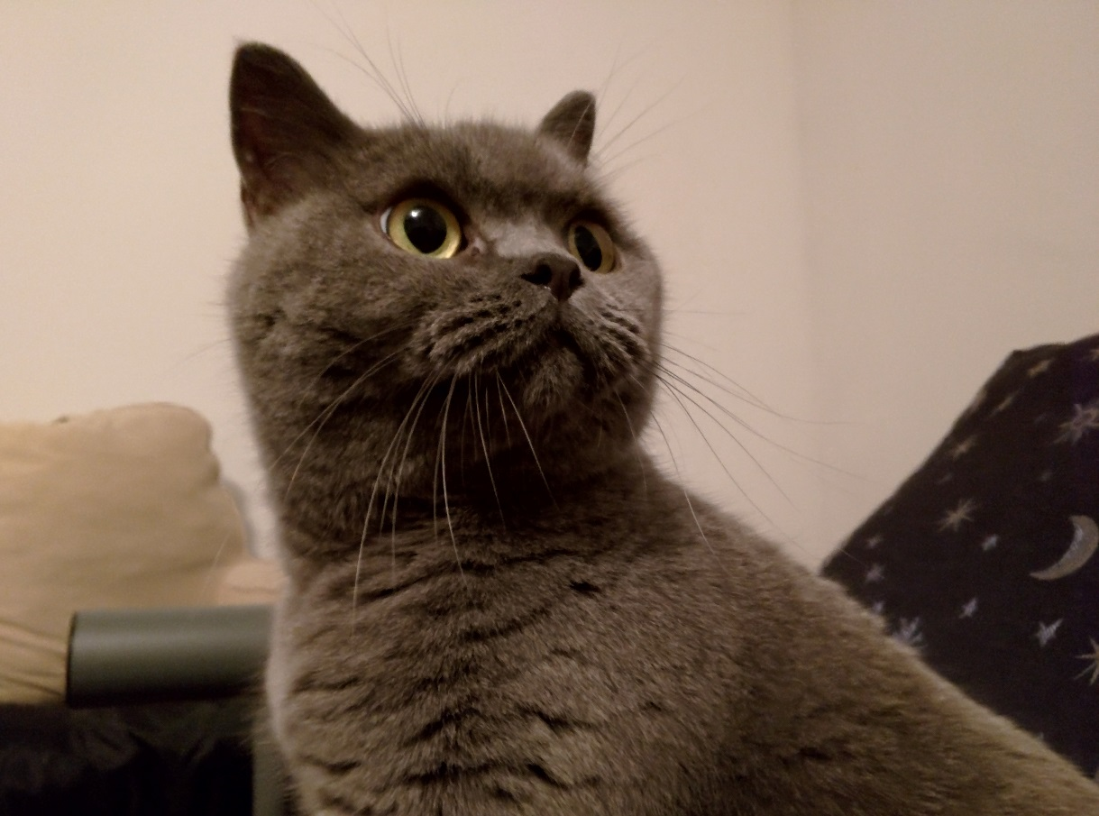
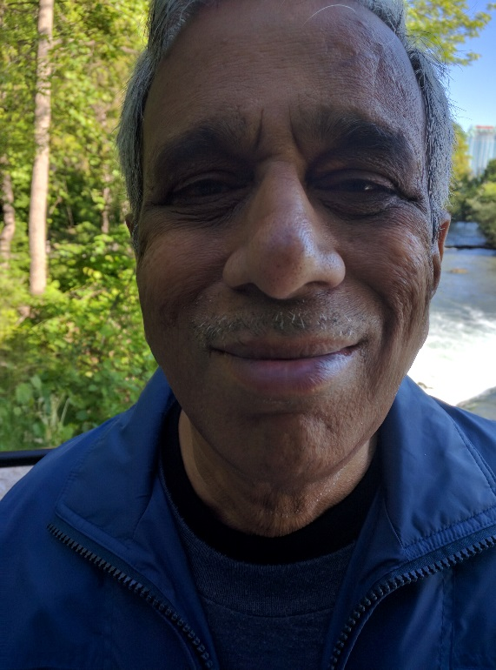
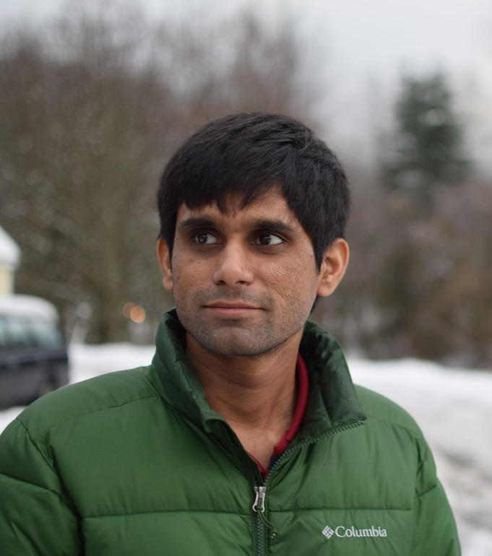
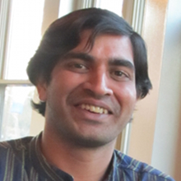
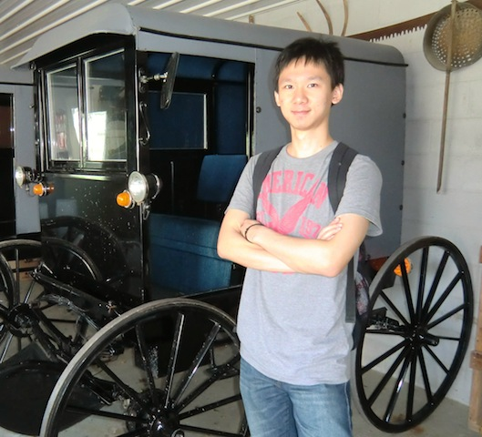
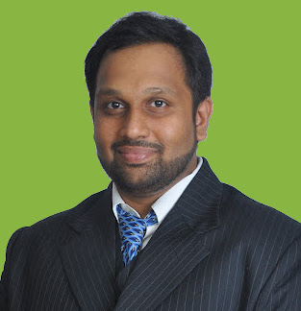
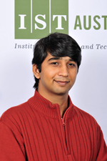
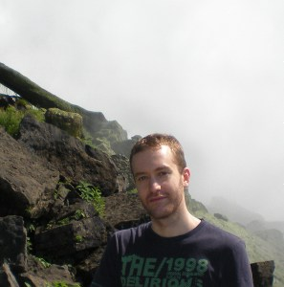
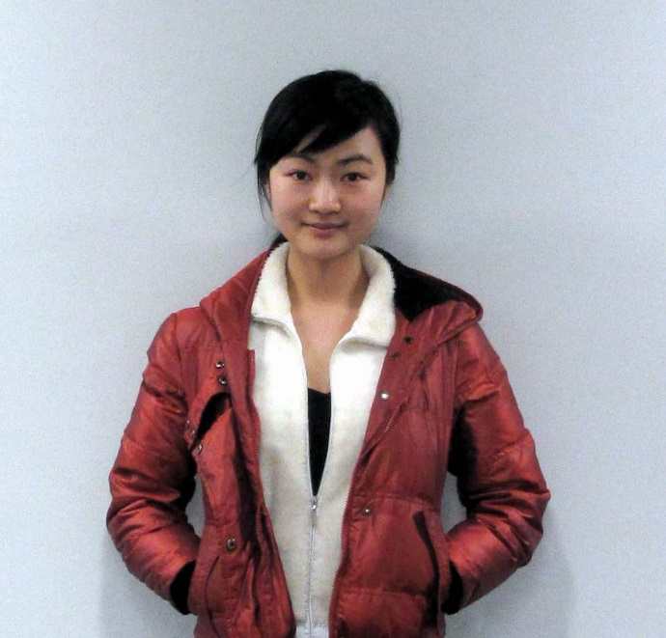
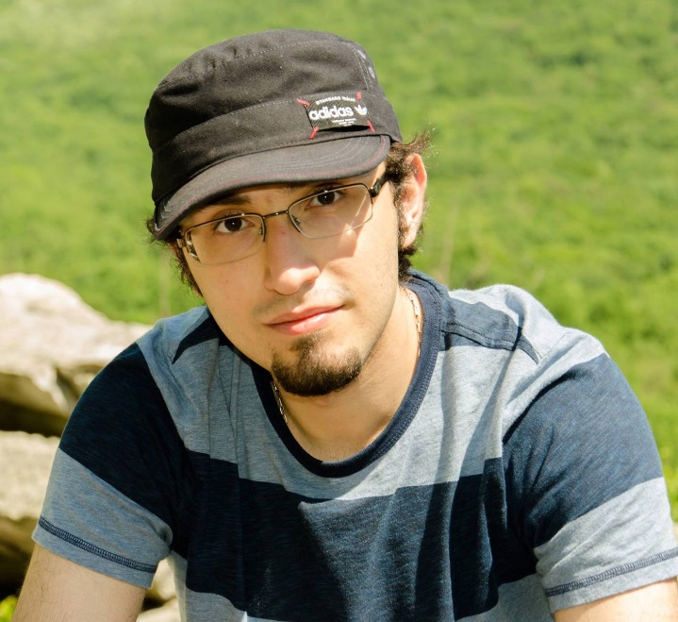
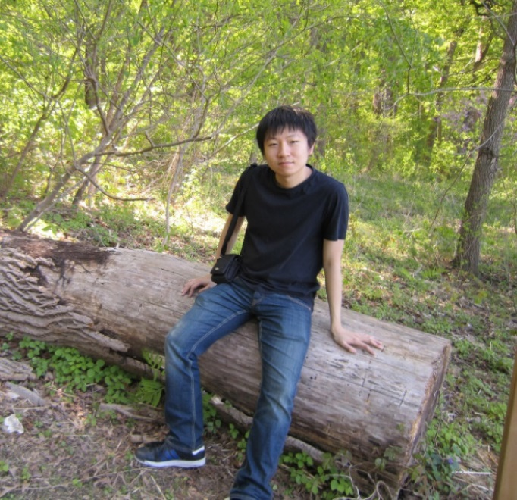
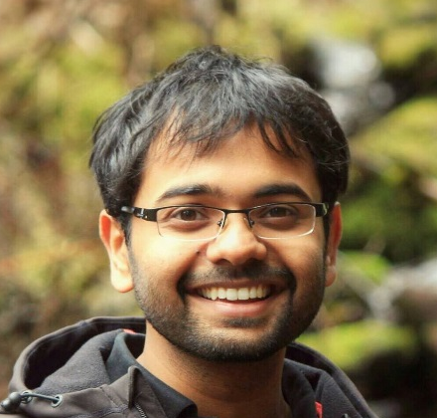
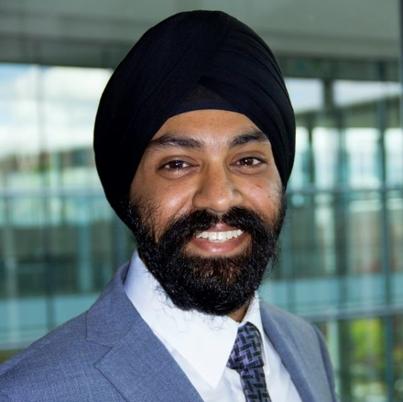
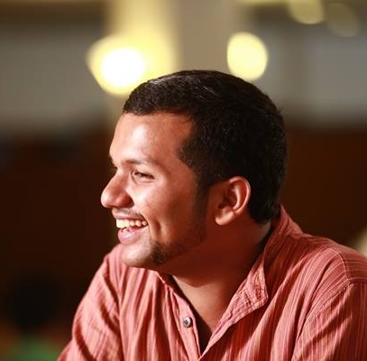
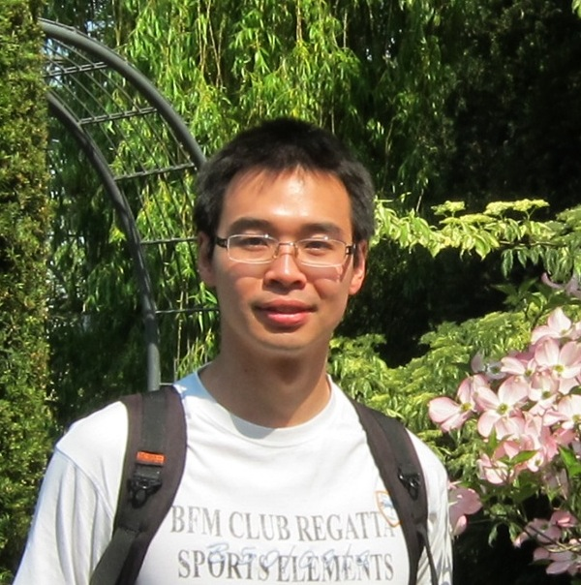
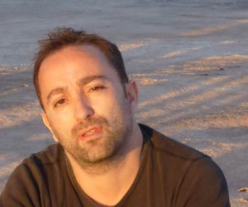
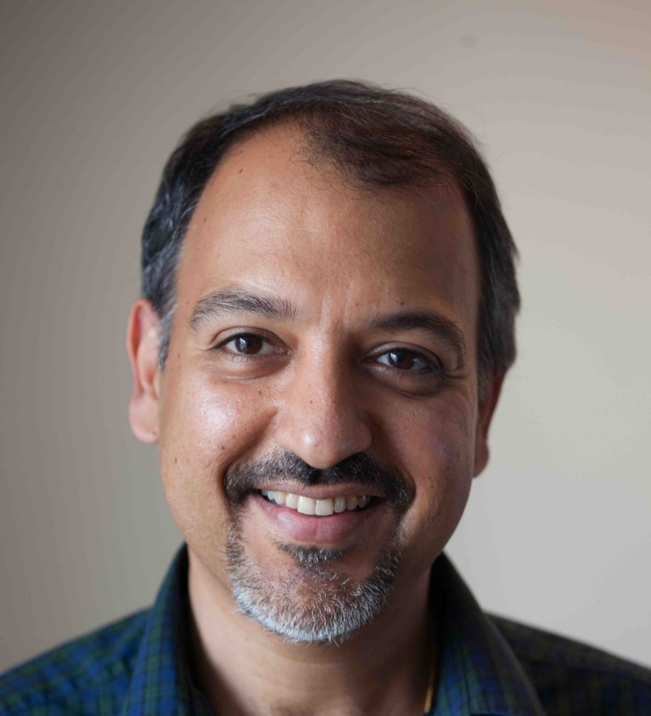
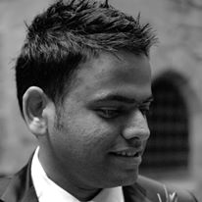
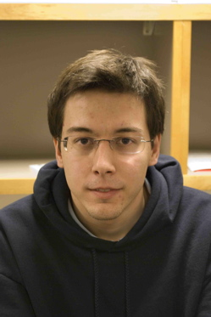
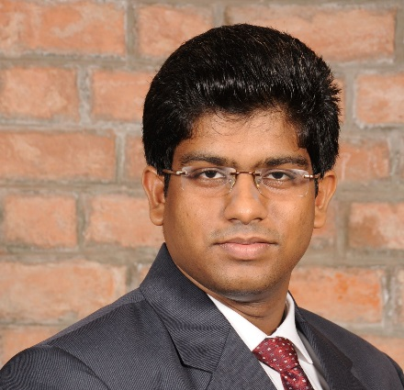
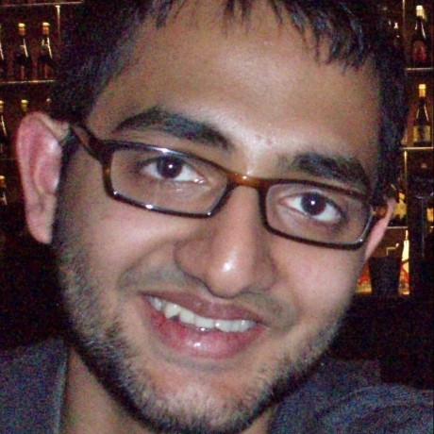
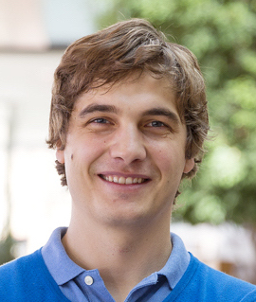
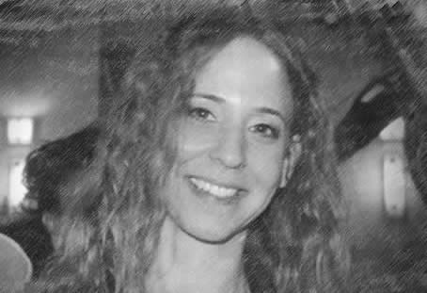
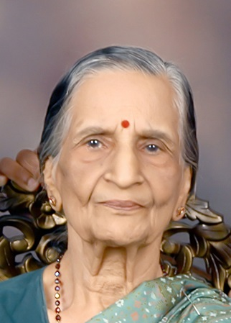
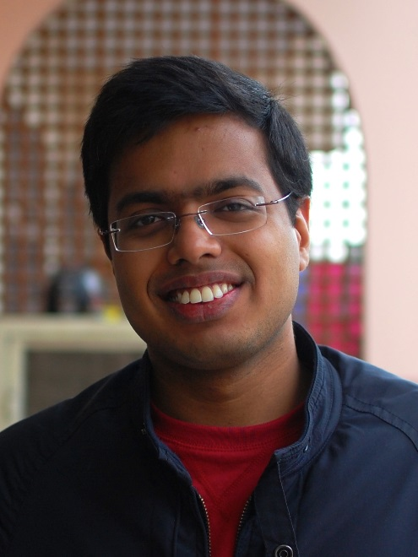
Thank You!
Notes:
Postdocs: Jyotirmoy, Arjun Radhakrishna, Kostas, Dana
Postdocs: Ashutosh, Christos
Internship: Jason, Youssef
Lab: Abhishek, Salar, Yifei, Loris, Nimit
Nan, Shahin, Kai, Arjun Ravi Narayan
ECE Lobby: Neeraj, Modi, Manchem, Abhishek Anand
Carin, Floki, VA, Pavan Nukala
Appu, Ammandu, Ambu, Ajji

