Slide 1
Difflog: Beyond Deductive Methods in Program Analysis
Mukund Raghothaman · Sulekha Kulkarni · Richard Zhang
Xujie Si · Kihong Heo · Woosuk Lee · Mayur Naik
University of Pennsylvania

Slide 2
Static Analyzers
Automatic bug-finding tools
The ideal static analyzer:
Identifies the most serious bugs
Produces no false alarms
Scales to very large codebases
Astrée
Microsoft
Windows Device Drivers
Airbus
Avionics Software
Synopsis
Enterprise Applications
Facebook
Mobile Applications

Slide 3
Heartbleed
Buffer over‑read bug in OpenSSL’s Heartbeat implementation
Introduced in 2011, discovered in 2014
Estimated to affect nearly 66% of all web servers
Why did static analysis tools not discover the Heartbleed bug?

Slide 4
Approximations in Static Analysis
Challenge #1: Most analysis questions are undecidable So, analysis tools are only approximately correct
Challenge #2: Tools must scale to large programs So, analysis designers make aggressive tradeoffs
“… can be difficult to do without introducing large numbers of false positives, or scaling performance exponentially poorly. In this case, balancing these and other factors in the analysis design caused us to miss the defect.”
―Coverity, On Detecting Heartbleed with Static Analysis, 2014
Alarms |  | Relevant
 |  | Yes | No
Reported | Yes | True positive | False positive
 | No | False negative | True negative
“Unsound”
“Incomplete”
Notes:
TODO: Add contributions slide. Artifact evaluation stamp on contribution slide.

Slide 5
Program Analysis, Traditionally
Program, $P$
Datalog
Solver
Analysis, $A$
Reports, $R$
Analysis
Designer
Programmer

Slide 6
Our Contribution
Training corpus
$\{P_{1},P_{2},…,P_{k}\}$
Data-driven analysis design
Program, $P$
Feedback, $F$
Difflog
Learning
Difflog
Inference
Difflog
Learning
Difflog
Inference
Analysis, $A$
Programmer
Analysis
Designer
Alarm prioritization
Generalization from feedback
Ranked
reports, $R$
Training labels
$\{l_{1},l_{2},…,l_{k}\}$

Slide 7
Anatomy of an Analysis: Datarace Detection
If $p_{1}$ and $p_{2}$ may execute in parallel,
and $p_{3}$ may execute immediately after $p_{2}$,
R | par($p_{1}$, $p_{3}$) | :- par($p_{1}$, $p_{2}$), next($p_{2}$, $p_{3}$).
then $p_{1}$ and $p_{3}$ may themselves execute in parallel.
Example of deduction rule in Datalog
par(L₁, L₂)
next(L₂, L₃)
⋮
x = y + 1; // L₁
⋮
⋮
z = y + 1; // L₂
z = z + 1; // L₃
⋮
Semmle
R
par(L₁, L₃)

Slide 8
Applying the Analysis …
Start with input tuples
par(L₁, L₂)
next(L₂, L₃)
R
R
Apply rules to derive new tuples
next(L₃, L₂)
par(L₁, L₃)
next(L₃, L₄)
alias(L₁, L₃)
R
Stop when nothing new can be concluded
R′
par(L₁, L₄)
alias(L₁, L₄)
race(L₁, L₃)
R′
race(L₁, L₄)

Slide 9
Applying the Analysis …
“Possible datarace on field ‘isPasv’ between lines Connection.java:191 (Read) and Connection.java:106 (Write)”
Checker Of Races and Deadlocks: Popular static analysis tool for Java
(Naik et al PLDI 2006)
Highly concurrent open source FTP server
[150 kLOC]
522 alarms
75 true positives
447 false positives

Slide 10
How do False Alarms Arise?
This rule causes incompleteness!
R | par($p_{1}$, $p_{3}$) | :- par($p_{1}$, $p_{2}$), next($p_{2}$, $p_{3}$).
⋮
x = x + 1; // L₁
⋮
⋮
if (numThreads == 1 /* L₂ */) {
x = x + 1; // L₃
}
⋮
✓
par(L₁, L₂)
next(L₂, L₃)
✓
R
par(L₁, L₃)
✘

Slide 11
How do False Alarms Arise?
Incorrect intermediate conclusions lead to false alarms downstream
Traditional solution:
Refine the analysis, use more elaborate rules
Requires domain expertise
Makes analysis computationally expensive
Effectiveness depends on program and on coding idioms

Slide 12
Our Observation
Alarms share root causes
Therefore, they are correlated in their ground truth
par(L₁, L₂)
next(L₂, L₃)
R
R
next(L₃, L₂)
par(L₁, L₃)
next(L₃, L₄)
par(L₁, L₃)
alias(L₁, L₃)
R
R′
par(L₁, L₄)
par(L₁, L₄)
alias(L₁, L₄)
race(L₁, L₃)
R′
race(L₁, L₃)
How to generalize from ¬race(L₁, L₃)?
By preserving the provenance of alarms!
race(L₁, L₄)
race(L₁, L₄)

Slide 13
Interactive Ranking and Marginal Inference
Training corpus
$\{P_{1},P_{2},…,P_{k}\}$
Program, $P$
Feedback, $F$
Difflog
Learning
Difflog
Inference
Difflog
Learning
Difflog
Inference
Analysis, $A$
Programmer
Analysis
Designer
Ranked
reports, $R$
Training labels
$\{l_{1},l_{2},…,l_{k}\}$
R., Kulkarni, Heo, Naik. PLDI 2018.

Slide 14
Marginal Inference and Interactive Ranking
How do we extract this probabilistic model?
$$\text{Pr}⁡(\text{a})$$
$$\text{Pr}⁡(\text{a}∣¬\text{a}\text{1})$$
$$\text{Pr}⁡(\text{a}∣¬{\text{a}}_{\text{1}},¬{\text{a}}_{\text{2}})$$
$$\text{Pr}(\text{a}∣¬{\text{a}}_{\text{1}},¬{\text{a}}_{\text{2}},{\text{a}}_{\text{3}})$$
👍
a₁
a₂
a₃
0.993
0.779
0.046
👎
👎

Slide 15
A Probabilistic Model of Alarms
This rule causes incompleteness!
R | par($p_{1}$, $p_{3}$) | :- par($p_{1}$, $p_{2}$), next($p_{2}$, $p_{3}$).
Quantifies incompleteness
par(L₁, L₂)
next(L₂, L₃)
“Even if both par(L₁, L₂) and next(L₂, L₃) hold, we only believe par(L₁, L₃) with confidence 0.95.”
“Even if both par(L₁, L₂) and next(L₂, L₃) hold, we only believe par(L₁, L₃) with confidence 0.95.”
R
par(L₁, L₃)
 | Pr(par(L₁, L₃) | $e$) | Pr(¬ par(L₁, L₃) | $e$)
$e$ = “par(L₁, L₂) ∧ next(L₂, L₃)” | 0.95 | 0.05
$e$ = “¬ (par(L₁, L₂) ∧ next(L₂, L₃))” | 0 | 1
Notes:
There are many ways one can measure the “incompleteness” of a rule. With a large corpus of labelled data, one could find out how often the rule misfires. Without training data, one could give a subjective estimate of its reliability: in fact, this is what we do in our experiments. With a corpus of labelled alarms, we could use expectation-maximization to come up with so-called maximum likelihood estimates.

Slide 16
A Probabilistic Model of Alarms
Joint probability distribution over ground truth of all tuples induced by factoring:
Pr(race(L₁, L₄), ¬ par(L₁, L₄), alias(L₁, L₄), …)
= Pr(race(L₁, L₄) | ¬ par(L₁, L₄), alias(L₁, L₄))
× Pr(¬ par(L₁, L₄) | ⋯)
× Pr(alias(L₁, L₄))
× ⋯
[Factor ❶]
[Factor ❷]
[Factor ❸]
par(L₁, L₂)
next(L₂, L₃)
R
R
Each tuple treated as a Boolean-valued random variable
next(L₃, L₂)
par(L₁, L₃)
next(L₃, L₄)
Factor ❷
alias(L₁, L₃)
R
R′
par(L₁, L₄)
alias(L₁, L₄)
Factor ❸
race(L₁, L₃)
R′
race(L₁, L₄)
Factor ❶

Slide 17
Experimental Evaluation
Analysis 1: Datarace analysis for Java programs
Analysis 2: Taint analysis for Android apps
Suite of 16 benchmarks: Dacapo and Android malware
40K—616KLOC
Notes:
Datarace: 102 rules, 102 relations, 58 input relations, 44 output relations
Taint: 62 rules, 77 relations, 52 input relations, 25 output relations
Used an off-the-shelf marginal inference engine, LibDAI

Slide 18
Effectiveness of Ranking
Hundreds of alarms, tens of true positives
With Bingo, the user needs to inspect 69% fewer false alarms
Datarace
Taint
Dramatic reductions in inspection burden
Notes:
44% fewer alarms than Base-C
58% fewer alarms than Base-R

Slide 19
Training corpus
$\{P_{1},P_{2},…,P_{k}\}$
Program, $P$
Feedback, $F$
Difflog
Learning
Difflog
Learning
Difflog
Inference
Difflog
Inference
Analysis, $A$
Programmer
Analysis
Designer
Ranked
reports, $R$
Training labels
$\{l_{1},l_{2},…,l_{k}\}$
R., Zhang, Si, Heo, Naik. In submission, 2018.

Slide 20
From the Discrete to the Continuous …
Rule weights induce numerical values for each conclusion
R₁ | pt($p$, $q$) | :- “$p$ ≔ &$q$”.
R₂ | pt($p$, $r$) | :- “$p$ ≔ $q$”, pt($q$, $r$).
R₃ | pt($p$, $s$) | :- “$p$ ≔ *$q$”, pt($q$, $r$), pt($r$, $s$).
R₄ | pt($r$, $s$) | :- “*$p$ ≔ $q$”, pt($p$, $r$), pt($q$, $s$).
R₁ | pt($p$, $q$) | :- “$p$ ≔ &$q$”. | 0.90
R₂ | pt($p$, $r$) | :- “$p$ ≔ $q$”, pt($q$, $r$). | 0.60
R₃ | pt($p$, $s$) | :- “$p$ ≔ *$q$”, pt($q$, $r$), pt($r$, $s$). | 0.80
R₄ | pt($r$, $s$) | :- “*$p$ ≔ $q$”, pt($p$, $r$), pt($q$, $s$). | 0.70
Ideally, 1.0 for true positives and 0.0 for false alarms
pt(b1, c1) | pt(a, b1) | pt(b1, c2) | pt(k, c1) | pt(k, c2)
Can we optimize for these values?
pt(b1, c1) | pt(a, b1) | pt(b1, c2) | pt(k, c1) | pt(k, c2)
0.90 | 0.90 | 0.90 | 0.65 | 0.65
Notes:
Incomplete, unrealizable specifications
Noisy data

Slide 21
From the Discrete to the Continuous …
Main challenge: Gradient descent would be very expensive
Because marginal inference is #P-complete
Because independence assumptions don’t always hold
Solution: Evaluate values using the Viterbi semiring instead
$$v_{t}=\bigvee_{g}{({v_{a}}_{1}∧{v_{a}}_{2}∧…∧{v_{a}}_{k})}$$
$$v_{t}=\max_{g}{(w_{g}×{v_{a}}_{1}×{v_{a}}_{2}×…×{v_{a}}_{k})}$$

Slide 22
Experimental Performance
Si, Lee, Zhang, Albarghouthi, Koutris, Naik. FSE 2018.
 | # Relations |  | # Rules |  | Time (s)
 | Input | Output | Expected | Candidates | Difflog | ALPS
Andersen | 4 | 1 | 4 | 27 | 4 | 148
Escape | 4 | 3 | 6 | 26 | 3 | 10
Mod/Ref | 7 | 5 | 10 | 30 | 99 | 5307
Ancestor | 2 | 2 | 4 | 38 | 3 | 25
Animals | 9 | 4 | 4 | 76 | 22 | 76
Dramatic improvements in synthesis time over state-of-the-art

Slide 23
Conclusion
Difflog: Framework to extend Datalog to continuous domains
Builds on theory of semiring provenance
Associates rules with tokens and computes provenance of alarms
Naturally captures alarm correlations
Enables data-driven analysis design
Interactive alarm prioritization
Notes:
Bayesian, human-in-the-loop ranking system

Slide 24
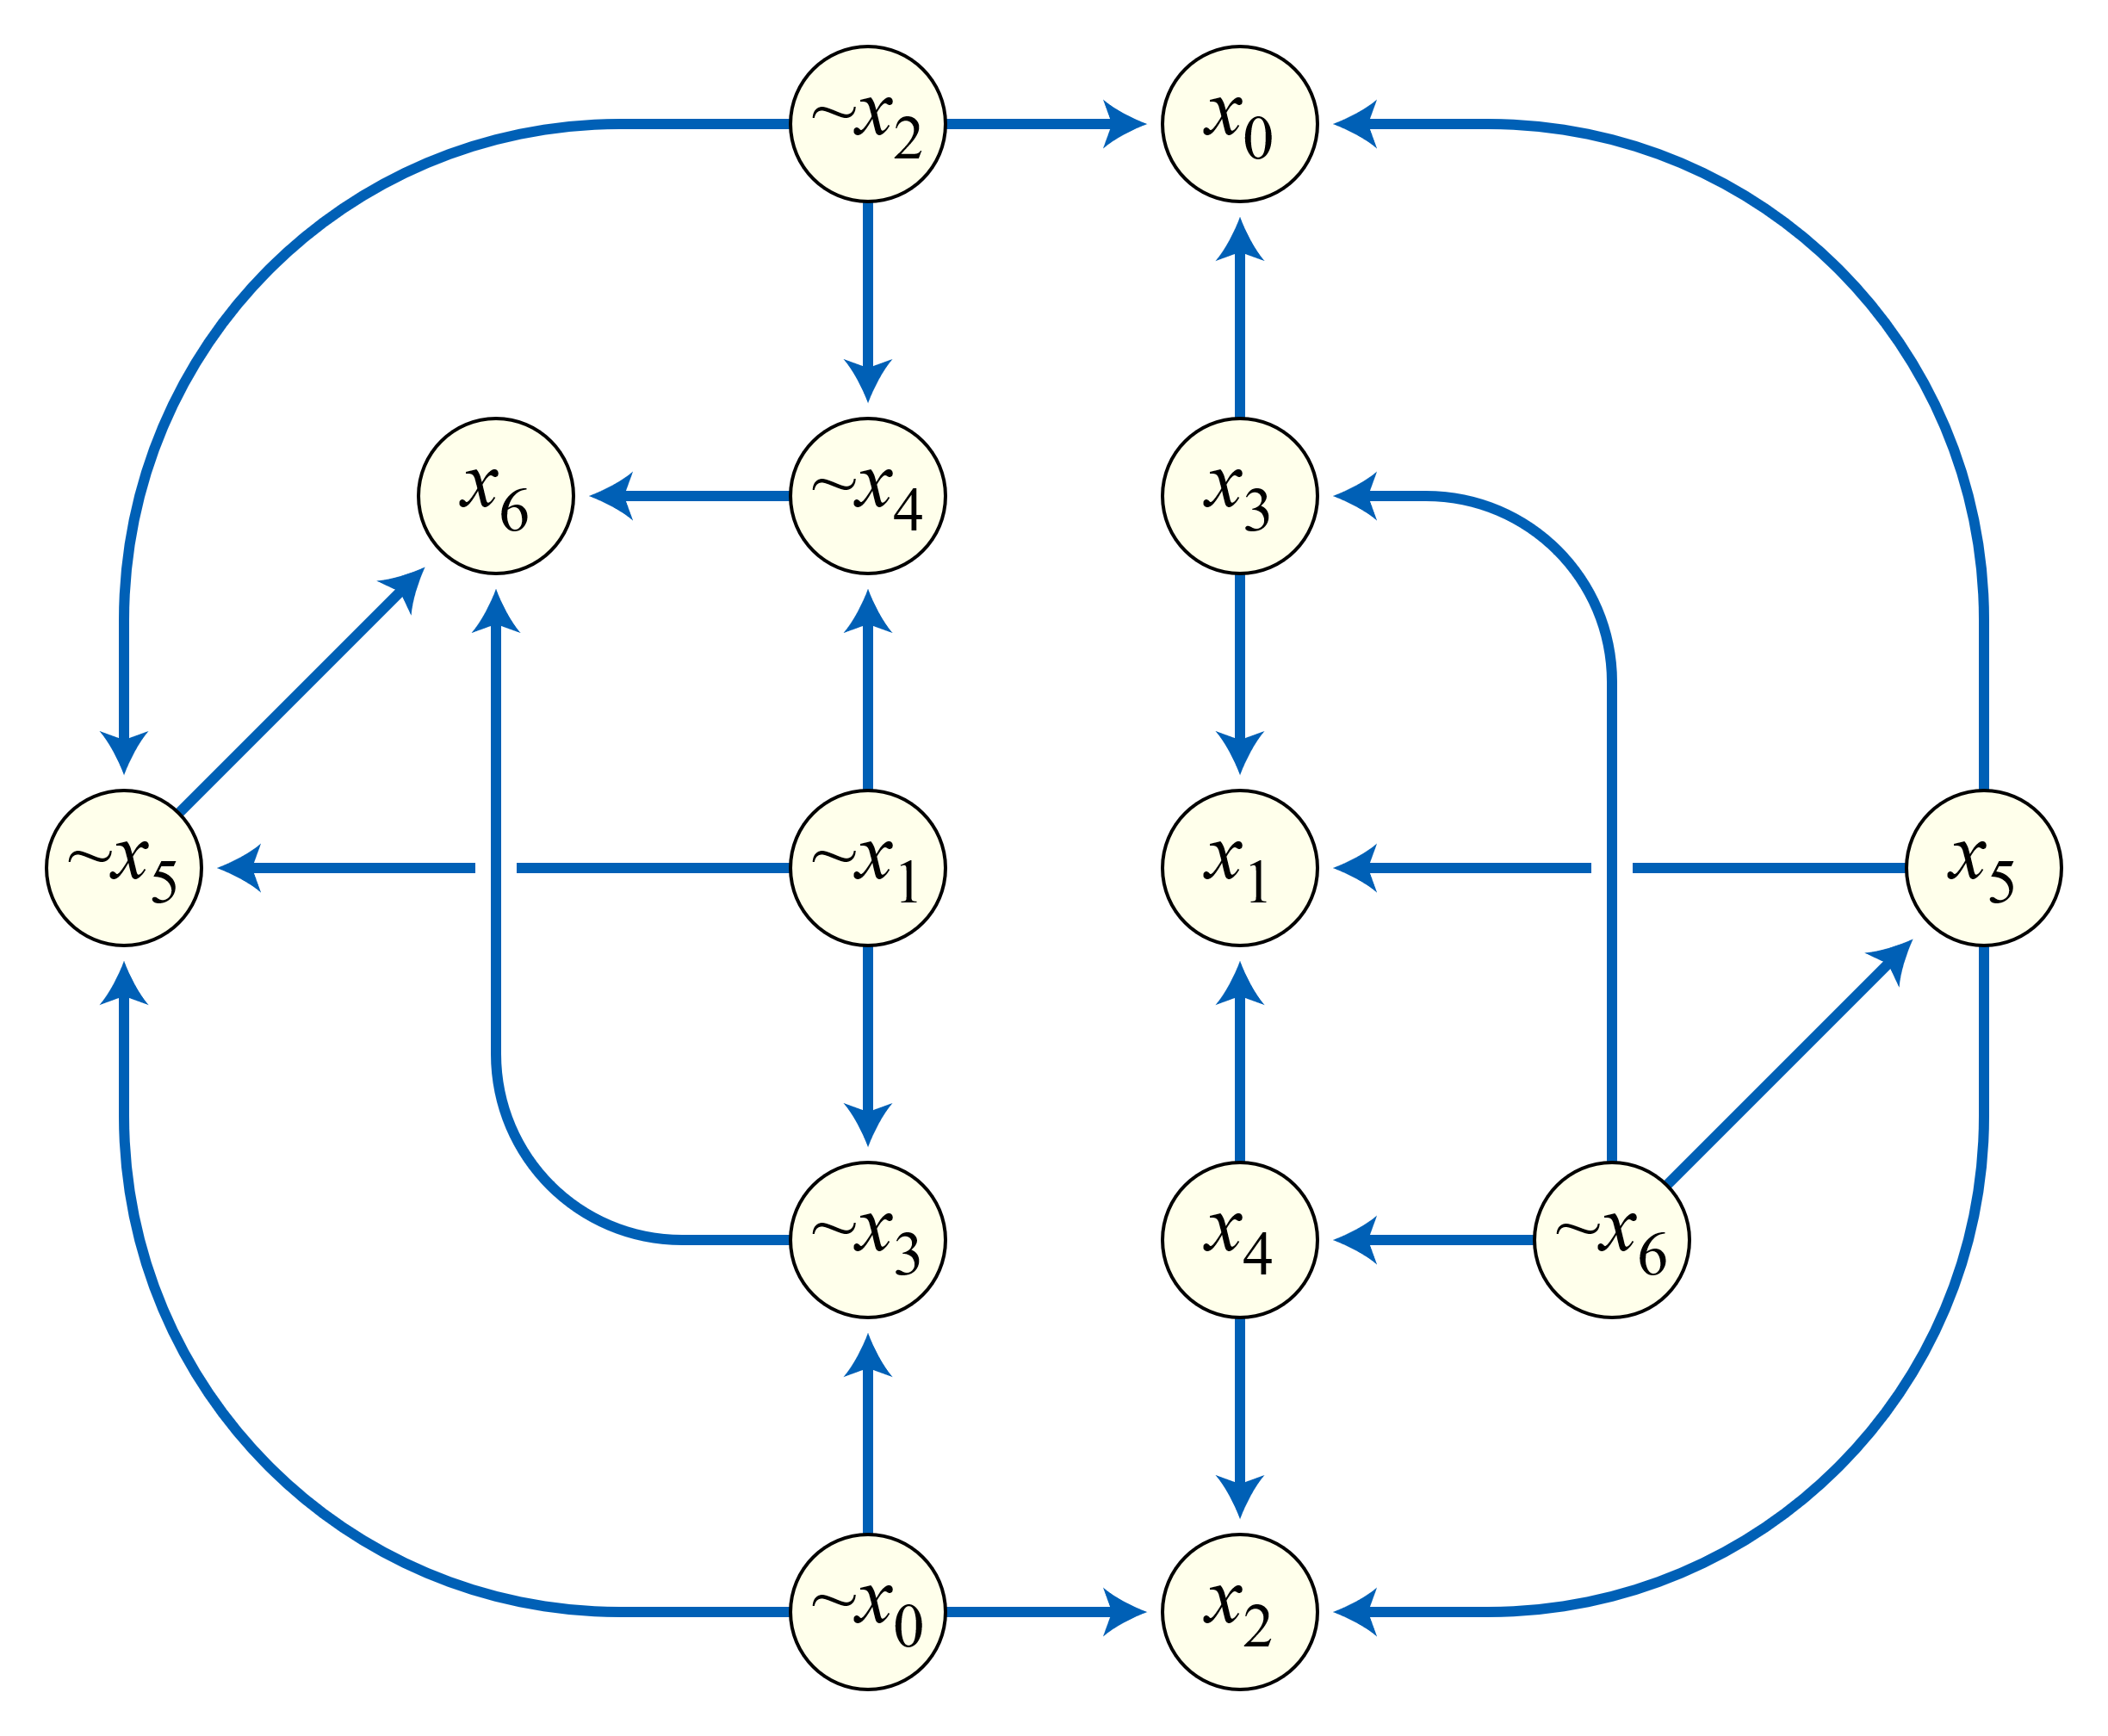
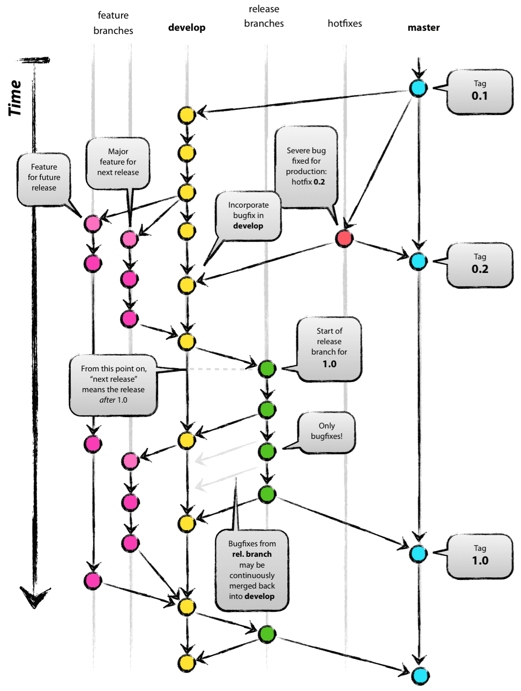
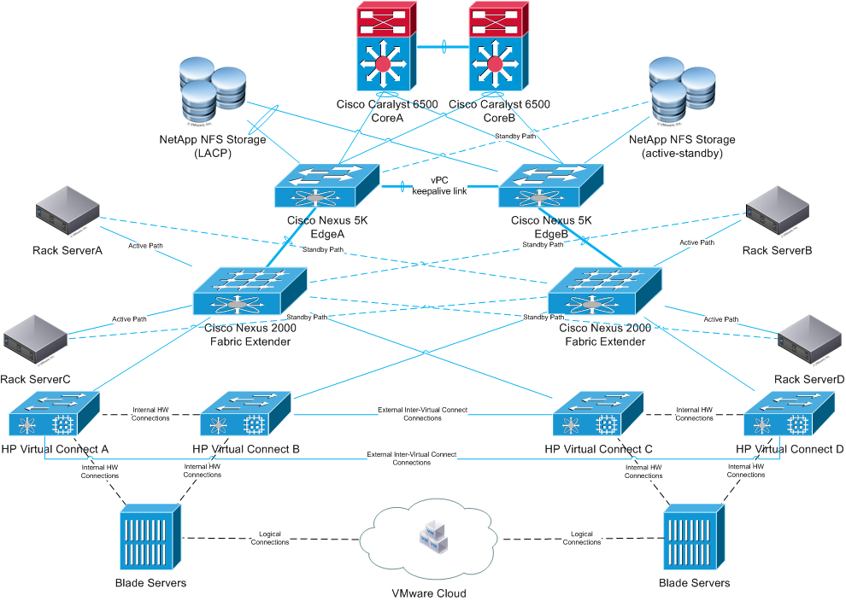
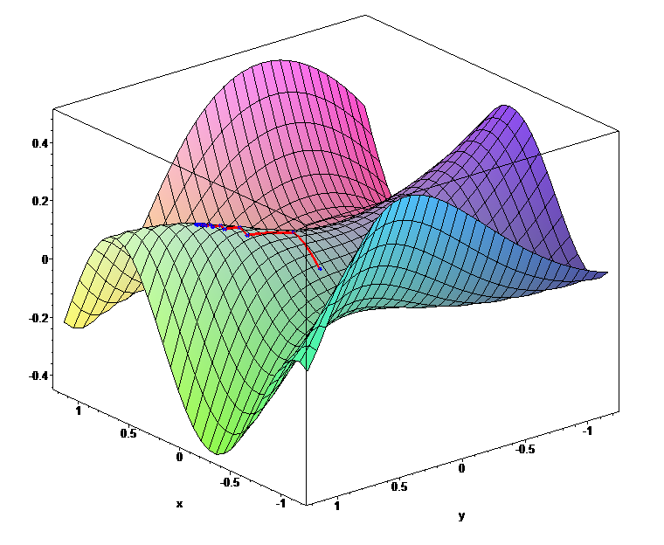
Future Directions
Continuous integration and incremental analyses
Fault localization in complex systems
Combining numerical optimization and CDCL
Notes:
Non-Datalog analyses

Slide 25
Effectiveness of Our Approach

Slide 26
Effectiveness of Our Approach

Slide 27
Discovering New Bugs
Alarms |  | Relevant
 |  | Yes | No
Reported | Yes | True positive | False positive
 | No | False negative | True negative
“Unsound”
“Incomplete”
Tools often sacrifice recall for improved precision

Slide 28
Discovering New Bugs Bingo vs. precise unsound analyses
 | Chord, soundy¹ |  | Chord, unsound |  |  | Bingo
 | Total | True | Total | True | Missed | Last true rank
Jspider | 257 | 9 | 52 | 5 | 4 | 20
Weblech | 30 | 6 | 7 | 4 | 2 | 11
FTP | 522 | 75 | 211 | 36 | 39 | 103
HEDC | 152 | 12 | 55 | 6 | 6 | 67
Avrora | 978 | 29 | 9 | 4 | 25 | 410
LUIndex | 940 | 2 | 494 | 2 | 0 | 14
Sunflow | 958 | 171 | 506 | 94 | 77 | 838
Xalan | 1870 | 75 | 80 | 52 | 23 | 273
Total | 5707 | 379 | 1414 | 203 | 176 | 1736
Discover 87% more bugs by inspecting 23% more alarms
Precision: 4.6%
Precision: 14%
Recall: 54%
¹Livshits et al., In Defense of Soundiness: A Manifesto, 2015

