Slide 1
Boosting Static Analysis Accuracy with Instrumented Test Executions
Tianyi Chen · Kihong Heo · Mukund Raghothaman
University of Southern California
KAIST

Slide 2
The Two Paradigms of Software Validation
Static reasoning: Abstract interpretation, program logics, type systems
Establish upper bounds
Challenges with false warnings, i.e., precision
Goal of our Research
Can we leverage dynamic evidence from test executions to improve static analysis accuracy?
Dynamic analyses, fuzzing symbolic execution
Establish lower bounds
Challenges with missed bugs, i.e., recall

Slide 3
Bayesian Reasoning for Program Analysis
(R. et al., PLDI 2018)
Analyzed the program using the Sparrow static analyzer (Oh et al., PLDI 2012)
Both are false warnings
 | ⚠️
 | ⚠️
L1 | char *line = ⋯;
L2 | char *tok = strtok(line, " ");
L3 | char *p = strlen(line);
L4 | while (p > tok) {
L5 | if (isdigit(p)) break;
L6 | if (isalpha(p)) break;
L7 | p--;
L8 | }
Potential buffer overflows at lines L5 and L6

Slide 4
Bayesian Reasoning for Program Analysis
(R. et al., PLDI 2018)
Step 1: Record the derivation process used to produce alarms
 | ⚠️
 | ⚠️
L1 | char *line = ⋯;
L2 | char *tok = strtok(line, " ");
L3 | char *p = strlen(line);
L4 | while (p > tok) {
L5 | if (isdigit(p)) break;
L6 | if (isalpha(p)) break;
L7 | p--;
L8 | }
⋯
edge(L4, L5)
path(L3, L4)
edge(L4, L6)
Overflow(L5)
path(L3, L5)
path(L3, L6)
Overflow(L6)
Alarm(L5)
Alarm(L6)

Slide 5
Bayesian Reasoning for Program Analysis
(R. et al., PLDI 2018)
Step 2: Convert derivation graph into a Bayesian network
 | ⚠️
 | ⚠️
L1 | char *line = ⋯;
L2 | char *tok = strtok(line, " ");
L3 | char *p = strlen(line);
L4 | while (p > tok) {
L5 | if (isdigit(p)) break;
L6 | if (isalpha(p)) break;
L7 | p--;
L8 | }
$Pr⁡(\text{path}\left(\text{L}\text{3}, \text{L}\text{5}\right)∣\text{path}(\text{L}\text{3}, \text{L}\text{4}))$ | 0.9
$Pr⁡(\text{path}\left(\text{L}\text{3},\text{L}\text{5}\right)∣¬\text{path}(\text{L}\text{3}, \text{L}\text{4}))$ | 0
⋯
edge(L4, L5)
path(L3, L4)
edge(L4, L6)
$Pr⁡(\text{Alarm}\left(\text{L}\text{5}\right)∣\text{path}(\text{L}\text{3}, \text{L}\text{5}))$ | 0.9
$Pr⁡(\text{Alarm}\left(\text{L}\text{5}\right)∣¬\text{path}(\text{L}\text{3}, \text{L}\text{5}))$ | 0
Overflow(L5)
path(L3, L5)
path(L3, L6)
Overflow(L6)
Alarm(L5)
Alarm(L6)
Notes:
1. Quantifies the likelihood of deriving an incorrect conclusion

Slide 6
Bayesian Reasoning for Program Analysis
(R. et al., PLDI 2018)
Step 3: Rank alarms according to confidence values
$$a$$ | $$Pr(a)$$
⋯
Alarm(L5) | 0.73
Alarm(L6) | 0.73
⋯
 | ⚠️
 | ⚠️
L1 | char *line = ⋯;
L2 | char *tok = strtok(line, " ");
L3 | char *p = strlen(line);
L4 | while (p > tok) {
L5 | if (isdigit(p)) break;
L6 | if (isalpha(p)) break;
L7 | p--;
L8 | }
⋯
$$a$$ | $$Pr(a∣¬\text{Alarm}(\text{L}\text{5}))$$
⋯
Alarm(L6) | 0.51
⋯
Alarm(L5) | 0
edge(L4, L5)
path(L3, L4)
edge(L4, L6)
Overflow(L5)
path(L3, L5)
path(L3, L6)
Overflow(L6)
Alarm(L5)
Alarm(L6)

Slide 7
Interactive Alarm Prioritization
$$\text{Pr}⁡(\text{a})$$
$$\text{Pr}⁡(\text{a}∣¬\text{a}\text{1})$$
$$\text{Pr}⁡(\text{a}∣¬{\text{a}}_{\text{1}},¬{\text{a}}_{\text{2}})$$
$$\text{Pr}(\text{a}∣¬{\text{a}}_{\text{1}},¬{\text{a}}_{\text{2}},{\text{a}}_{\text{3}})$$
👍
a₁
a₂
a₃
👎
👎

Slide 8
Interactive Alarm Prioritization with Bingo
(R. et al., PLDI 2018)
Source code
Bayesian network
Feedback
✔ …
✘ …
✘ …
#include <stdi
int main() {
int x = ⋯;
int *y = &x;
*y = ⋯;
}
Static Analyzer
Marginal Inference
“Given evidence $e$, for each alarm $a$, what is $Pr⁡(a∣e)$?”
…
…
…
Ranked alarms

Slide 9
The Dynaboost Prioritization Framework
Source code
Bayesian network
Feedback
✔ …
✘ …
✘ …
#include <stdi
int main() {
int x = ⋯;
int *y = &x;
*y = ⋯;
}
Static Analyzer
Our Insight
Monitor test runs to detect intermediate behaviors
Use evidence to bootstrap prioritization
SDTransfer
Marginal Inference
Instrumentation Harness
✔ …
✘ …
✘ …
DSTransfer
…
…
…
Test inputs
Empirical observations
Ranked alarms

Slide 10
Targeted Code Instrumentation
path(L1, L2): “There may be a flow of data from line L1 to line L2”
Confirmation of this hypothesis will reduce uncertainty in downstream warning Alarm(Lk)
Monitor test executions for evidence using dyamic dataflow monitoring tool DFSan
If found, compute $Pr(a∣\text{path}(\text{L}\text{1}, \text{L}\text{2}))$
⋯
L1 | x = ⋯;
 | ⋯
L2 | read(y);
 | dfsan_set_label("src-a", &x);
 | print(dfsan_get_label(y));
edge(L2, L3)
path(L1, L2)
path(L1, L3)
⋯
Overflow(L5)
path(L1, Lk)
Alarm(Lk)
Notes:
1. Observing a dataflow from L1 to L2 does not necessarily mean that tainted data can flow from L1 to L2. So transferring evidence into probabilistic model requires some care.

Slide 11
Experimental Setup
Connected to Sparrow static analyzer for C programs (Oh et al., PLDI 2012)
Used DFSan dynamic dataflow analyzer to monitor test executions
Used test suite supplied with the program when available
Corpus of 13 Unix command-line programs, 9–112 KLOC
Buffer overflow, integer overflow, format string bugs
Baseline: Interactive alarm prioritization using Bingo (Raghothaman et al., PLDI 2018)

Slide 12
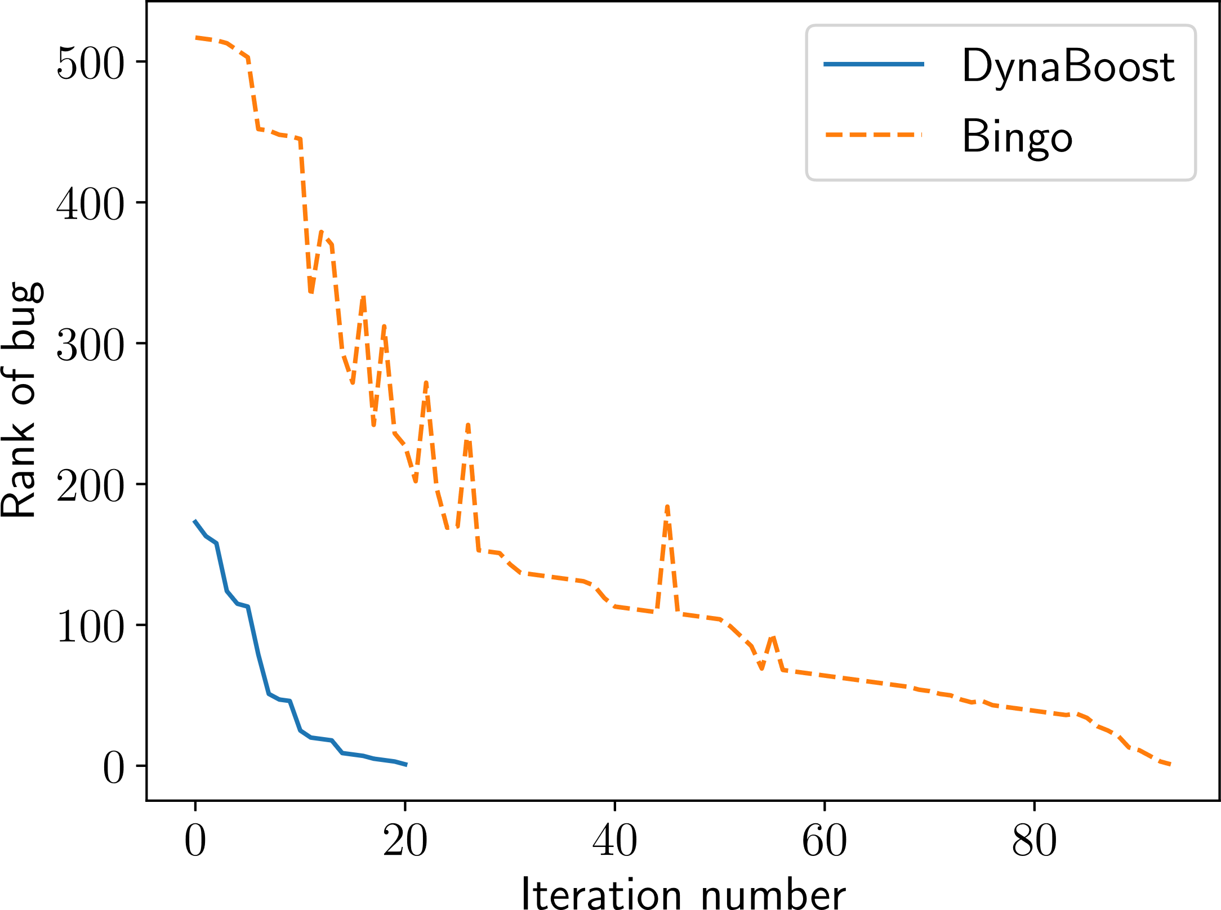
Experimental Effectiveness
Sparrow emits 805 alarms
CVE-2019-16166
GNU cfl0w 1.5
Savings enabled by DynaBoost
Bingo discovers bug in 94 iterations
DynaBoost discovers bug in 21 iterations
Notes:
GNU cflow-1.5: Program to construct control flow graphs of C programs
TODO: Observe decreased sensitivity to false generalization events

Slide 13
Experimental Effectiveness
Alarms needing inspection with only human feedback
35% reduction on average
Effort needed when including dynamic evidence

Slide 14
Experimental Effectiveness
565
92
60
Average number of alarms emitted by Sparrow
Iterations needed to find all bugs with only user guidance
Iterations needed when combining user guidance and dynamic evidence

Slide 15
Conclusion
Introduced DynaBoost: A probabilistic technique to combine information from static and dynamic program analyses
Integrated into Bingo, a framework for interactive prioritization of static analysis warnings
Experiments indicate a 35% reduction in effort needed to find bugs
In the paper:
Algorithms to apply DFSan instrumentation from dataflow facts
Algorithms to transfer experimental observations to probabilistic model
Detailed experimental results

Slide 16
Source code
Bayesian network
Feedback
✔ …
✘ …
✘ …
#include <stdi
int main() {
int x = ⋯;
int *y = &x;
*y = ⋯;
}
Static Analyzer
SDTransfer
Marginal Inference
Instrumentation Harness
✔ …
✘ …
✘ …
DSTransfer
…
…
…
Test inputs
Empirical observations
Ranked alarms

Slide 17
#include <stdi
int main() {
int x = ⋯;
int *y = &x;
*y = ⋯;
}
Program to be analyzed
Feedback
✔ …
✘ …
✘ …
Analysis
Marginal Inference
Bayesian Network
…
…
…
Ranked alarms
Few true alarms
Lots of false alarms
Not ordered
$$\text{Pr}⁡(\text{a})$$
$$\text{Pr}⁡(\text{a}∣¬\text{a}\text{1})$$
$$\text{Pr}⁡(\text{a}∣¬{\text{a}}_{\text{1}},¬{\text{a}}_{\text{2}})$$
$$\text{Pr}(\text{a}∣¬{\text{a}}_{\text{1}},¬{\text{a}}_{\text{2}},{\text{a}}_{\text{3}})$$
👍
a₁
a₂
a₃
👎
👎

Slide 18
$$\text{Pr}⁡(\text{a})$$
$$\text{Pr}⁡(\text{a}∣¬\text{a}\text{1})$$
$$\text{Pr}⁡(\text{a}∣¬{\text{a}}_{\text{1}},¬{\text{a}}_{\text{2}})$$
$$\text{Pr}(\text{a}∣¬{\text{a}}_{\text{1}},¬{\text{a}}_{\text{2}},{\text{a}}_{\text{3}})$$
👍
a₁
a₂
a₃
👎
👎

Slide 19
⋯
edge(L4, L5)
path(L3, L4)
edge(L4, L6)
Overflow(L5)
path(L3, L5)
path(L3, L6)
Overflow(L6)
Alarm(L5)
Alarm(L6)

