Slide 1
BinHunter: A Fine-Grained Graph Representation for Localizing Vulnerabilities in Binary Executables
Sima Arasteh · Jelena Mirkovic Mukund Raghothaman · Christophe Hauser
University of Southern California
Dartmouth College

Slide 2
“… Vulnerabilities in Binary Executables”
Lots of research on detecting vulnerabilities in source code
But (#1): Source code is frequently unavailable
But (#2): Source code might not reflect binary semantics
E.g., during supply chain attacks
Therefore (This Talk): How do we detect vulnerabilities directly within binaries?
Hope: This will also help for subsequent patching

Slide 3
Vulnerability Signatures
Idea: Associate each vulnerability with patterns of data flow and function invocations (the “signature”)
E.g.: [malloc → free → dereference] suggests use-after-free
Examples:
BinXray (Xu et al., ISSTA 2020)
MVP (Xiao et al., USENIX Security 2020)
Challenge:
Composing signatures is labor-intensive
Sensitive to compiler flags, source code changes, etc.
Example of use-after-free vulnerability
int *ptr = (int *)malloc(sizeof(int)); ... // Uses of *ptr ... free(ptr);
... int x = *ptr;

Slide 4
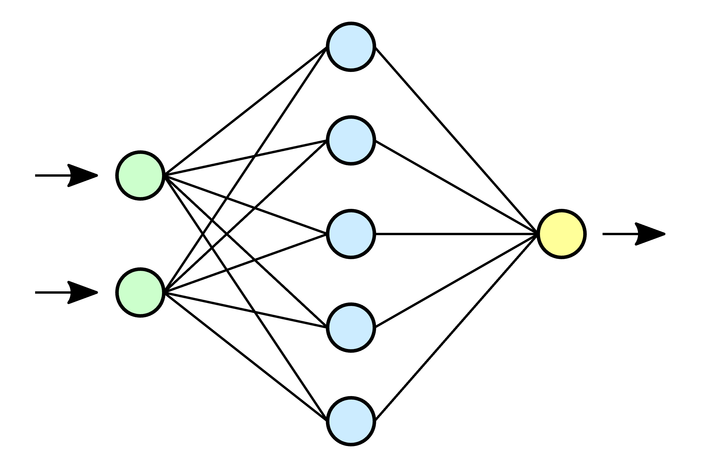
Learning to Find Vulnerabilities
Idea: Train classifiers using machine learning algorithms
_start: ; Allocate memory for buffer mov rdi, 16 call malloc mov [buffer], rax mov rax, [buffer] lea rbx, [message] mov [rax], rbx ; Free allocated memory mov rdi, [buffer] call free ; Reuse previously freed memory mov rax, [buffer] mov rbx, [rax] mov rdi, rbx call puts
...
Training Algorithm
Immediate Questions
Q1. Representation? What training algorithm?
Q2. Granularity of detection?
Classifier
Example assembly code with use-after-free bug

Slide 5
Representation and Training Algorithm
Classically:
Handcrafted representation
Attributed CFGs
Genius (Feng et al., CCS 2016)
Gemini (Xu et al., CCS 2017), …
Numerical and structural statistics
Number of instructions, size of local variables, etc.
DiscovER (Eschweiler et al., NDSS 2016)

Slide 6
Representation and Training Algorithm
More recently:
Use deep learning and NLP-based techniques
Automatically learned representation
LSTM, Word2vec, BERT, etc.
Asm2vec (Ding et al., SP 2019)
Jtrans (Wang et al., ISSTA 2022)
Challenge: NLP-based techniques are oblivious to program semantics (e.g., data and control flow)
Question: How do we make a classifier aware of this information?
Papers use ad hoc techniques to make algorithm aware of control flow

Slide 7
Granularity of Detection
Traditionally: Individual functions classified as vulnerable or not
Classifier essentially operates over function similarity
Non vulnerable functions
Vulnerable functions
Classifier

Slide 8
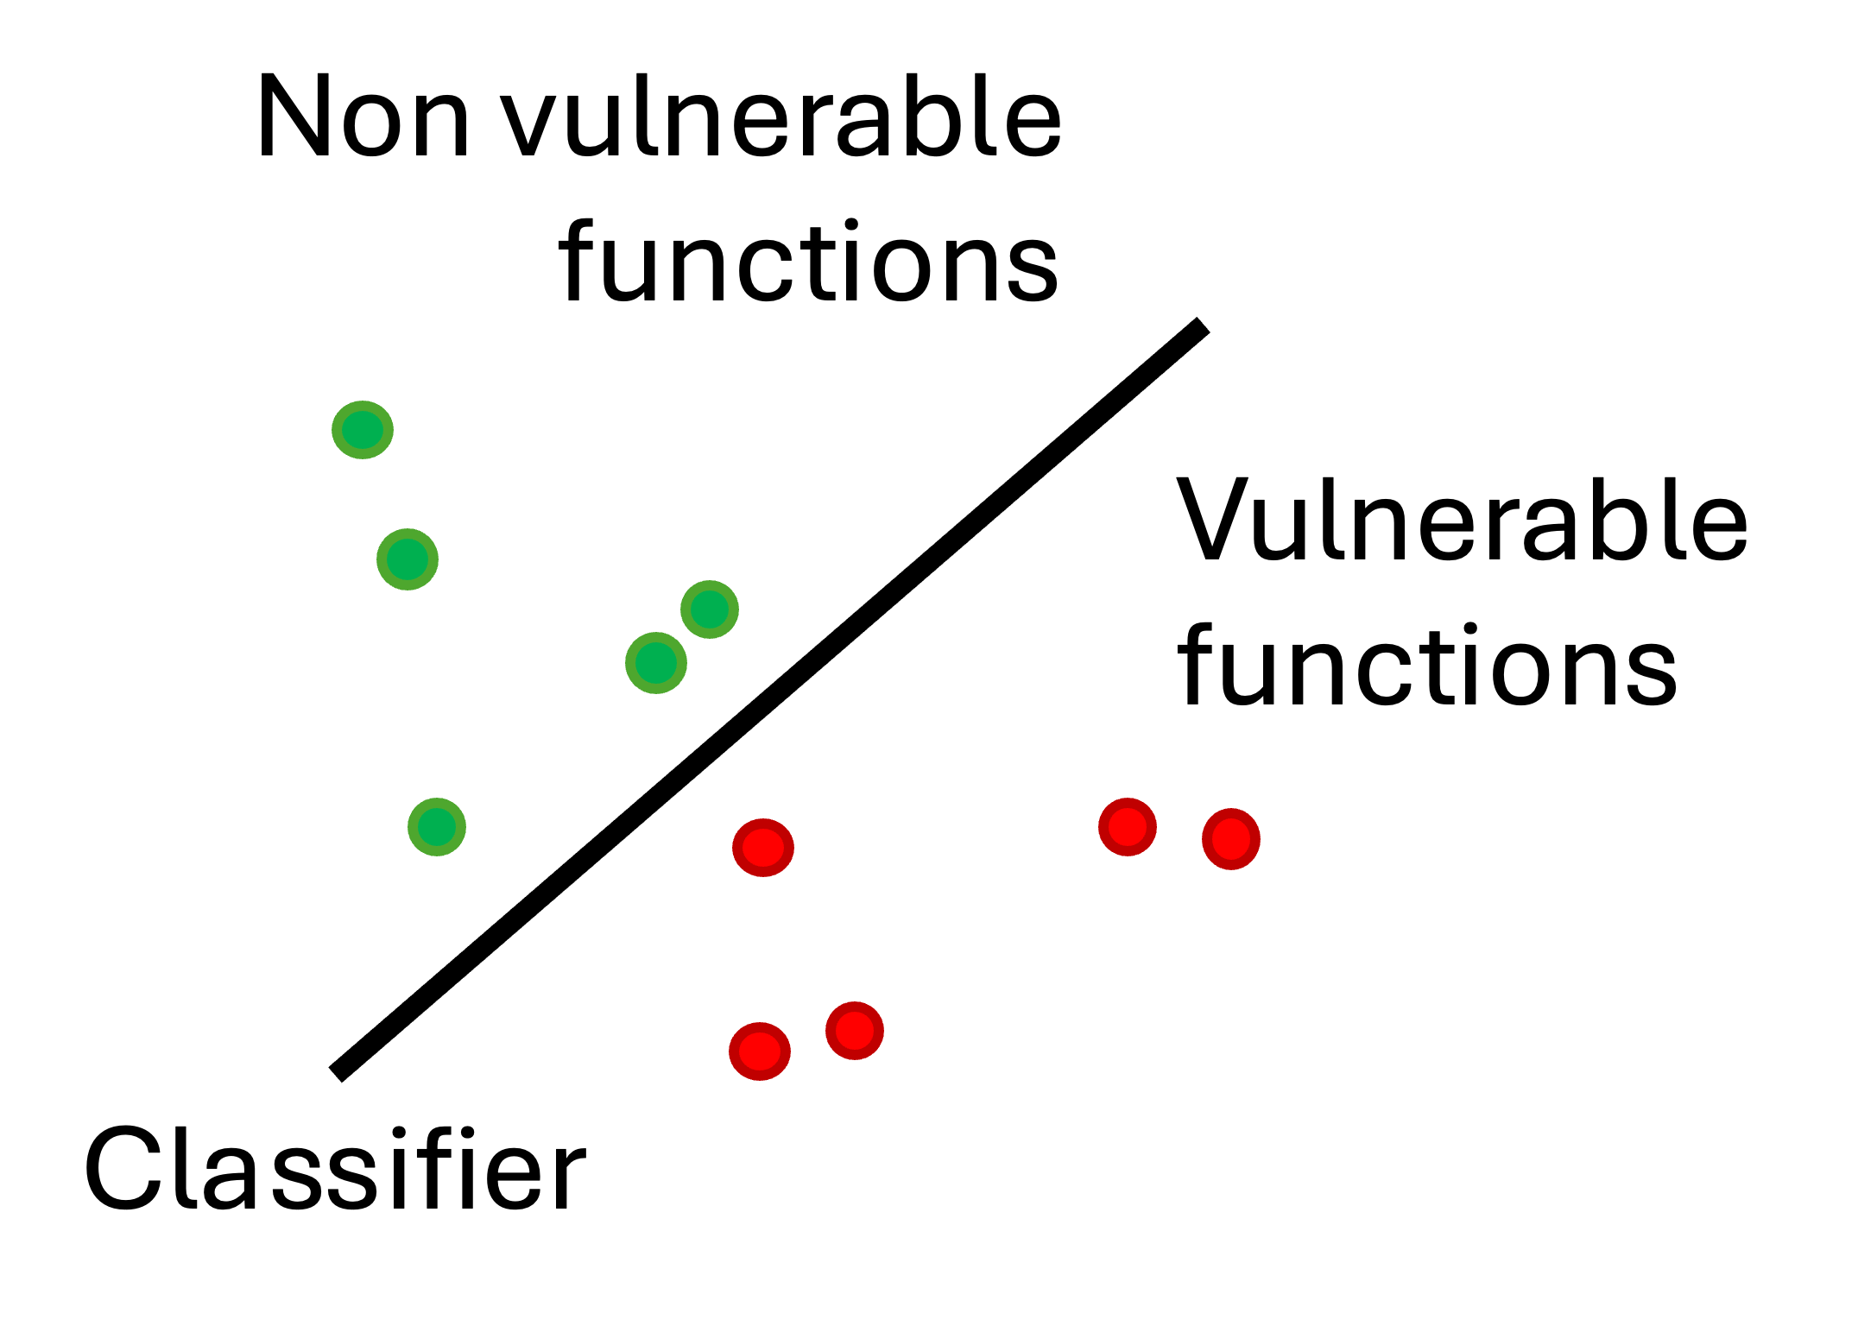
Granularity of Detection
Challenge 1: How to make classifier focus on the vulnerability, rather than on function semantics?
Function similarity detection causes issues with “large” functions
void user_authentication(const char *input) {
char buffer[16]; // Fixed size buffer
strcpy(buffer, input); // NO BOUNDS CHECK!!!
printf("Authenticating user %s\n", buffer);
...
if (...) {
printf("Access granted.\n");
} else {
printf("Access denied.\n");
}
}
void process_file(const char *fname) {
char temp_buffer[16]; // Fixed size buffer
strcpy(buffer, fname); // NO BOUNDS CHECK!!!
printf("Processing file...\n");
...
}

Slide 9
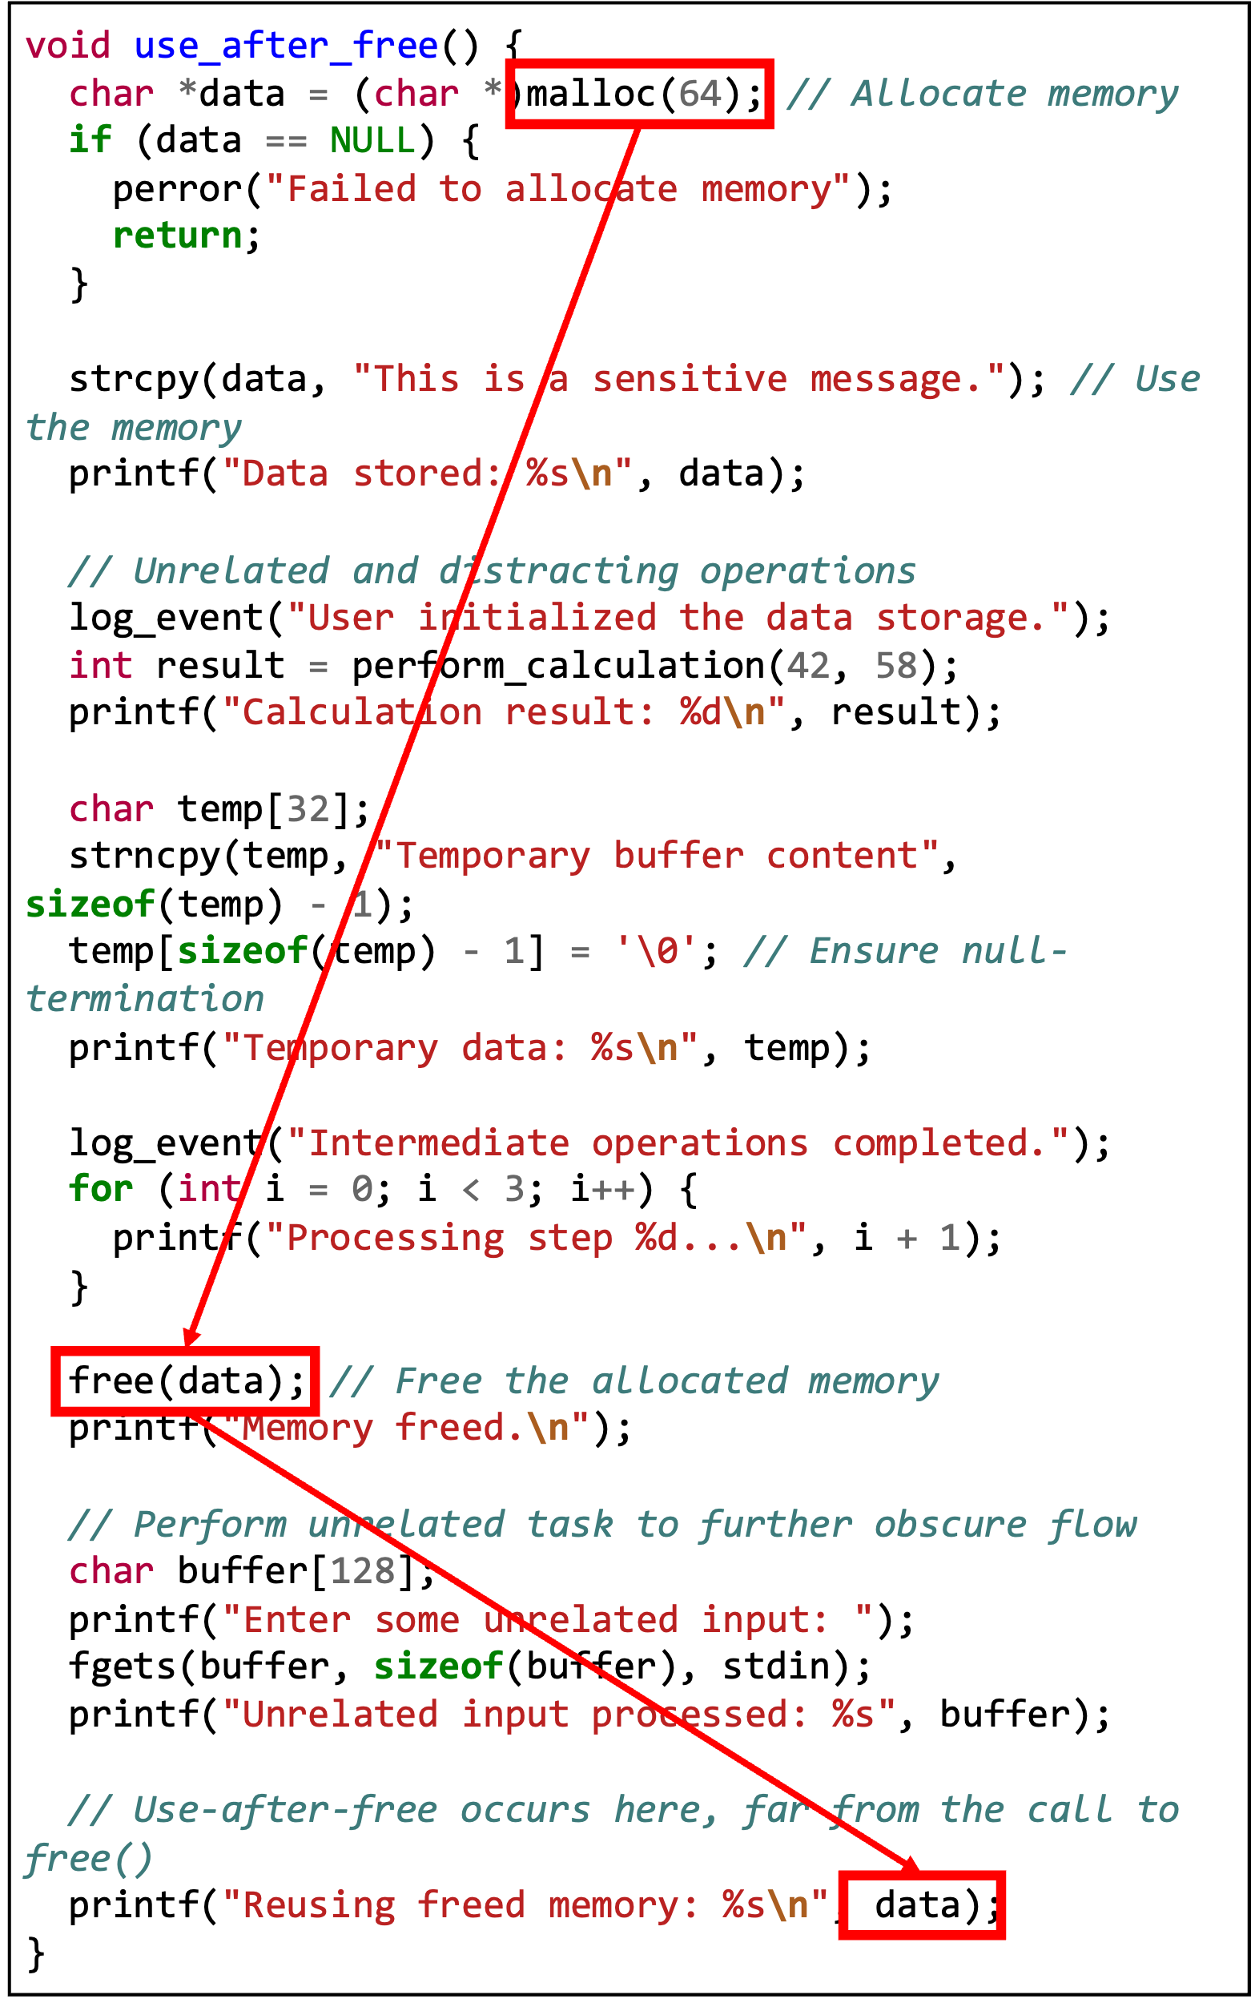
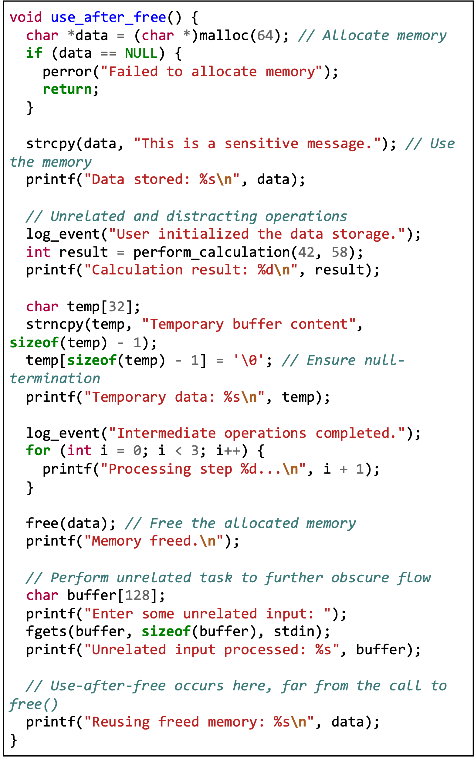
Granularity of Detection
Challenge 2: Simply identifying vulnerable functions does not help with triage or patching
Problem amplified when function body is large

Slide 10
Our Central Contribution
New graph representation that captures both data and control dependencies
Technique to localize vulnerabilities in large function bodies
The rest of this talk:
How BinHunter works
How well does BinHunter work?
The rest of this talk:
How BinHunter works
How well does BinHunter work?

Slide 11
Starting Out…
_start: ; Allocate memory for buffer mov rdi, 16 call malloc mov [buffer], rax mov rax, [buffer] lea rbx, [message] mov [rax], rbx ; Free allocated memory mov rdi, [buffer] call free ; Reuse previously freed memory mov rax, [buffer] mov rbx, [rax] mov rdi, rbx call puts
...
0x101279:(register, 0x200, 1) INT_LESS (register, 0x20, 8), (const, 0x10, 8)
0x101279:(register, 0x20b, 1) INT_SBORROW (register, 0x20, 8), (const, 0x10, 8)
0x101279:(register, 0x20, 8) INT_SUB (register, 0x20, 8), (const, 0x10, 8)
0x101279:(register, 0x207, 1) INT_SLESS (register, 0x20, 8), (const, 0x0, 8)
0x101279:(register, 0x206, 1) INT_EQUAL (register, 0x20, 8), (const, 0x0, 8)
0x101279:(unique, 0x12c00, 8) INT_AND (register, 0x20, 8), (const, 0xff, 8)
0x101279:(unique, 0x12c80, 1) POPCOUNT (unique, 0x12c00, 8)
0x101279:(unique, 0x12d00, 1) INT_AND (unique, 0x12c80, 1), (const, 0x1, 1)
0x101279:(register, 0x202, 1) INT_EQUAL (unique, 0x12d00, 1), (const, 0x0, 1)
0x101280: --- CALL (ram, 0x101030, 8), (register, 0x20, 8)
Ghidra
P-Code
Architecture-independent RTL / IR obtained from binary disassembly
Assembly code for each function

Slide 12
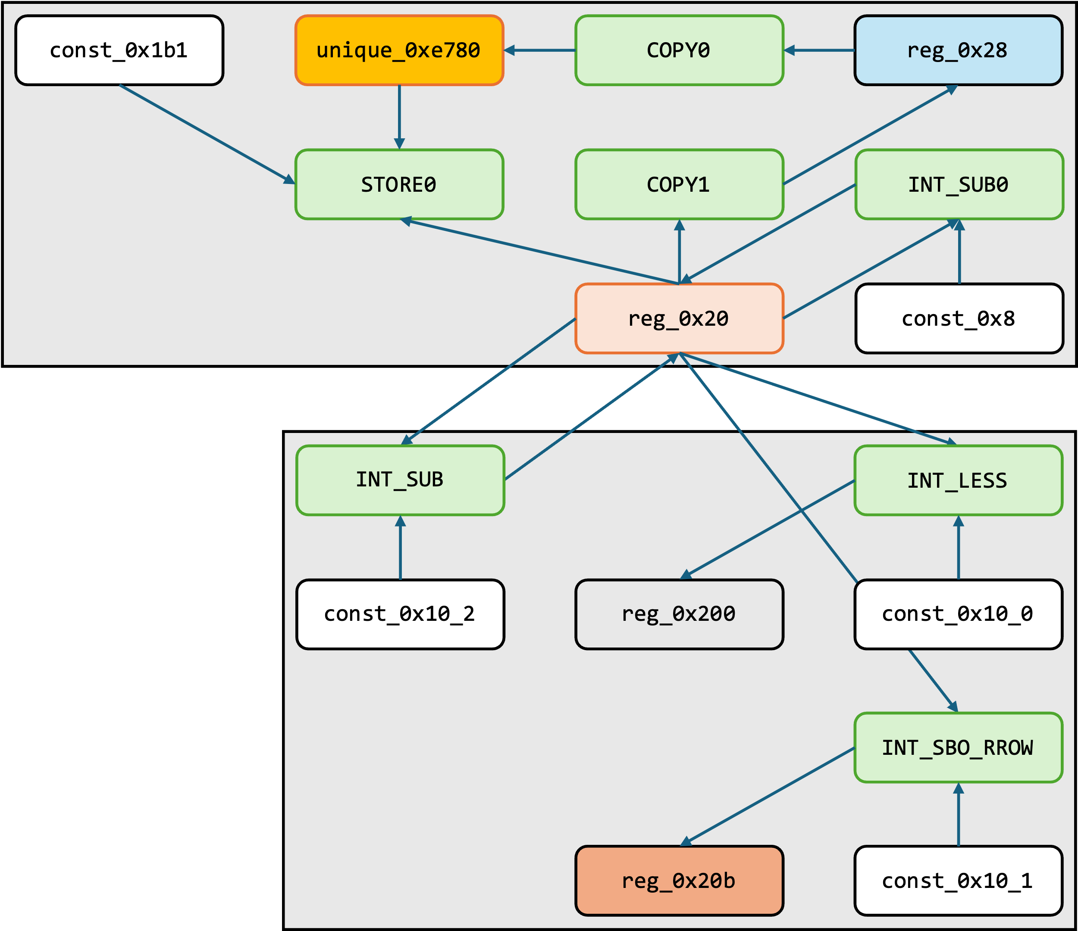
Recovering Data and Control Dependencies
Control dependencies between basic blocks
Data dependencies at finer granularity level
Basic blocks
0x101275:(unique, 0xe780, 8) COPY (register, 0x28, 8)
0x101275:(register, 0x20, 8) INT_SUB (register, 0x20, 8), (const, 0x8, 8)
0x101275: --- STORE (const, 0x1b1, 4), (register, 0x20, 8), (unique, 0xe780, 8)
0x101275:(register, 0x20a, 1) COPY (const, 0x0, 1)
0x101276:(register, 0x28, 8) COPY (register, 0x20, 8)
0x101279:(register, 0x200, 1) INT_LESS (register, 0x20, 8), (const, 0x10, 8)
0x101279:(register, 0x20b, 1) INT_SBORROW (register, 0x20, 8), (const, 0x10, 8)
0x101279:(register, 0x20, 8) INT_SUB (register, 0x20, 8), (const, 0x10, 8)
0x101279:(register, 0x207, 1) INT_SLESS (register, 0x20, 8), (const, 0x0, 8)
0x101279:(register, 0x206, 1) INT_EQUAL (register, 0x20, 8), (const, 0x0, 8)
0x101279:(unique, 0x12c00, 8) INT_AND (register, 0x20, 8), (const, 0xff, 8)
0x101279:(unique, 0x12c80, 1) POPCOUNT (unique, 0x12c00, 8)
0x101279:(unique, 0x12d00, 1) INT_AND (unique, 0x12c80, 1), (const, 0x1, 1)
0x101279:(register, 0x202, 1) INT_EQUAL (unique, 0x12d00, 1), (const, 0x0, 1)
0x101280: --- CALL (ram, 0x101030, 8), (register, 0x20, 8)

Slide 13
Slicing Subgraphs Relevant to Vulnerability
Observation: Only small subsets of instructions actually relevant to vulnerability
Claim: Identifying these subsets can improve classification accuracy
Hope: Can also be used by developers for triage and patching
Question: How to identify these instructions?

Slide 14
Slicing Subgraphs Relevant to Vulnerability
Question: How to identify relevant instructions?
Answer (Easy Version): At training time, simply look at instructions that changed between buggy and patched versions
Statements modified in patch
Implicated IR statements
0x101275:(unique, 0xe780, 8) COPY (register, 0x28, 8)
0x101275:(register, 0x20, 8) INT_SUB (register, 0x20, 8), (const, 0x8, 8)
0x101275: --- STORE (const, 0x1b1, 4), (register, 0x20, 8), (unique, 0xe780, 8)
0x101275:(register, 0x20a, 1) COPY (const, 0x0, 1)
0x101276:(register, 0x28, 8) COPY (register, 0x20, 8)
0x101275:(unique, 0xe780, 8) COPY (register, 0x28, 8)
0x101275:(register, 0x20, 8) INT_SUB (register, 0x20, 8), (const, 0x8, 8)
0x101275: --- STORE (const, 0x1b1, 4), (register, 0x20, 8), (unique, 0xe780, 8)
0x101275:(register, 0x20a, 1) COPY (const, 0x0, 1)
0x101276:(register, 0x28, 8) COPY (register, 0x20, 8)
0x101275:(unique, 0xe780, 8) COPY (register, 0x28, 8)
0x101275:(register, 0x20, 8) INT_SUB (register, 0x20, 8), (const, 0x8, 8)
0x101275: --- STORE (const, 0x1b1, 4), (register, 0x20, 8), (unique, 0xe780, 8)
0x101275:(register, 0x20a, 1) COPY (const, 0x0, 1)
0x101276:(register, 0x28, 8) COPY (register, 0x20, 8)
0x101279:(register, 0x200, 1) INT_LESS (register, 0x20, 8), (const, 0x10, 8)
0x101279:(register, 0x20b, 1) INT_SBORROW (register, 0x20, 8), (const, 0x10, 8)
0x101279:(register, 0x20, 8) INT_SUB (register, 0x20, 8), (const, 0x10, 8)
0x101279:(register, 0x207, 1) INT_SLESS (register, 0x20, 8), (const, 0x0, 8)
0x101279:(register, 0x206, 1) INT_EQUAL (register, 0x20, 8), (const, 0x0, 8)
0x101279:(unique, 0x12c00, 8) INT_AND (register, 0x20, 8), (const, 0xff, 8)
0x101279:(unique, 0x12c80, 1) POPCOUNT (unique, 0x12c00, 8)
0x101279:(unique, 0x12d00, 1) INT_AND (unique, 0x12c80, 1), (const, 0x1, 1)
0x101279:(register, 0x202, 1) INT_EQUAL (unique, 0x12d00, 1), (const, 0x0, 1)
0x101280: --- CALL (ram, 0x101030, 8), (register, 0x20, 8)
0x101279:(register, 0x200, 1) INT_LESS (register, 0x20, 8), (const, 0x10, 8)
0x101279:(register, 0x20b, 1) INT_SBORROW (register, 0x20, 8), (const, 0x10, 8)
0x101279:(register, 0x20, 8) INT_SUB (register, 0x20, 8), (const, 0x10, 8)
0x101279:(register, 0x207, 1) INT_SLESS (register, 0x20, 8), (const, 0x0, 8)
0x101279:(register, 0x206, 1) INT_EQUAL (register, 0x20, 8), (const, 0x0, 8)
0x101279:(unique, 0x12c00, 8) INT_AND (register, 0x20, 8), (const, 0xff, 8)
0x101279:(unique, 0x12c80, 1) POPCOUNT (unique, 0x12c00, 8)
0x101279:(unique, 0x12d00, 1) INT_AND (unique, 0x12c80, 1), (const, 0x1, 1)
0x101279:(register, 0x202, 1) INT_EQUAL (unique, 0x12d00, 1), (const, 0x0, 1)
0x101280: --- CALL (ram, 0x101030, 8), (register, 0x20, 8)
0x101279:(register, 0x200, 1) INT_LESS (register, 0x20, 8), (const, 0x10, 8)
0x101279:(register, 0x20b, 1) INT_SBORROW (register, 0x20, 8), (const, 0x10, 8)
0x101279:(register, 0x20, 8) INT_SUB (register, 0x20, 8), (const, 0x10, 8)
0x101279:(register, 0x207, 1) INT_SLESS (register, 0x20, 8), (const, 0x0, 8)
0x101279:(register, 0x206, 1) INT_EQUAL (register, 0x20, 8), (const, 0x0, 8)
0x101279:(unique, 0x12c00, 8) INT_AND (register, 0x20, 8), (const, 0xff, 8)
0x101279:(unique, 0x12c80, 1) POPCOUNT (unique, 0x12c00, 8)
0x101279:(unique, 0x12d00, 1) INT_AND (unique, 0x12c80, 1), (const, 0x1, 1)
0x101279:(register, 0x202, 1) INT_EQUAL (unique, 0x12d00, 1), (const, 0x0, 1)
0x101280: --- CALL (ram, 0x101030, 8), (register, 0x20, 8)
DWARF Information
Also include forward and backward data dependencies

Slide 15
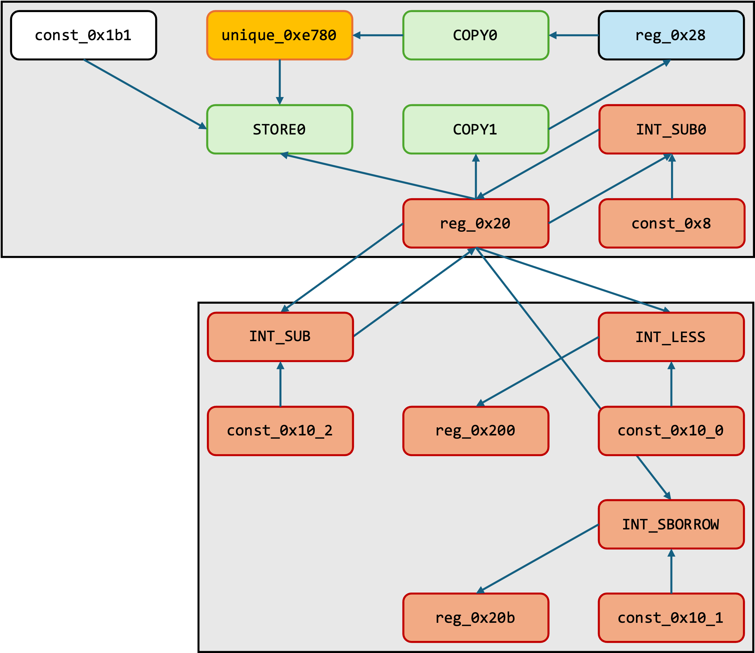
Slicing Subgraphs Relevant to Vulnerability
Question: How to identify relevant instructions?
Answer (Easy Version): At training time, simply look at instructions that changed between buggy and patched versions
0x101275:(unique, 0xe780, 8) COPY (register, 0x28, 8)
0x101275:(register, 0x20, 8) INT_SUB (register, 0x20, 8), (const, 0x8, 8)
0x101275: --- STORE (const, 0x1b1, 4), (register, 0x20, 8), (unique, 0xe780, 8)
0x101275:(register, 0x20a, 1) COPY (const, 0x0, 1)
0x101276:(register, 0x28, 8) COPY (register, 0x20, 8)
0x101279:(register, 0x200, 1) INT_LESS (register, 0x20, 8), (const, 0x10, 8)
0x101279:(register, 0x20b, 1) INT_SBORROW (register, 0x20, 8), (const, 0x10, 8)
0x101279:(register, 0x20, 8) INT_SUB (register, 0x20, 8), (const, 0x10, 8)
0x101279:(register, 0x207, 1) INT_SLESS (register, 0x20, 8), (const, 0x0, 8)
0x101279:(register, 0x206, 1) INT_EQUAL (register, 0x20, 8), (const, 0x0, 8)
0x101279:(unique, 0x12c00, 8) INT_AND (register, 0x20, 8), (const, 0xff, 8)
0x101279:(unique, 0x12c80, 1) POPCOUNT (unique, 0x12c00, 8)
0x101279:(unique, 0x12d00, 1) INT_AND (unique, 0x12c80, 1), (const, 0x1, 1)
0x101279:(register, 0x202, 1) INT_EQUAL (unique, 0x12d00, 1), (const, 0x0, 1)
0x101280: --- CALL (ram, 0x101030, 8), (register, 0x20, 8)

Slide 16
Slicing Subgraphs Relevant to Vulnerability
Harder Question: How to slice graph at test time?
Insight: Vulnerabilities frequently involve calls to external library functions (BVDetector, Tian et al., 2020)
Heuristic: Trace forward and backward dependencies from calls to external functions, such as libc

Slide 17
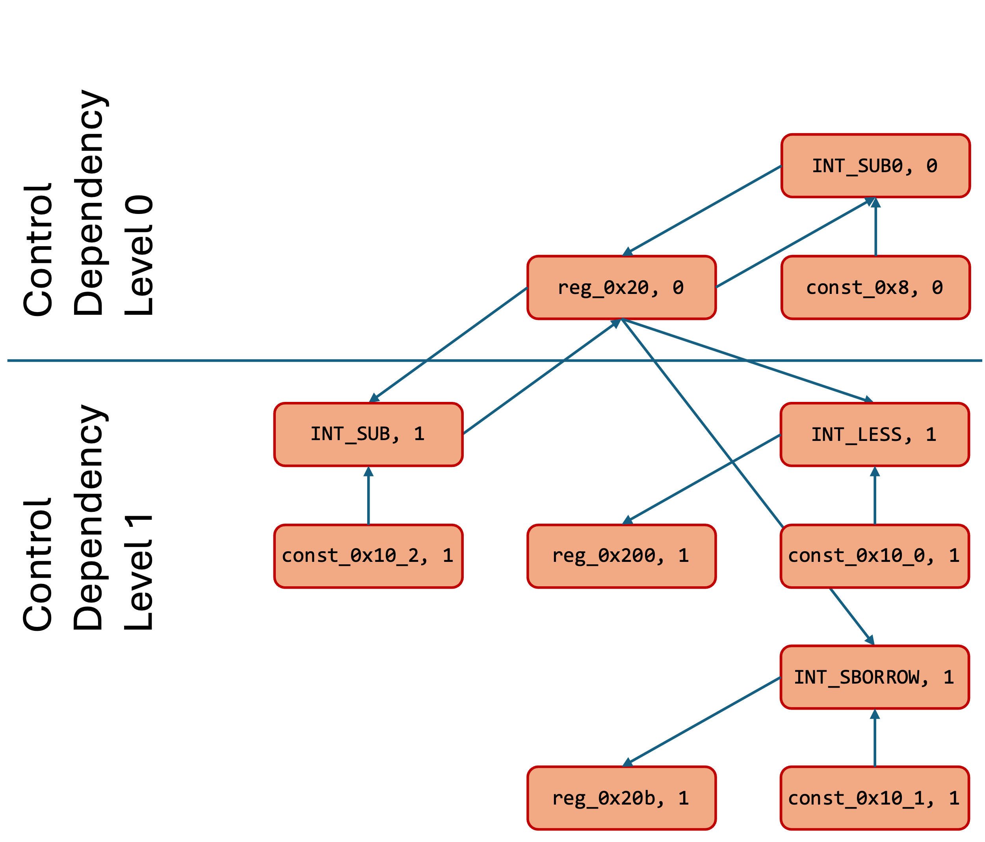
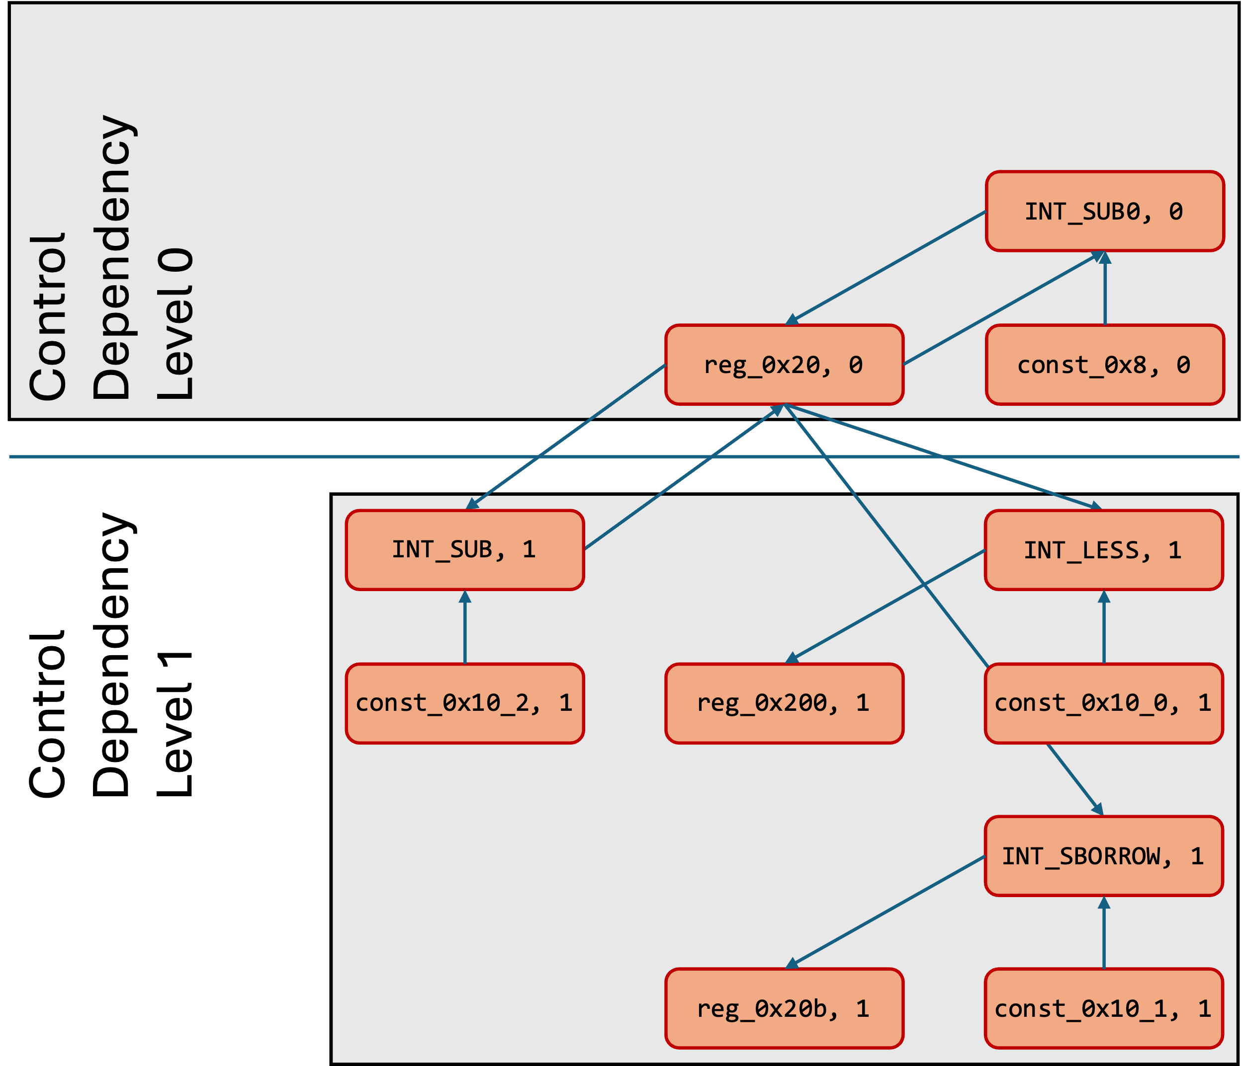
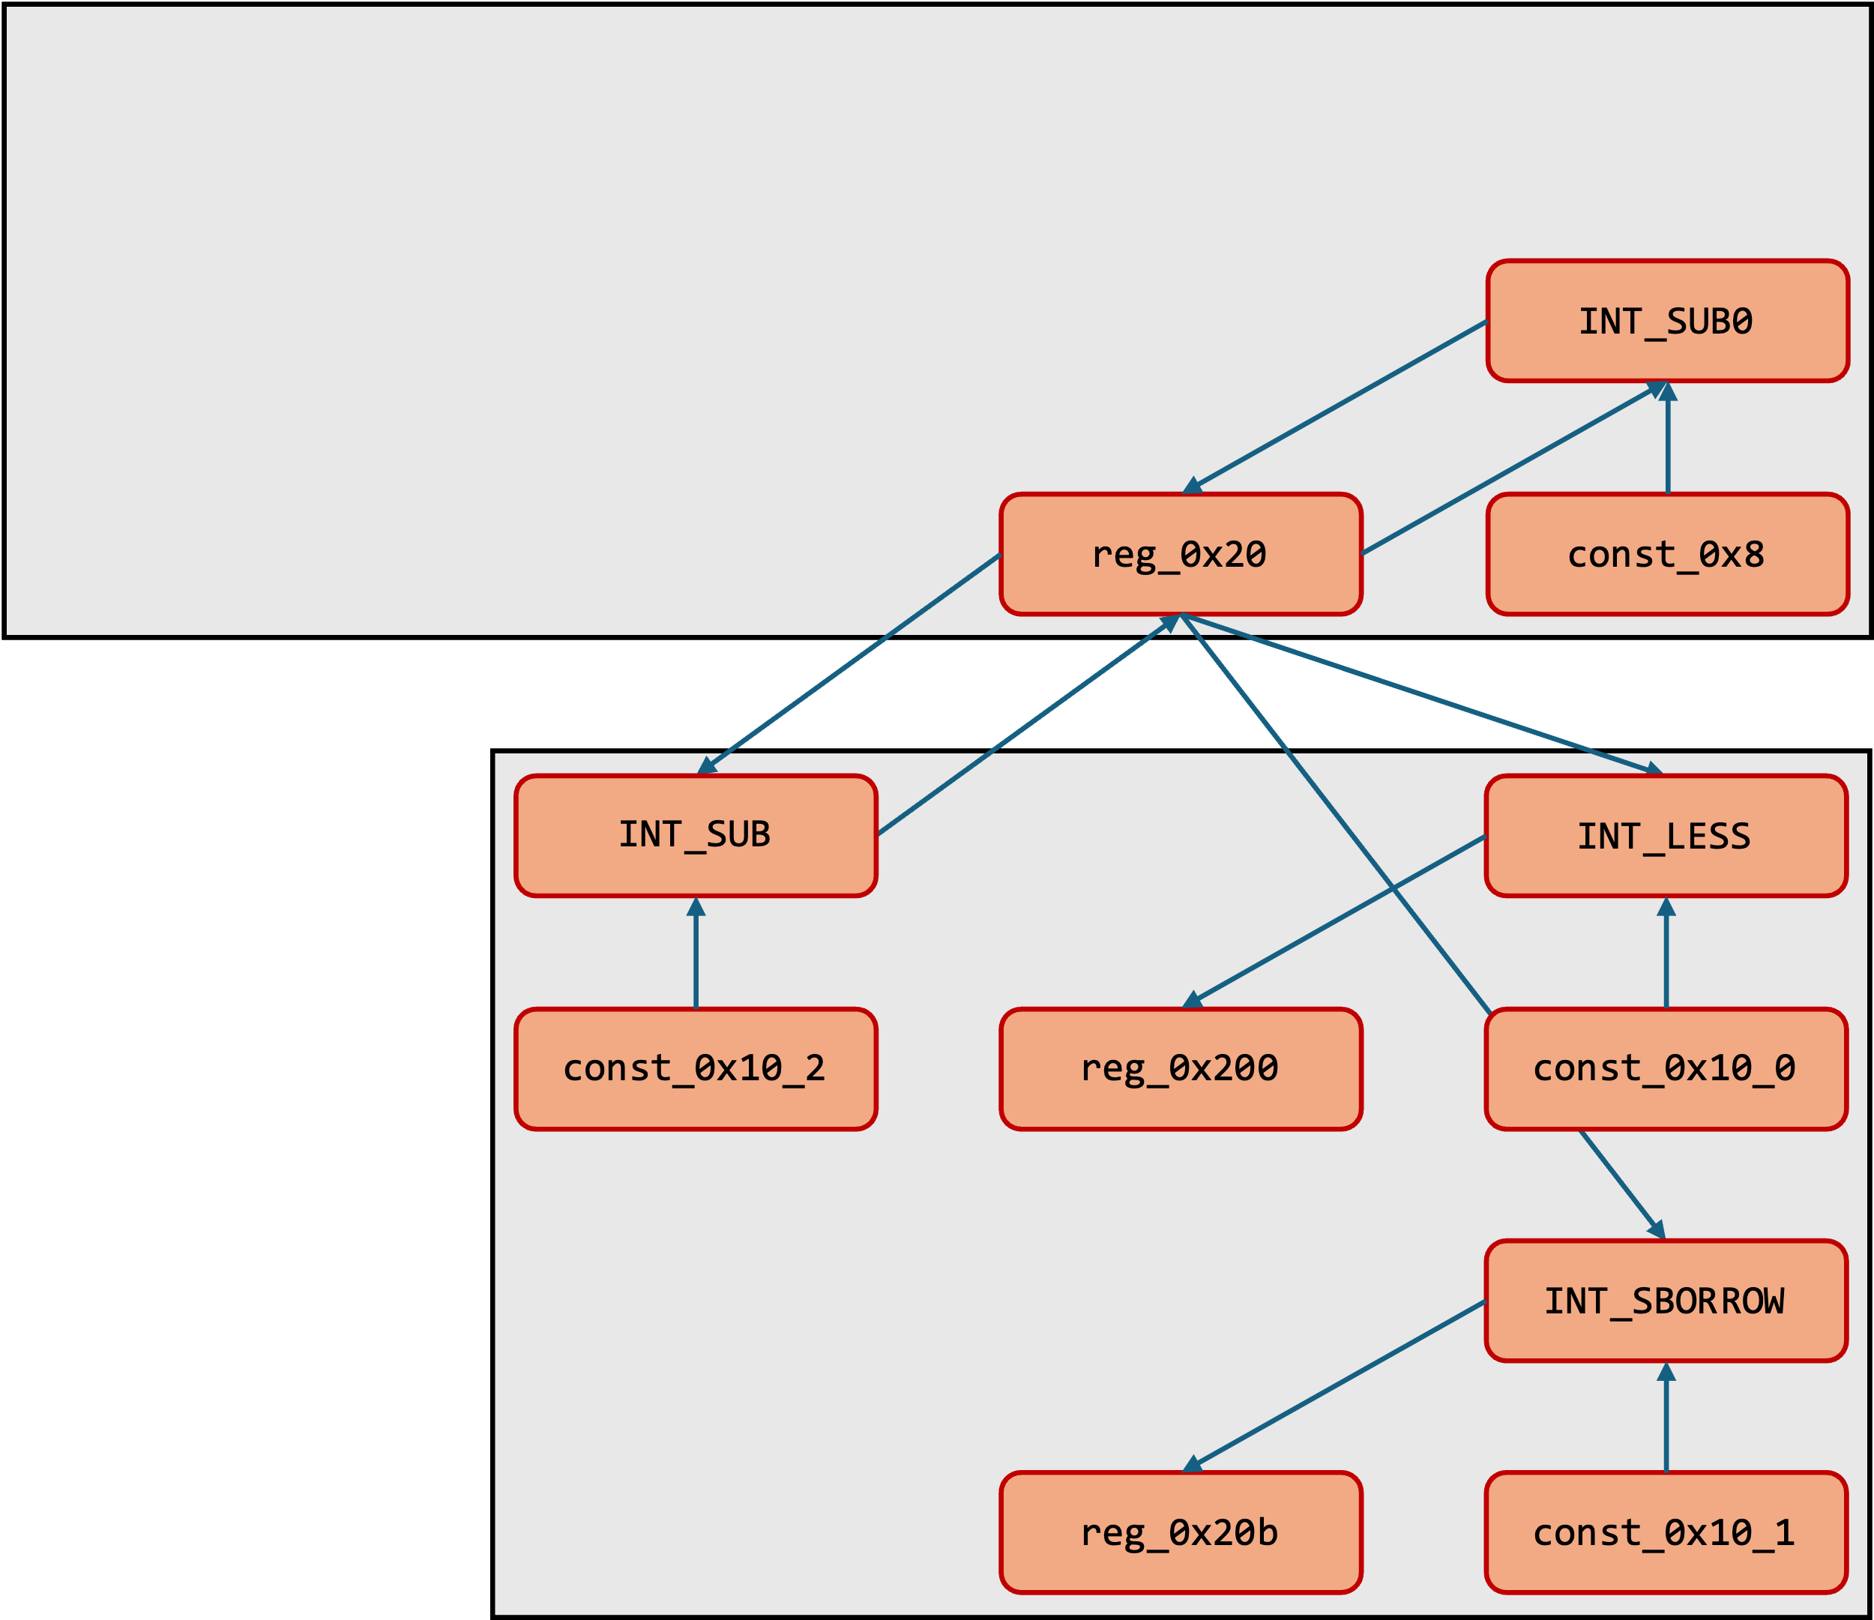
Final Steps…
Extend nodes with number of control dependency levels
One-hot feature encoding using node labels
Classifier uses Kipf architecture for GCNs (Kipf et al., ICLR 2017)

Slide 18
Our Central Contribution
New graph representation that captures both data and control dependencies
Technique to localize vulnerabilities in large function bodies
The rest of this talk:
How BinHunter works
How well does BinHunter work?
The rest of this talk:
How BinHunter works
How well does BinHunter work?

Slide 19
Experimental Setup
① Dataset
Juliet C / C++ Test Suite (NSA Center for Assured Software, 2012)
Focus on intraprocedural vulnerabilities
Require ≥100 samples in Test Set (#1)
Reduces to 17 CWEs, 24,725 Juliet binaries
Training
70%
Labelled samples of vulnerable code
118 CWEs
Preprocessor switches to obtain buggy and patched versions of code
Validation
15%
Manually curated collection of CVEs
Test Set (#1)
“Real-world” vulnerabilities
Correlating NVD database with Debian snapshots, 2015—2022
24 CVEs, 15 Debian packages
15%
Test Set (#2)

Slide 20
Experimental Setup
② Baselines
Genius (Feng et al., CCS 2016)
Asm2vec (Ding et al., SP 2019)
Jtrans (Wang et al., ISSTA 2022)
Bin2vec (Arakelyan et al., 2021)
Code search engines
Machine learning based techniques with applications to vulnerability discovery
Binary classifier

Slide 21
How Effective is BinHunter for Finding Bugs?
Bigger TPR is better
Smaller FPR is better
Notes:
cat effectiveness-juliet.tex | grep "^CWE" | sed 's/ *& */\t/g' | sed 's/ *\\\\$//' | sed 's/\\textbf{//g' | sed 's/}//g' | sed 's/ *//g' | sed 's/^CWE-//' | cut -f 1,3,4,15,16,13,14,17,18,11,12

Slide 22
How Effective is BinHunter in Finding Bugs?
BinHunter finds 17 of the 24 historical CVEs
Bin2vec finds 2 bugs
Remaining baselines are uniformly unsuccessful at finding bugs

Slide 23
How Well Does BinHunter Localize Bugs?
V = Set of vulnerable instructions (Ground truth)
S = Instructions flagged by BinHunter
Notes:
cat slice-size.tex | head -n 32 | sed 's/ *//' | grep "^CWE" | sed 's/ *\\\\//'| sed 's/ *& */\t/g' | cut -f 1,3,4
cat slice-size.tex | tail -n +34 | sed 's/ *//' | grep '^CVE' | sed 's/ *\\\\//' | sed 's/ *& */\t/g'

Slide 24
Conclusion
Our Central Contribution
New graph representation to capture both data and control dependencies
Technique to localize vulnerabilities in large function bodies
In the paper:
Details about constructing the representation
Implementation details
More experiments, ablation studies, etc.
Artifact: https://github.com/SimaArasteh/binhuntertool

Slide 25
void use_after_free() {
char *data = (char *)malloc(64); // Allocate memory
if (data == NULL) {
perror("Failed to allocate memory");
return;
}
strcpy(data, "This is a sensitive message."); // Use the memory
printf("Data stored: %s\n", data);
// Unrelated and distracting operations
log_event("User initialized the data storage.");
int result = perform_calculation(42, 58);
printf("Calculation result: %d\n", result);
char temp[32];
strncpy(temp, "Temporary buffer content", sizeof(temp) - 1);
temp[sizeof(temp) - 1] = '\0'; // Ensure null-termination
printf("Temporary data: %s\n", temp);
log_event("Intermediate operations completed.");
for (int i = 0; i < 3; i++) {
printf("Processing step %d...\n", i + 1);
}
free(data); // Free the allocated memory
printf("Memory freed.\n");
// Perform unrelated task to further obscure flow
char buffer[128];
printf("Enter some unrelated input: ");
fgets(buffer, sizeof(buffer), stdin);
printf("Unrelated input processed: %s", buffer);
// Use-after-free occurs here, far from the call to free()
printf("Reusing freed memory: %s\n", data);
}

Slide 26
const_0x1b1
unique_0xe780
COPY0
reg_0x28
STORE0
COPY1
INT_SUB0
reg_0x20
const_0x8
INT_SUB
INT_LESS
const_0x10_2
reg_0x200
const_0x10_0
INT_SBORROW
reg_0x20b
const_0x10_1

Slide 27
const_0x1b1
unique_0xe780
COPY0
reg_0x28
STORE0
COPY1
INT_SUB0
reg_0x20
const_0x8
INT_SUB
INT_LESS
const_0x10_2
reg_0x200
const_0x10_0
INT_SBORROW
reg_0x20b
const_0x10_1

Slide 28
INT_SUB0
reg_0x20
const_0x8
INT_SUB
INT_LESS
const_0x10_2
reg_0x200
const_0x10_0
INT_SBORROW
reg_0x20b
const_0x10_1

Slide 29
Control Dependency Level 0
INT_SUB0, 0
reg_0x20, 0
const_0x8, 0
INT_SUB, 1
INT_LESS, 1
Control Dependency Level 1
const_0x10_2, 1
reg_0x200, 1
const_0x10_0, 1
INT_SBORROW, 1
reg_0x20b, 1
const_0x10_1, 1

Slide 30
Control Dependency Level 0
INT_SUB0, 0
reg_0x20, 0
const_0x8, 0
INT_SUB, 1
INT_LESS, 1
Control Dependency Level 1
const_0x10_2, 1
reg_0x200, 1
const_0x10_0, 1
INT_SBORROW, 1
reg_0x20b, 1
const_0x10_1, 1

Slide 31
0x101275:(unique, 0xe780, 8) COPY (register, 0x28, 8)
0x101275:(register, 0x20, 8) INT_SUB (register, 0x20, 8), (const, 0x8, 8)
0x101275: --- STORE (const, 0x1b1, 4), (register, 0x20, 8), (unique, 0xe780, 8)
0x101275:(register, 0x20a, 1) COPY (const, 0x0, 1)
0x101276:(register, 0x28, 8) COPY (register, 0x20, 8)
0x101275:(unique, 0xe780, 8) COPY (register, 0x28, 8)
0x101275:(register, 0x20, 8) INT_SUB (register, 0x20, 8), (const, 0x8, 8)
0x101275: --- STORE (const, 0x1b1, 4), (register, 0x20, 8), (unique, 0xe780, 8)
0x101275:(register, 0x20a, 1) COPY (const, 0x0, 1)
0x101276:(register, 0x28, 8) COPY (register, 0x20, 8)
0x101279:(register, 0x200, 1) INT_LESS (register, 0x20, 8), (const, 0x10, 8)
0x101279:(register, 0x20b, 1) INT_SBORROW (register, 0x20, 8), (const, 0x10, 8)
0x101279:(register, 0x20, 8) INT_SUB (register, 0x20, 8), (const, 0x10, 8)
0x101279:(register, 0x207, 1) INT_SLESS (register, 0x20, 8), (const, 0x0, 8)
0x101279:(register, 0x206, 1) INT_EQUAL (register, 0x20, 8), (const, 0x0, 8)
0x101279:(unique, 0x12c00, 8) INT_AND (register, 0x20, 8), (const, 0xff, 8)
0x101279:(unique, 0x12c80, 1) POPCOUNT (unique, 0x12c00, 8)
0x101279:(unique, 0x12d00, 1) INT_AND (unique, 0x12c80, 1), (const, 0x1, 1)
0x101279:(register, 0x202, 1) INT_EQUAL (unique, 0x12d00, 1), (const, 0x0, 1)
0x101280: --- CALL (ram, 0x101030, 8), (register, 0x20, 8)
0x101279:(register, 0x200, 1) INT_LESS (register, 0x20, 8), (const, 0x10, 8)
0x101279:(register, 0x20b, 1) INT_SBORROW (register, 0x20, 8), (const, 0x10, 8)
0x101279:(register, 0x20, 8) INT_SUB (register, 0x20, 8), (const, 0x10, 8)
0x101279:(register, 0x207, 1) INT_SLESS (register, 0x20, 8), (const, 0x0, 8)
0x101279:(register, 0x206, 1) INT_EQUAL (register, 0x20, 8), (const, 0x0, 8)
0x101279:(unique, 0x12c00, 8) INT_AND (register, 0x20, 8), (const, 0xff, 8)
0x101279:(unique, 0x12c80, 1) POPCOUNT (unique, 0x12c00, 8)
0x101279:(unique, 0x12d00, 1) INT_AND (unique, 0x12c80, 1), (const, 0x1, 1)
0x101279:(register, 0x202, 1) INT_EQUAL (unique, 0x12d00, 1), (const, 0x0, 1)
0x101280: --- CALL (ram, 0x101030, 8), (register, 0x20, 8)

