Slide 1
Generating Function Names to Improve Comprehension of Synthesized Programs
Amirmohammad Nazari · Swabha Swayamdipta Souti Chattopadhyay · Mukund Raghothaman
University of Southern California

Slide 2
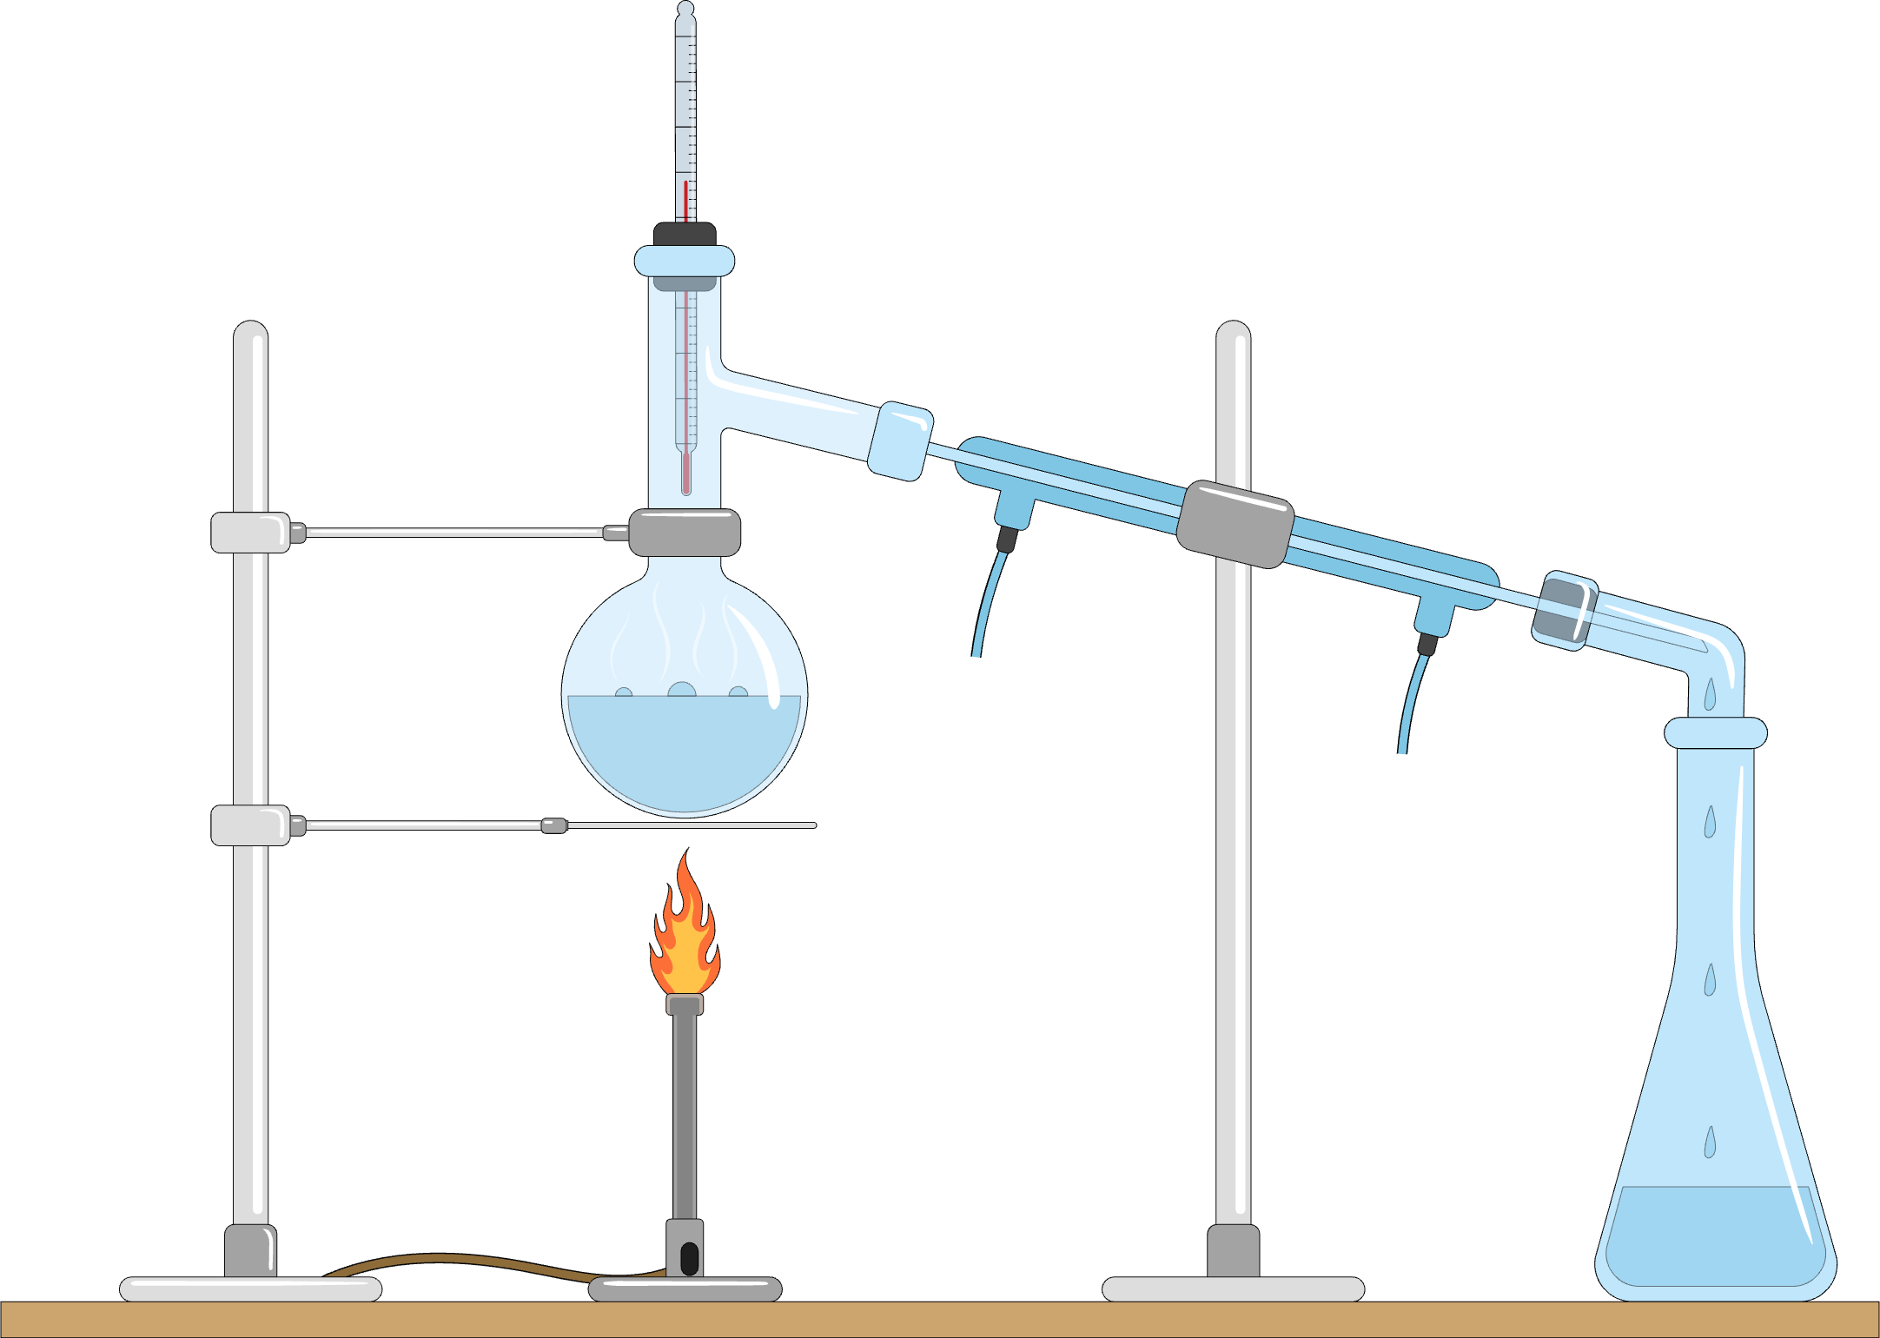
Program Synthesis
Specification, $φ$
Implementation, $f$
Examples, logical formulas, demonstrations, …
Guarantee that $f$ satisfies $φ$
Synthesizer
Explosion of work in the last ~15 years
Hope: Allow programmers to more freely express intent
Applications: Compilers, networking policies, robot control, end-user programming, …
Algorithms: (Probabilistic) Enumeration, conflict-driven learning, assembling libraries, …

Slide 3
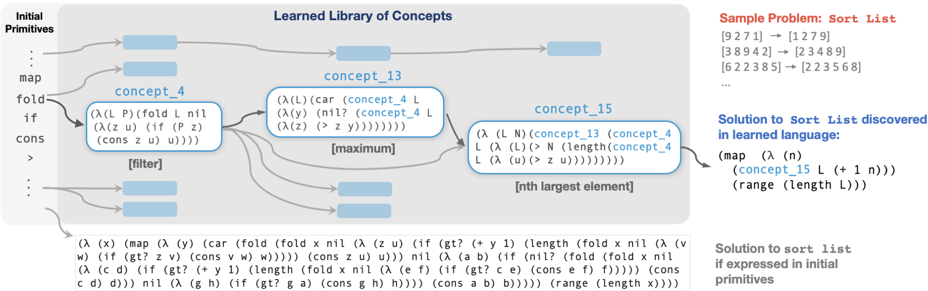
Example: Sorting a List of Numbers
Central Question of this Paper
How do we help the programmer understand the synthesized implementation?
[Ellis et al., PLDI 2021]
Program is
non-trivial
Authors provide helpful comments

Slide 4
Example: Sorting a List of Numbers
Simple idea: Ask an LLM to suggest meaningful function names
Question: Are these names appropriate?
f | = | (λ (l) (map (λ (n) (c15 l (+ 1 n))) (range (len l))))
c15 | = | (λ (l n) (c13 (c4 l (λ (z) (> n (len (c4 l (λ (u) (> z u)))))))))
c13 | = | (λ (l) (car (c4 l (λ (y) (nil? (c4 l (λ (z) (> z y))))))))
c4 | = | (λ (l p) (fold l nil (λ (z u) (if (p z) (cons z u) u))))
“largestSmallestIndices”
“getHighestValueInList”

Slide 5
Baseline Effectiveness
144 specification–implementation pairs
344 subroutines
Manually written reference names
Credit if Jaro similarity > 0.7

Slide 6
Baseline User Understanding
18 / 2 = 9 participants
Mixture of experience: Undergrad, Masters, Ph.D. students
Average scores from three experts
“What does c13 do?”
“c15?”
“f?”
“Result of evaluating (f (3 8 9 4 2))?”

Slide 7
User Preferences
18 participants, different from before
13 subroutines
“How appropriate is this name for this function?”

Slide 8
Rest of This Talk
Question: How to get more trustworthy name suggestions?
Introduction
Reverse-engineering with print statements
Validating name proposals
Conclusion
Question: How to get more trustworthy name suggestions?
Introduction
Reverse-engineering with print statements
Validating name proposals
Conclusion

Slide 9
Simple Interventions
Possible Conclusion: (c13 l) identifies the largest element of the list l
f | = | (λ (l) (map (λ (n) (c15 l (+ 1 n))) (range (len l))))
c15 | = | (λ (l n) (c13 (c4 l (λ (z) (> n (len (c4 l (λ (u) (> z u)))))))))
c13 | = | (λ (l) (car (c4 l (λ (y) (nil? (c4 l (λ (z) (> z y))))))))
c4 | = | (λ (l p) (fold l nil (λ (z u) (if (p z) (cons z u) u))))
(print l)
(print out)
l | ↦ | (f l)
(9 2 7 1) |  | (1 2 7 9)
Global Specification
l | ↦ | (c13 l)
(1) |  | 1
(2 1) |  | 2
(2 7 1) |  | 7
(9 2 7 1) |  | 9
Observations of c13
“Subspecification” of c13

Slide 10
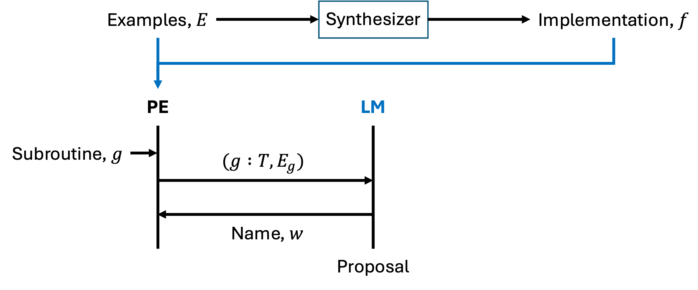
Prompt Expansion Using Subspecs
Prompt:
Suggest a name for the function $g$
Observe that $g$ has type $T$
Also observe that $g\left(⋯\right)=…$
Subspec of $g$

Slide 11
Effectiveness of Prompt Expansion
144 specification–implementation pairs
344 subroutines
Manually written reference names
Credit if Jaro similarity > 0.7

Slide 12
User Preferences
18 participants, different from before
13 subroutines
“How appropriate is this name for this function?”

Slide 13
Rest of This Talk
Question: How to get more trustworthy name suggestions?
Introduction
Reverse-engineering with print statements
Validating name proposals
Conclusion
Question: How to get more trustworthy name suggestions?
Introduction
Reverse-engineering with print statements
Validating name proposals
Conclusion

Slide 14
Validating Suggested Names
Prompt expansion with subspecs helps, but still …
Problem: No way to algorithmically distinguish appropriate and inappropriate names
Insight: If the name captures “essential” features of the subroutine, then it is appropriately chosen

Slide 15
Validating Suggested Names
Insight: If the name captures “essential” features of the subroutine, then it is appropriately chosen
f | = | (λ (l) (map (λ (n) (c15 l (+ 1 n))) (range (len l))))
c15 | = | (λ (l n) (c13 (c4 l (λ (z) (> n (len (c4 l (λ (u) (> z u)))))))))
c13 | = | (λ (l) (car (c4 l (λ (y) (nil? (c4 l (λ (z) (> z y))))))))
c4 | = | (λ (l p) (fold l nil (λ (z u) (if (p z) (cons z u) u))))
f' | = | (λ (l) (map (λ (n) (c15' l (+ 1 n))) (range (len l))))
c15' | = | (λ (l n) (c13' (c4 l (λ (z) (> n (len (c4 l (λ (u) (> z u)))))))))
c13' | = | (λ (l) (max l))
c4 | = | (λ (l p) (fold l nil (λ (z u) (if (p z) (cons z u) u))))
We believe: (c13 l) identifies the largest element of the list l
Hypothesis: If f' still satisfies the spec, then max is very likely a good name for c13
l | ↦ | (f l)
(9 2 7 1) |  | (1 2 7 9)
Global Specification

Slide 16
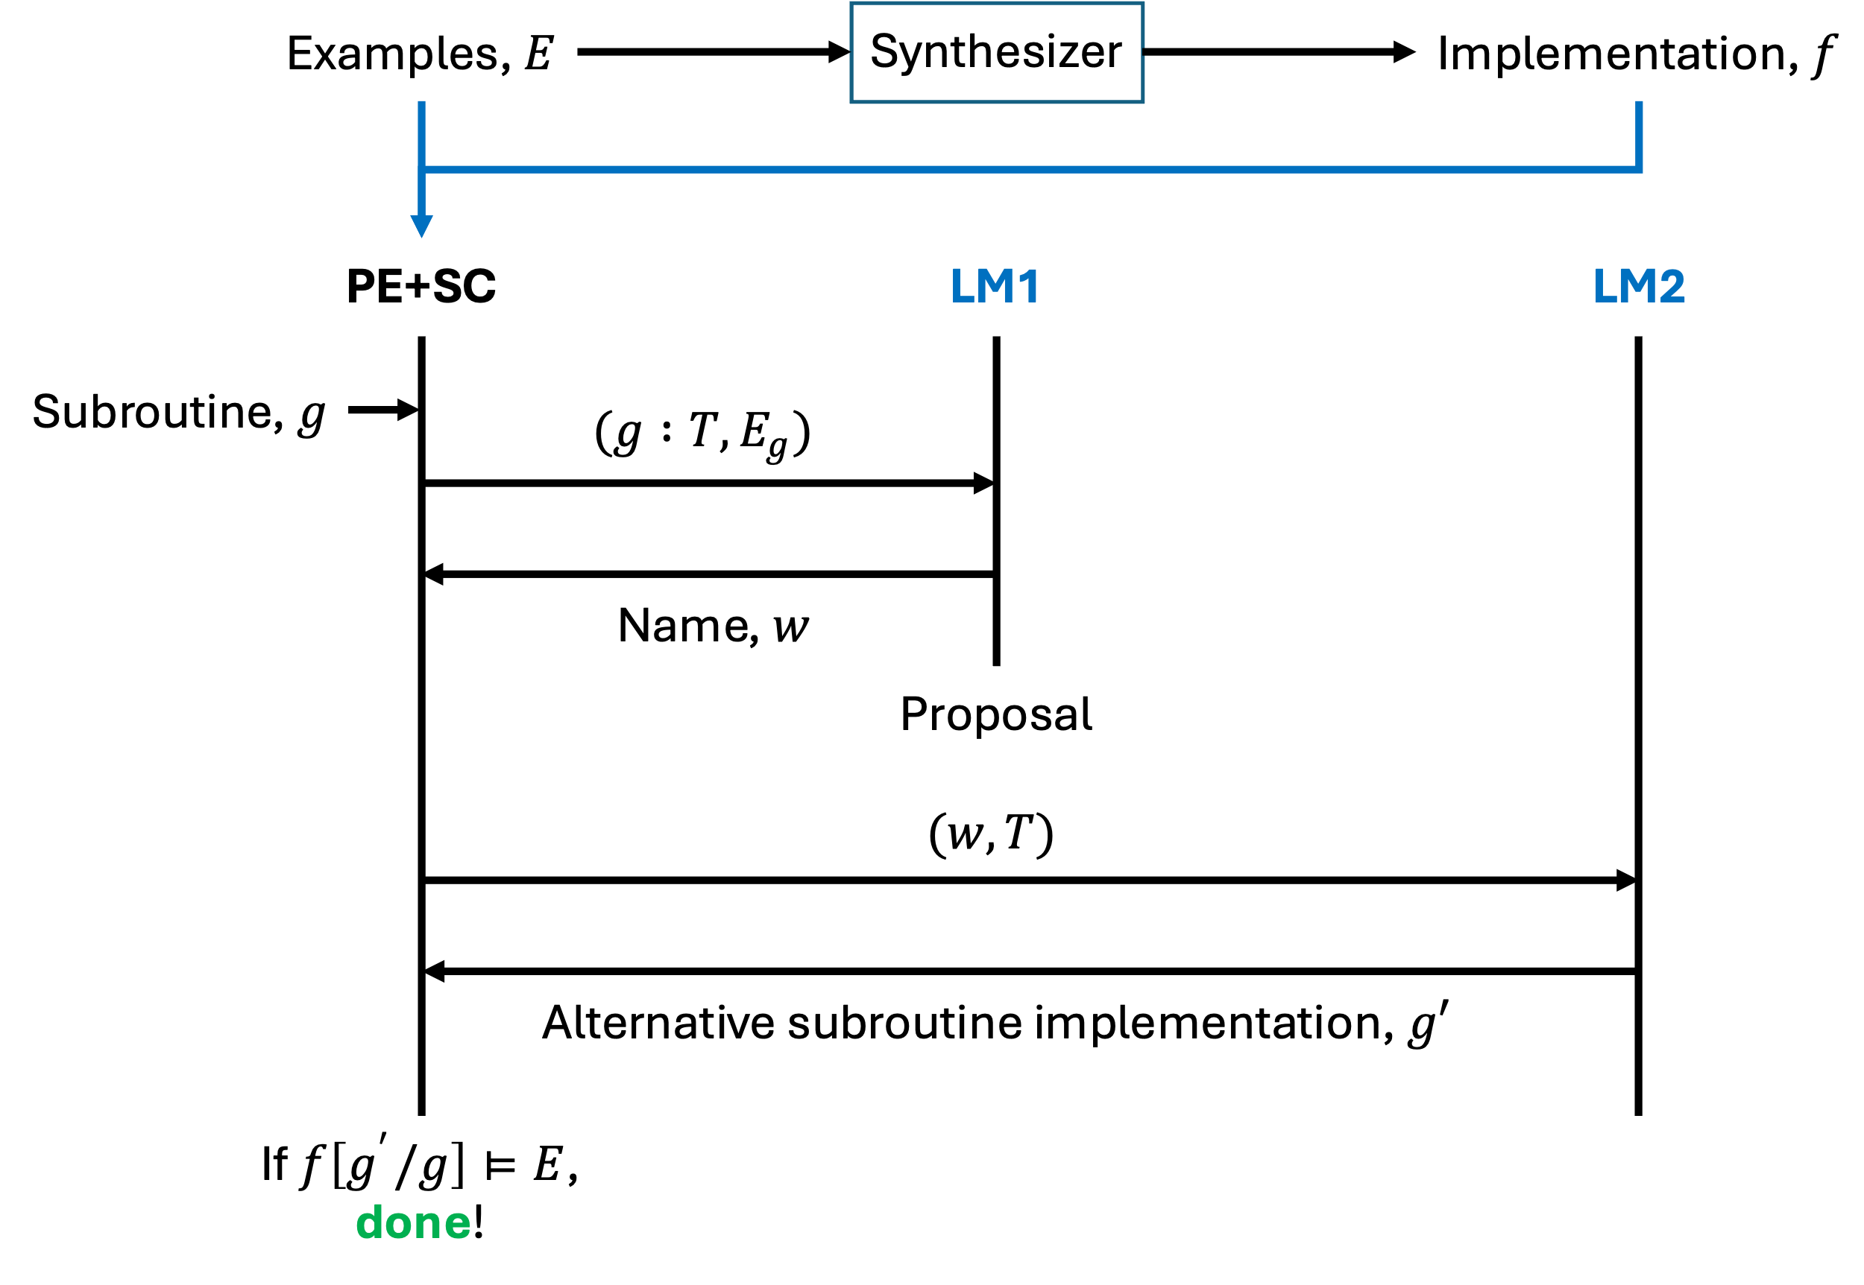
Algorithmic Sanity Checks
Use second language model to validate name

Slide 17
Effectiveness of Algorithmic Sanity Checks
We pay for higher accuracy with a diminished response rate

Slide 18
User Preferences
18 participants, different from before
13 subroutines
“How appropriate is this name for this function?”

Slide 19
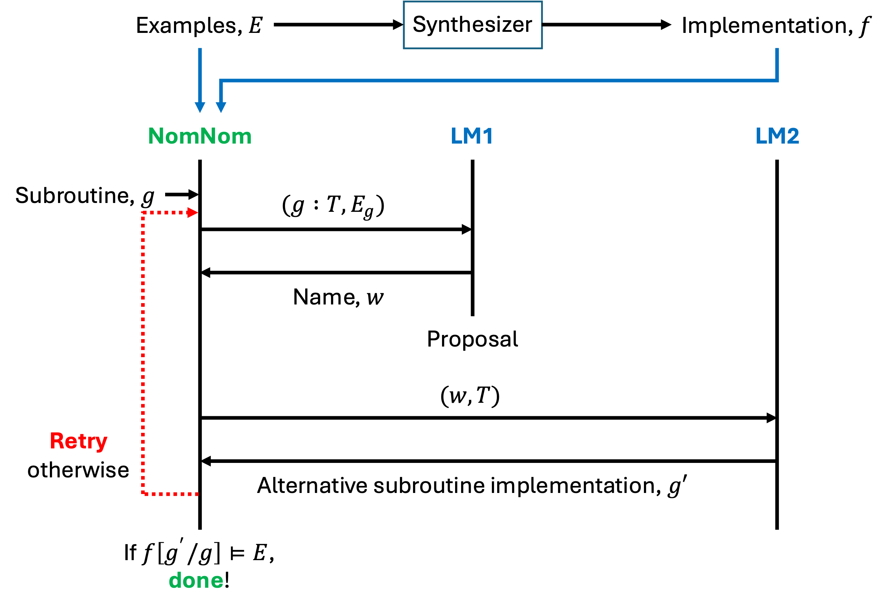
Final Loop: NomNom
Retry upon failure

Slide 20
Effectiveness
Retries restore response rate
Some additional optimizations

Slide 21
User Preferences
18 participants, different from before
13 subroutines
“How appropriate is this name for this function?”

Slide 22
Measuring User Understanding
Average score increases by 2.5×
Notes:
(.81 - .23) / .23 ~= 2.5

Slide 23
Quotations and Anecdotes
Baseline is unhelpful:
“Hard to understand code … not written by humans … function names could not help us”
“Difficult to follow logical paths because of similar and meaningless names …”
Higher-order functions are hard:
“Pretty difficult, especially for functions in functions”
“Nested functions … especially if input to the function is a function itself”
NomNom helps:
“Questions were hard … [but] function names made them easier”
“When functions had informative names, easy to infer functionality, assuming that the names were correct”

Slide 24
Rest of This Talk
Question: How to get more trustworthy name suggestions?
Introduction
Reverse-engineering with print statements
Validating name proposals
Conclusion
Question: How to get more trustworthy name suggestions?
Introduction
Reverse-engineering with print statements
Validating name proposals
Conclusion

Slide 25
Limitations and Threats to Validity
NomNom only generates identifier (function) names
Are function names sufficient to improve comprehension?
Outstanding problem: How to generate trustworthy comments?
Issues with experimental methodology:
We wrote reference names
Validated by visiting student researcher
What if input-output examples are missing?

Slide 26
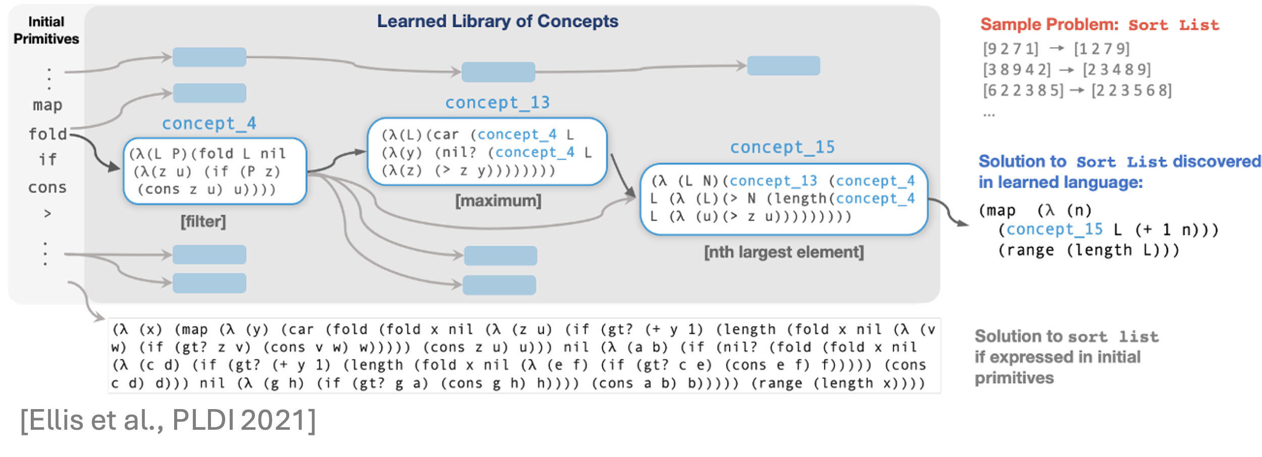
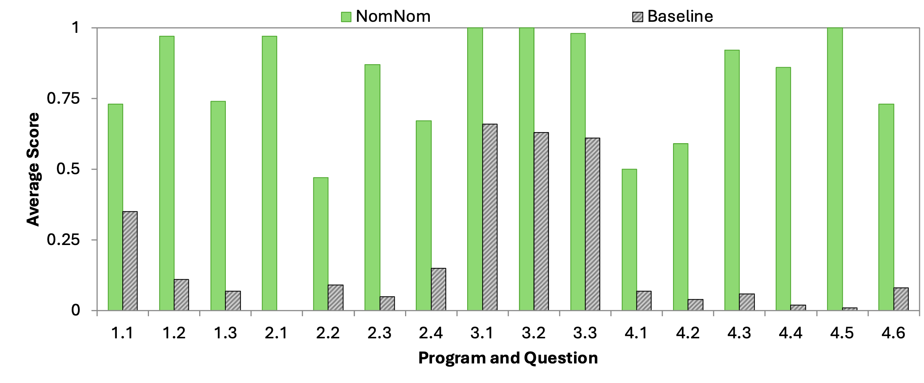
Conclusion
Program synthesizers produce inscrutable code
Idea ①: Poke implementation using subspecs / print statements
Idea ②: Validate suggestions by back-generating implementation
Massive increases in user performance

Slide 27
Examples, $E$
Synthesizer
Implementation, $f$
NomNom
LM1
LM2
Subroutine, $g$
$$(g :T, E_{g})$$
Name, $w$
Proposal
$$(w, T)$$
Retry otherwise
Alternative subroutine implementation, $g′$
If $f\left[g^{′}/g\right]⊨E$, done!

Slide 29
Effectiveness

Slide 30
Measuring User Understanding

Slide 31
User Preferences

