Slide 1
CSCI 431: An Introduction to Functional Programming
Welcome and Introduction
Mukund Raghothaman
Fall 2024

Slide 2
About This Course
We’ll study several different programming languages
What languages do you know?
What makes them different?

Slide 3

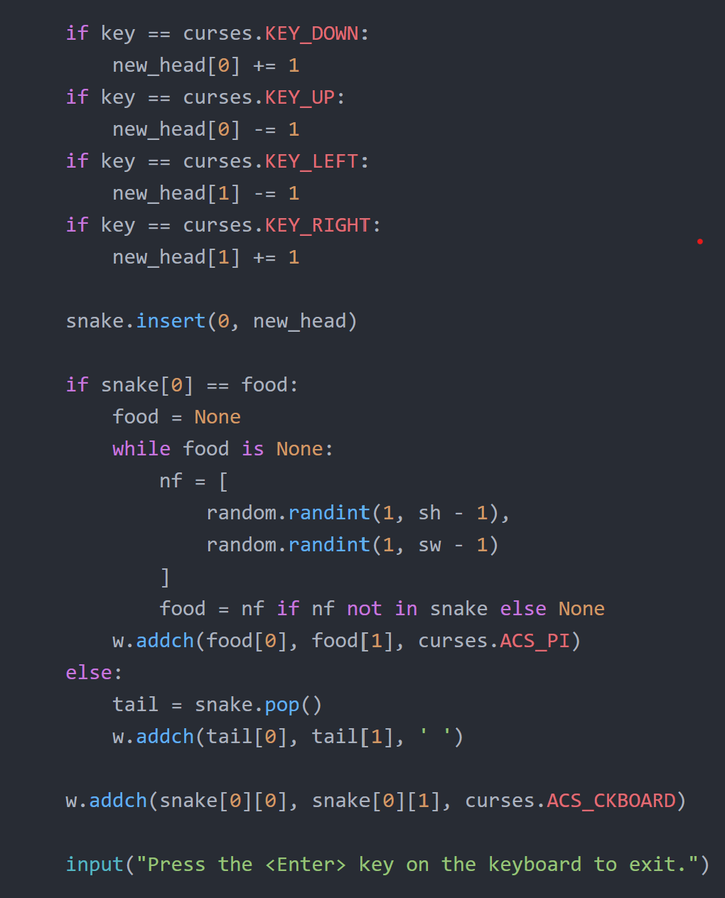
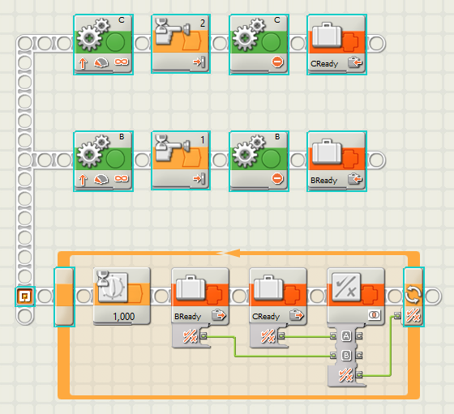
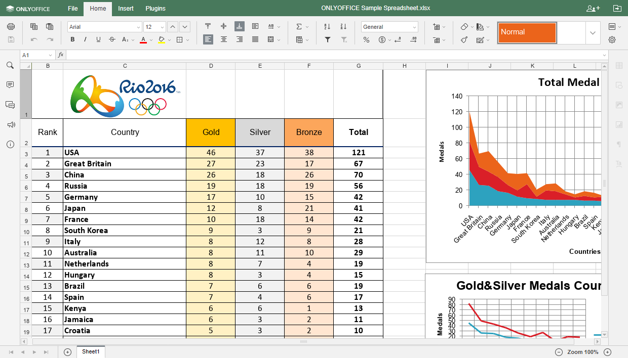
About This Course
What is a programming language?
Notation for specifying computations

Slide 4
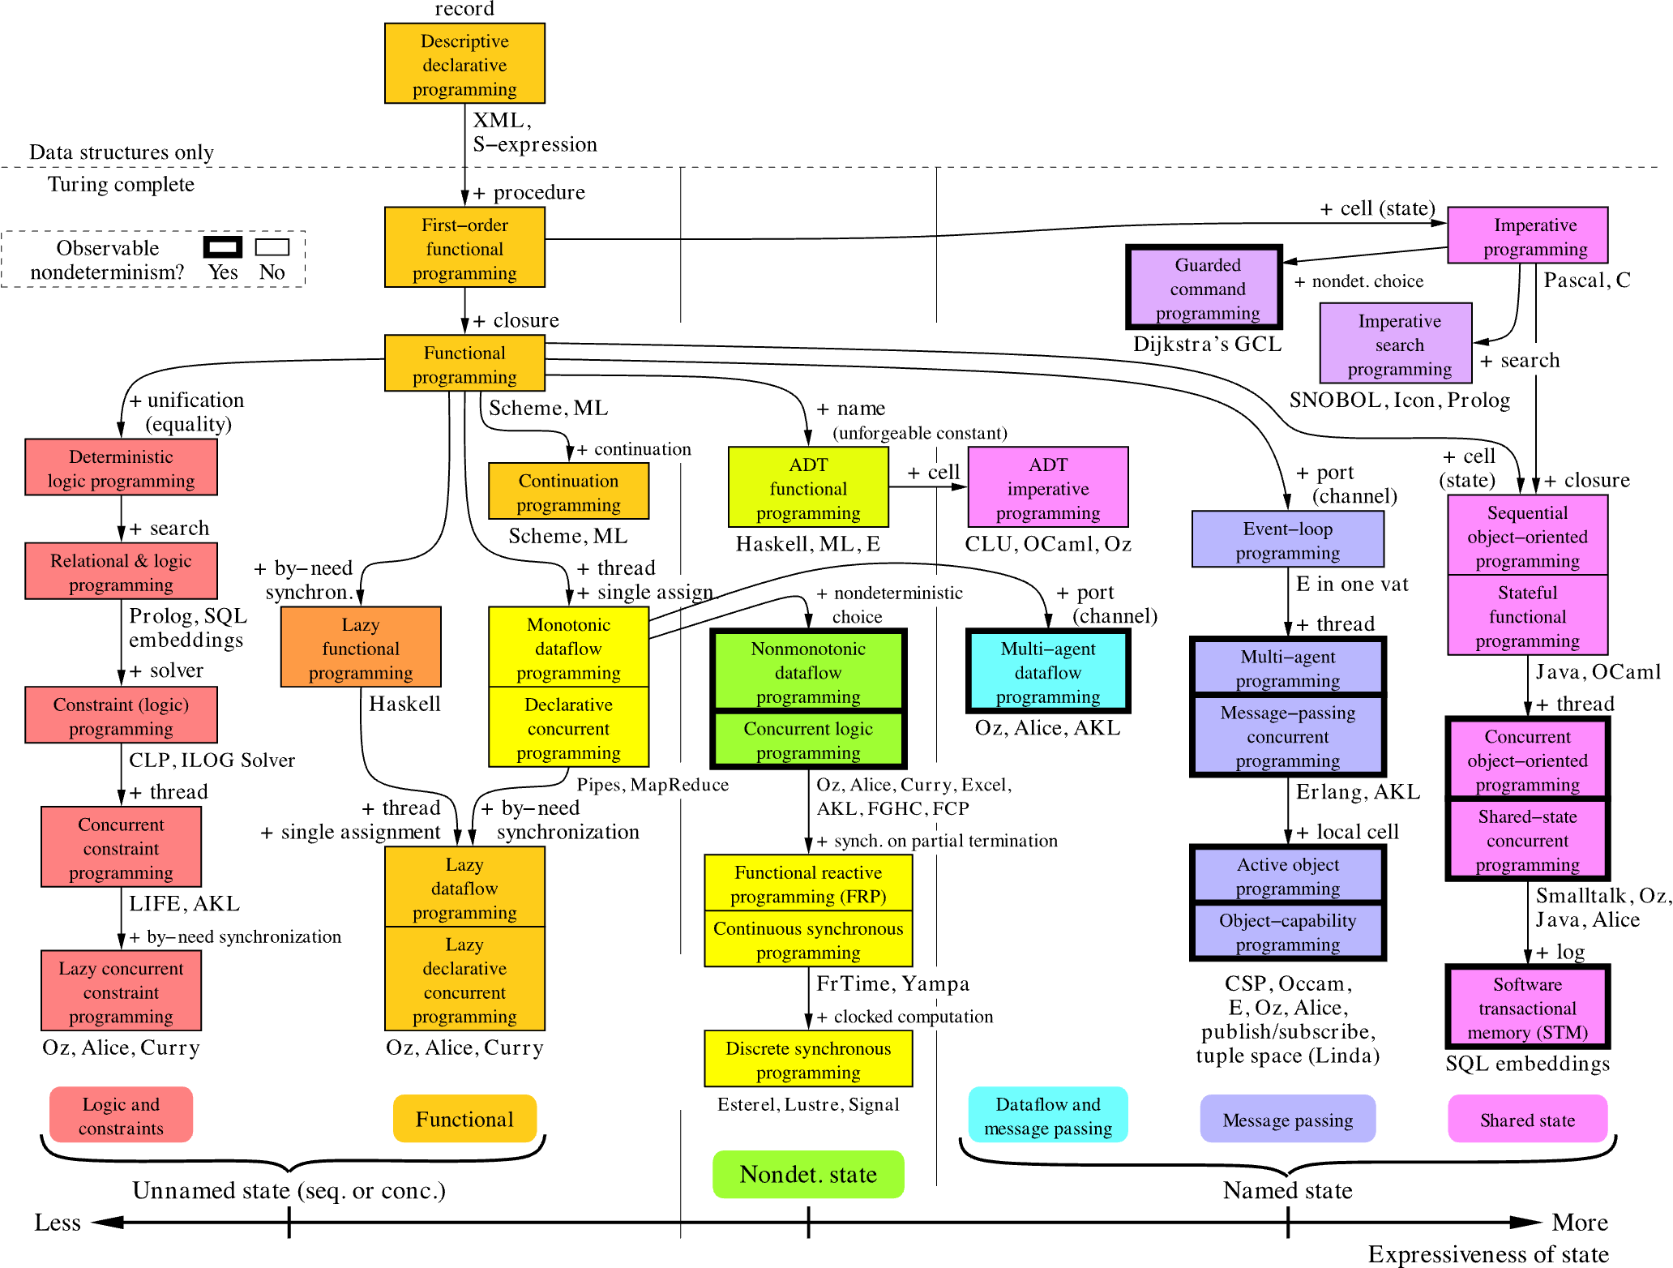
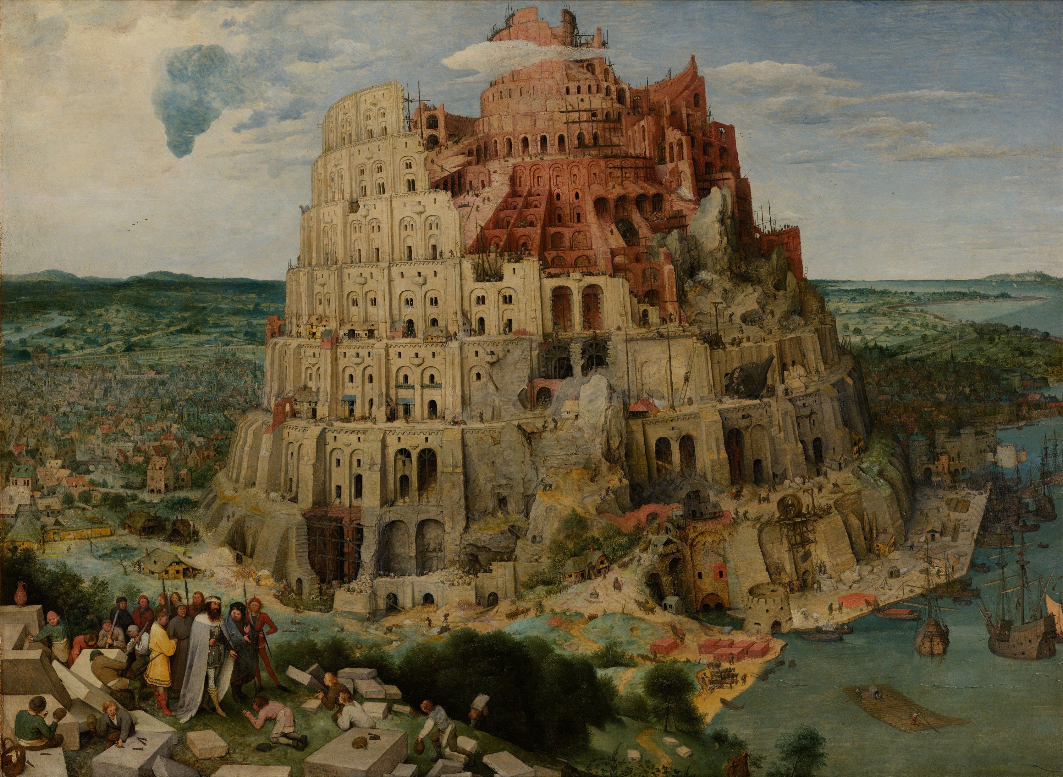

About This Course
Why so many languages?

Slide 5
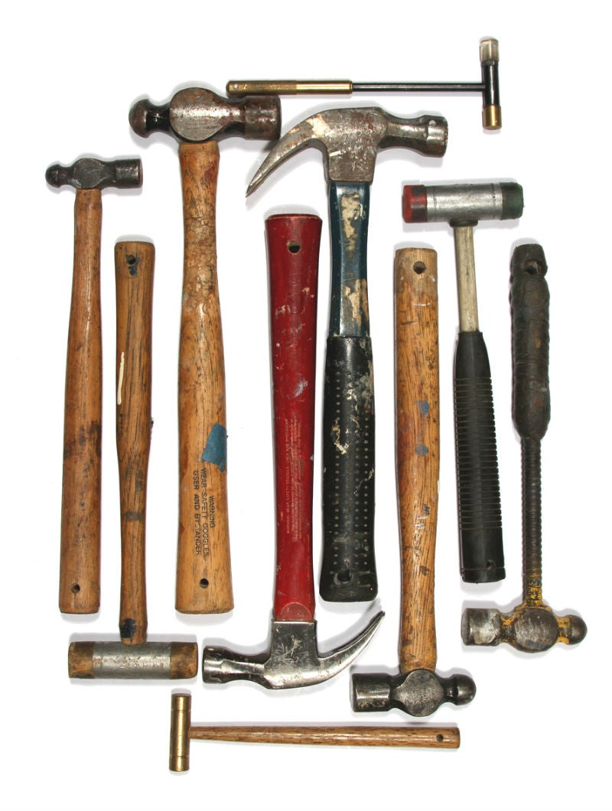
Why So Many Languages?
Different languages for different tasks
  Verilog for describing hardware
  Assembly for low-level computations
  JavaScript for manipulating the DOM

Slide 6

Why Study Programming Languages?
Linguistic Relativity: Structure of a language affects the speaker’s thought
Radiolab podcast on colors in ancient texts: https://radiolab.org/episodes/211213-sky-isnt-blue
“A language that doesn't affect the way you think
about programming, is not worth knowing.”
--- Alan Perlis, Epigrams on Programming

Slide 7
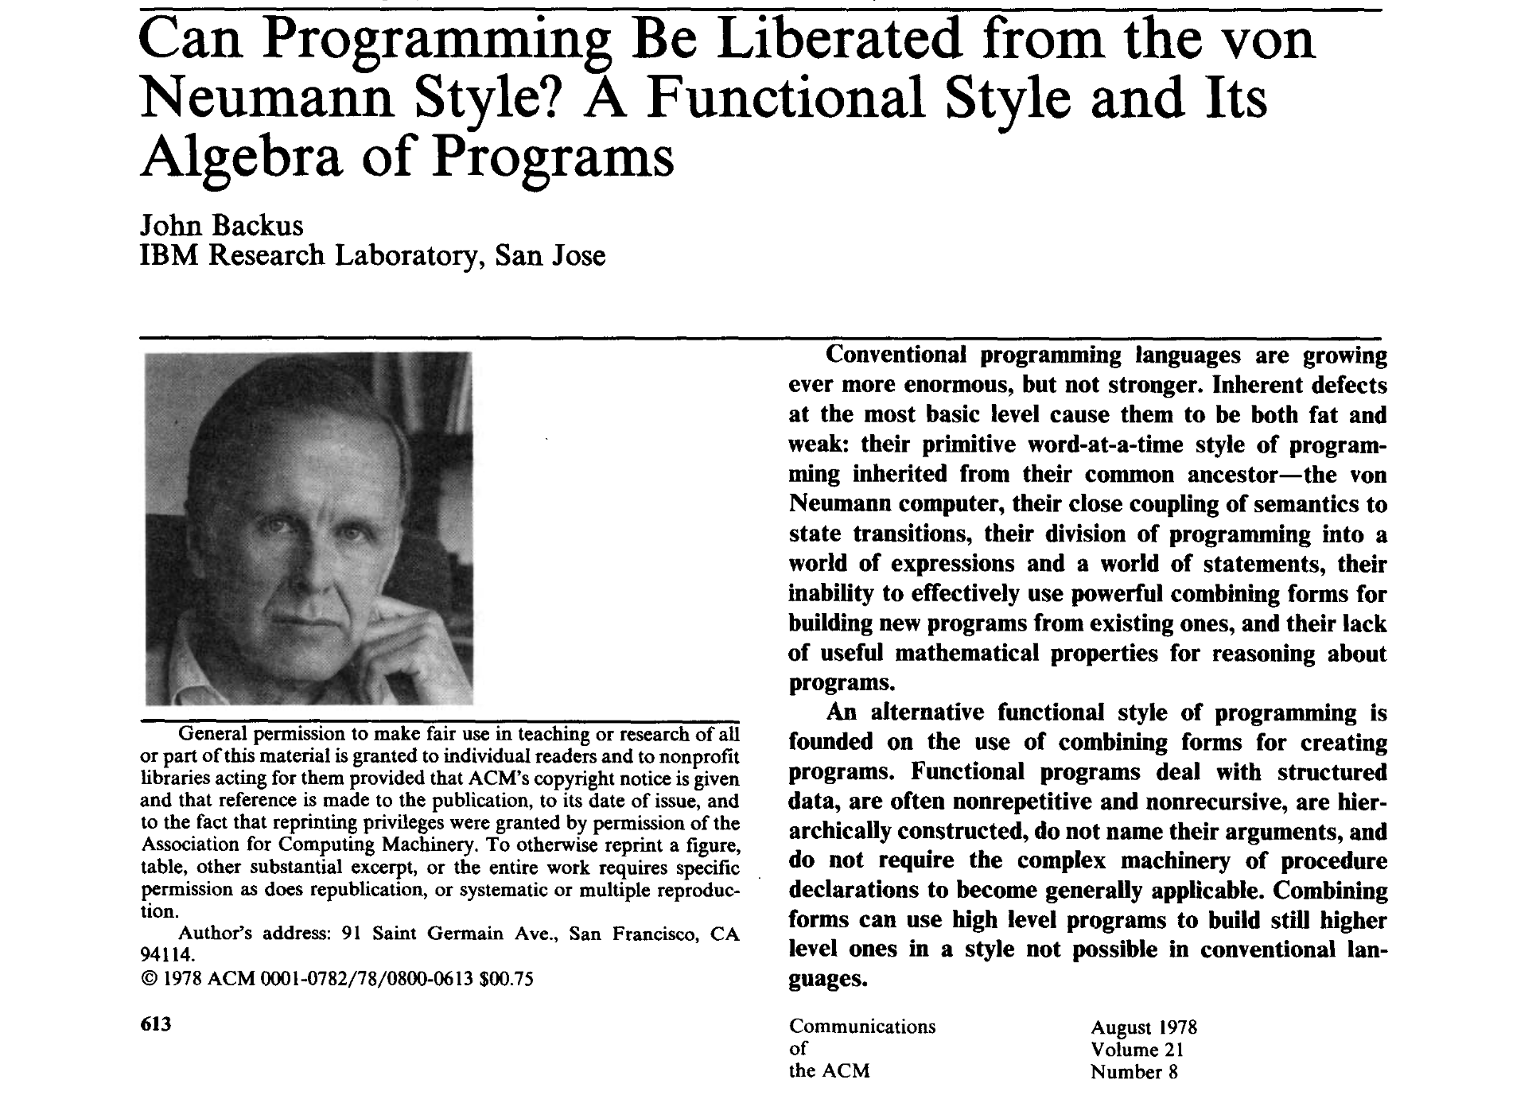
Why Study Programming Languages?

Slide 8

Our Goals in this Course
Make you better programmers …
… by exposing you to powerful new languages and programming constructs
Demystify some of the magic
Make you informed leaders who can influence technical decisions
Change the way you think about computation

Slide 9
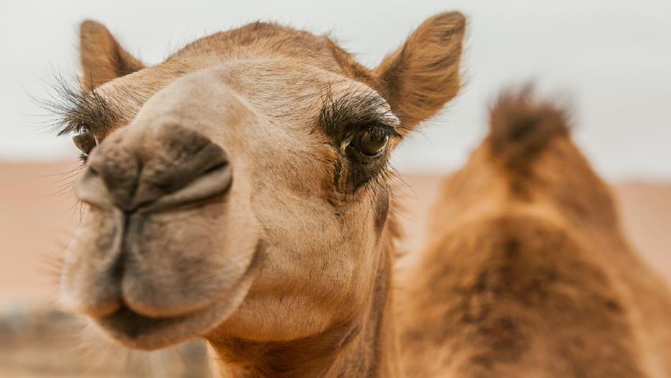
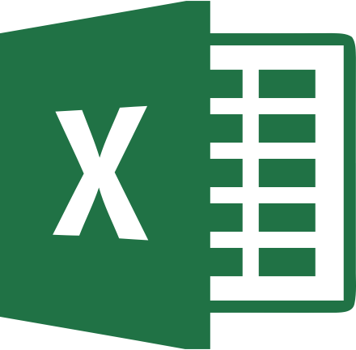

Ideas to Take Away
Unit 1
Functional Programming
Immutable data
First-class functions
Static types
Pattern matching
Unit 2
Language Implementation
Processing syntax
Type inference
Garbage collection
Unit 3
Relational Programming
Spreadsheets and DAGs
Declarative languages
Recursive queries

Slide 10
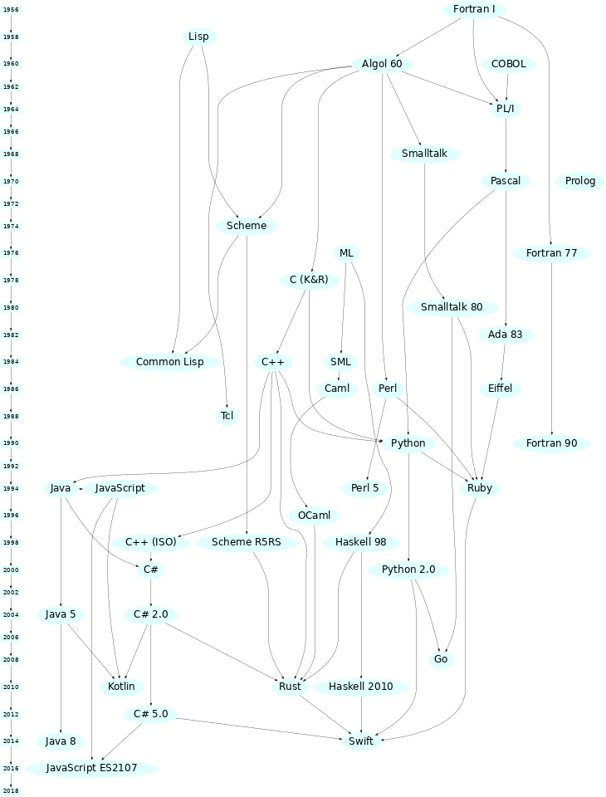
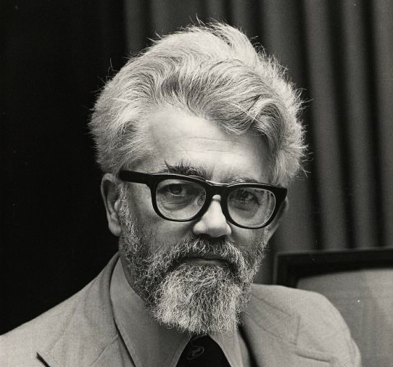
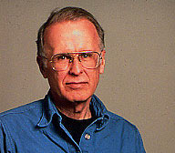
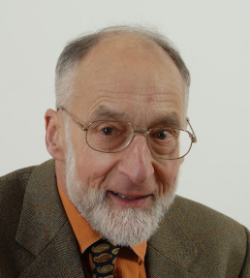
History of Programming Languages
John McCarthy
1927—2011
Turing Award 1971
John Backus
1924—2007
Turing Award 1977
Robin Milner
1934—2010
Turing Award 1991
OCaml
[Pascal Rigaux]

Slide 11
Why Functional Programming?
Encourage immutability
Programs are easier to think about
Algebraic data types and pattern matching
Elegant ways to construct and destruct data
First-class functions
Functions can be passed around just like values
Static type checking
Programs have fewer bugs
Automatic type inference
Make the compiler work for you
Parametric polymorphism
Can generalize computation across many types
Garbage collection
Make the runtime work for you
Modules
Elegant ways of structuring large systems

Slide 12
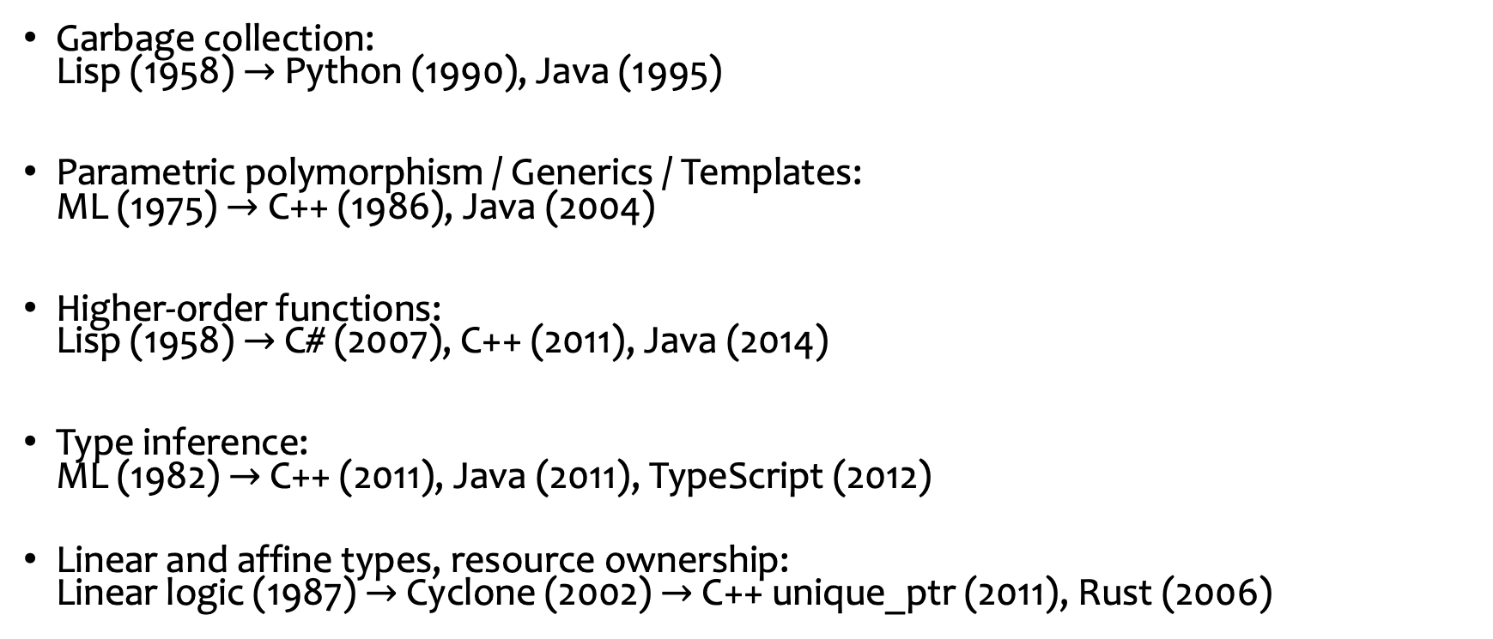
Functional Influences on Programming Practice
Garbage collection:
Lisp (1958) $→$ Python (1990), Java (1995)
Parametric polymorphism / Generics / Templates:
ML (1975) $→$ C++ (1986), Java (2004)
Higher-order functions:
Lisp (1958) $→$ C# (2007), C++ (2011), Java (2014)
Type inference:
ML (1982) $→$ C++ (2011), Java (2011), TypeScript (2012)
Linear and affine types, resource ownership:
Linear logic (1987) $→$ Cyclone (2002) $→$ C++ unique_ptr (2011), Rust (2006)

Slide 13




Functional Programming in Industry
OCaml: Jane Street, Bloomberg, Citrix
Scala: X (formerly Twitter), Foursquare, LinkedIn
Haskell: Facebook, Barclays, AT&T
Erlang: WhatsApp, Amazon, T-Mobile
See StackOverflow Developer Survey for
economic motivation 🤑
More recently: Lean + Mathlib, AlphaProof

Slide 14
Today’s Plan
Motivation and Overview
Course Logistics
Diving into OCaml

Slide 15
Textbooks
Yaron Minsky, Anil Madhavapeddy, and Jason Hickey
Real World OCaml
Michael Clarkson
OCaml Programming: Correct + Efficient + Beautiful
Harold Abelson, Gerald Jay Sussman, and Julie Sussman
Structure and Interpretation of Computer Programs
All books are open access

Slide 16
Classes and Office Hours
Tuesdays and Thursdays
4pm—5:50pm Los Angeles time
Will be streamed over Zoom, recorded*
Website: https://r-mukund.github.io/teaching/fa2024-csci431/
Office Hours:
  Fridays, 4pm—5:50pm
  Or by appointment

Slide 17
Assessment (1)
3 homework assignments × 17% each = 50%
2 quizzes and 1 final exam, 17% each = 50%
  You are allowed to consult one handwritten letter paper-sized crib sheet
Welcome to collaborate with a partner on homeworks
But! Identify your partner, write answers by yourselves
GPT / LLM policy
  Welcome to use
  But… (1) clearly reflect on why you used it (or not). And how it was helpful. Tell us
  That said, (2) this policy is experimental. Subject to change at any time
  (2) No technology access during quizzes or exams

Slide 18
Assessment (2)
HW0 is posted to Brightspace
Not graded
Due at 10pm, Monday, 2 September 2024
Going forward…
Assignments due 10pm on Monday after unit is complete
Reference solutions will be posted on Wednesday at 2pm
Submissions after reference solutions are posted will not be graded
Talk to us in advance if you are unable to submit an assignment on time

Slide 19
Accommodations
Talk to me if you:
  are unable to submit an assignment on time,
  are finding it difficult to keep up,
  need any help to make the most of this course, or
  want to bring anything to my attention

Slide 20
About Me
Mukund Raghothaman
PhD from UPenn, 2017
Joined USC in Fall 2019
Research Area: “How do we reason about programs?”
Find bugs; prove correctness; synthesize code!
Can data (i.e., GitHub) help?
Can we use probabilities and / or machine learning?

Slide 21
Tell Us About Yourselves
Name, program
Background in programming
Languages you have used + Familiarity

Slide 22
For Next Class
Install OCaml on your computers
Start work on Homework 0, due 10pm, Monday, 2 September
Reading:
  RWO, Chapter 1: Guided Tour
  MC, Chapters 1, 2

