Slide 1
Program Synthesis and Computer-Aided Verification
CSCI 625 · Spring 2025
Mukund Raghothaman
https://r-mukund.github.io/teaching/sp2025-csci625/

Slide 2




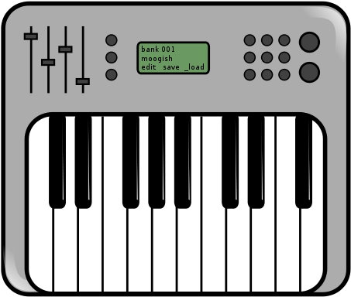
∃∀
⇒⊢
“What should my program do?”
“Does my program do that?”
“What does it do instead?”
Programmer
“How do I fix it?”

Slide 3
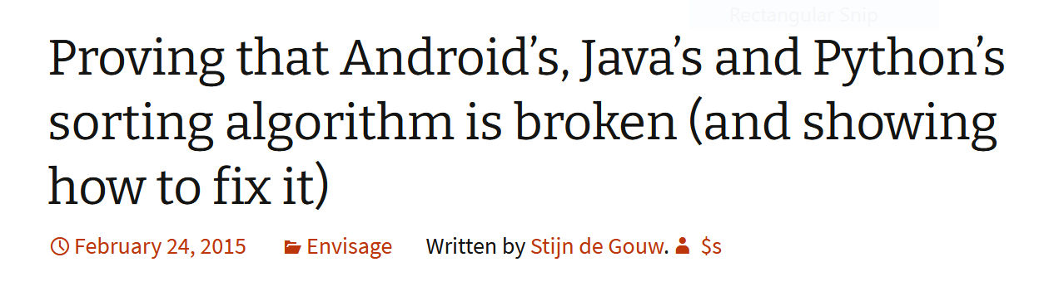
A Simple Program
algorithm quicksort(A, lo, hi) is
if lo < hi then
p := partition(A, lo, hi)
quicksort(A, lo, p - 1)
quicksort(A, p + 1, hi)
algorithm partition(A, lo, hi) is
pivot := A[hi]
i := lo
for j := lo to hi do
if A[j] < pivot then
swap A[i] with A[j]
i := i + 1
swap A[i] with A[hi]
return i
Does this program sort the array?
On binary search: “of these twenty books, only five had correct subroutines”—Pattis, 1988. SIGCSE Bulletin.
https://en.wikipedia.org/wiki/Quicksort

Slide 4

The Dao Attack
Decentralized organization operating on the Ethereum blockchain
May 2016: Reached an Ether value of $150 million
June 2016: Attack on the Dao fraudulently transferred around $50 million
June 2017: “Ether thief remains mystery one year after digital heist” – Bloomberg News
https://www.bloomberg.com/features/2017-the-ether-thief/
How to find and fix such vulnerabilities before attacks?

Slide 5
Side Channel Attacks on Cryptographic Circuits
PPRM1 AES S-Box implementation [Morioka and Satoh, 2002]
Vulnerability: Timing-based attack can reveal secret input In2

Slide 6
Side Channel Attacks on Cryptographic Circuits
FSA attack resilient ckt: All input-to-output paths have same delays
Manually hand-crafted solution [Schaumont et al, DATE 2014]

Slide 7
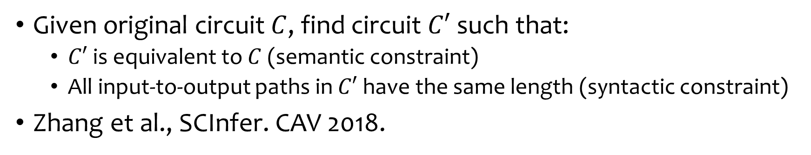
Side Channel Attacks on Cryptographic Circuits
Given original circuit $C$, find circuit $C′$ such that:
  $C′$ is equivalent to $C$ (semantic constraint)
  All input-to-output paths in $C′$ have the same length (syntactic constraint)
Zhang et al., SCInfer. CAV 2018.

Slide 8
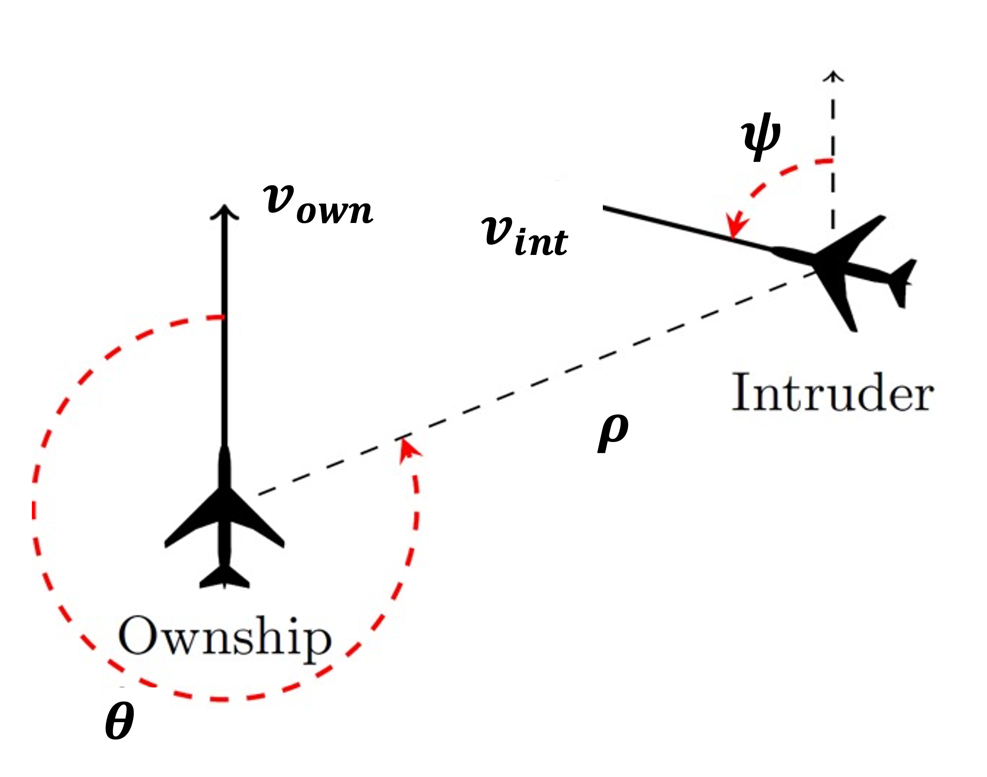
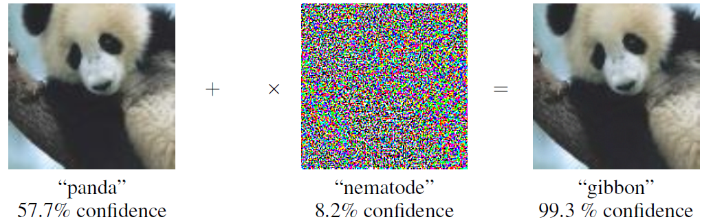

Proving Properties of Neural Networks
Problem: Compressing Airborne Collision Avoidance System (ACAS-Xu)
Question: How to confirm that neural network is robust?
$$ε$$

Slide 9
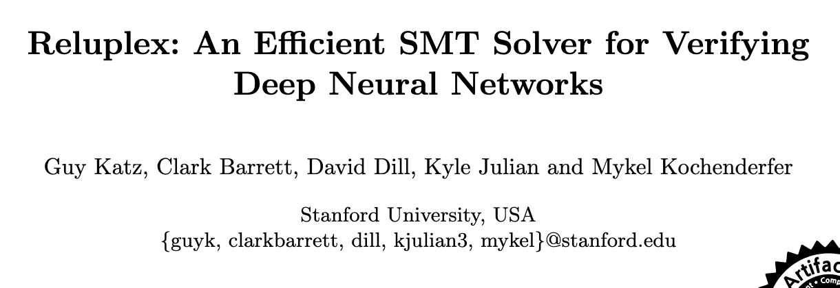
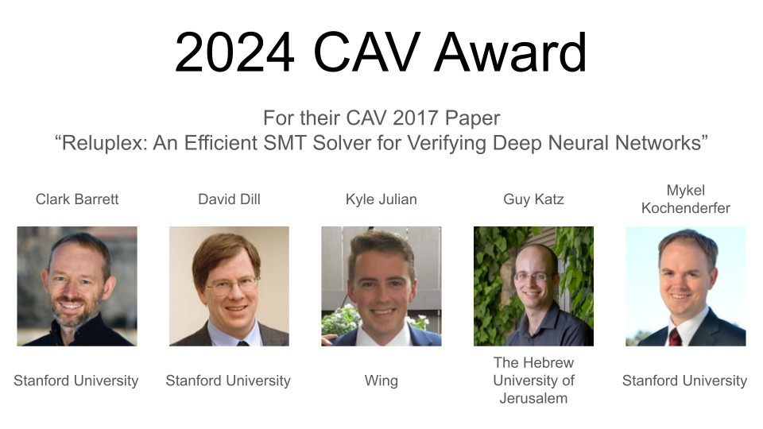
Proving Properties of Neural Networks

Slide 10
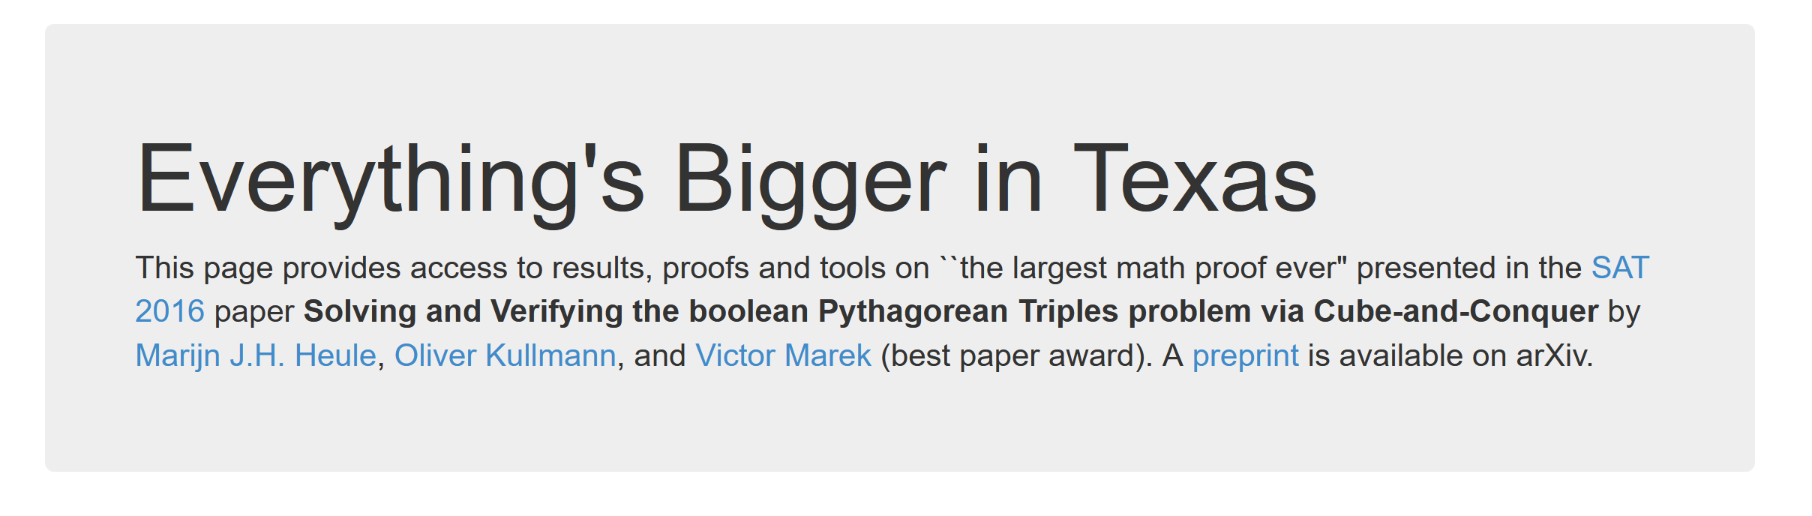
Automated Reasoning in Mathematics
Boolean Pythagorean Triples Problem
Can the positive integers be coloured red and blue so that every Pythagorean triple has a mixture of colours?
Affirmative answer by Heule et al., SAT 2016
Largest proof ever of a mathematical statement (200 TB)

Slide 11

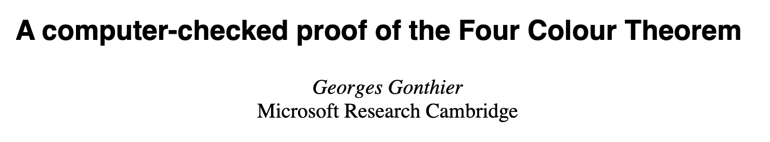
Mechanized Reasoning in Mathematics
Four Color Theorem
Conjectured ~1852 (Guthrie)
First proved by Appel and Haken (1976)
1000 hours of computation, 400 pages of microfilm
Rumors of a bug (Schmidt, 1981)
Certified proof by Gonthier (2005)

Slide 12
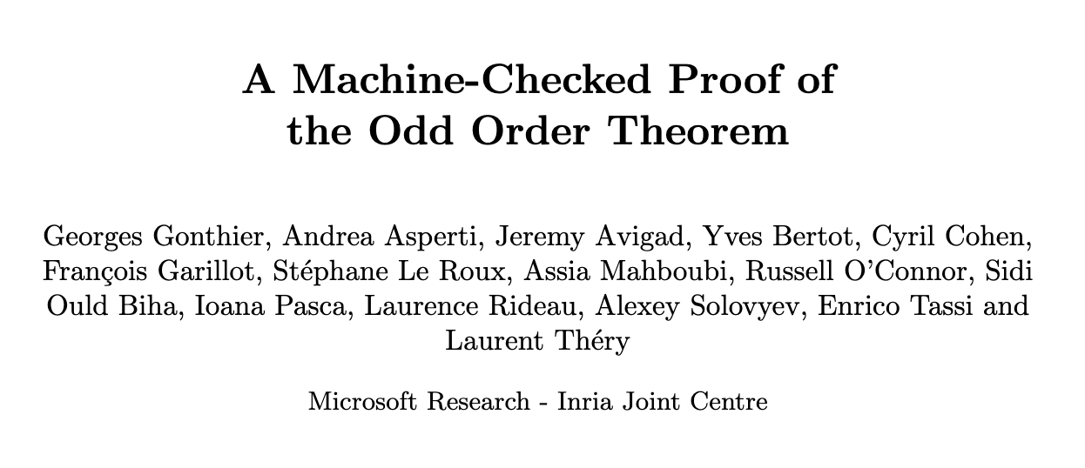
Mechanized Reasoning in Mathematics
Feit-Thompson Theorem (255 pages!)
Important step towards classification of finite simple groups
“Major project of 20th century mathematics research”
Certified proof by Gonthier et al., 2012

Slide 13
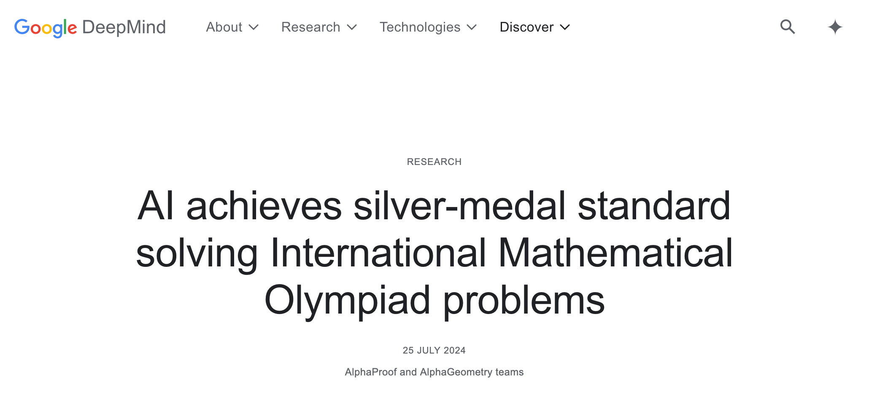
Automated Reasoning in Mathematics

Slide 14


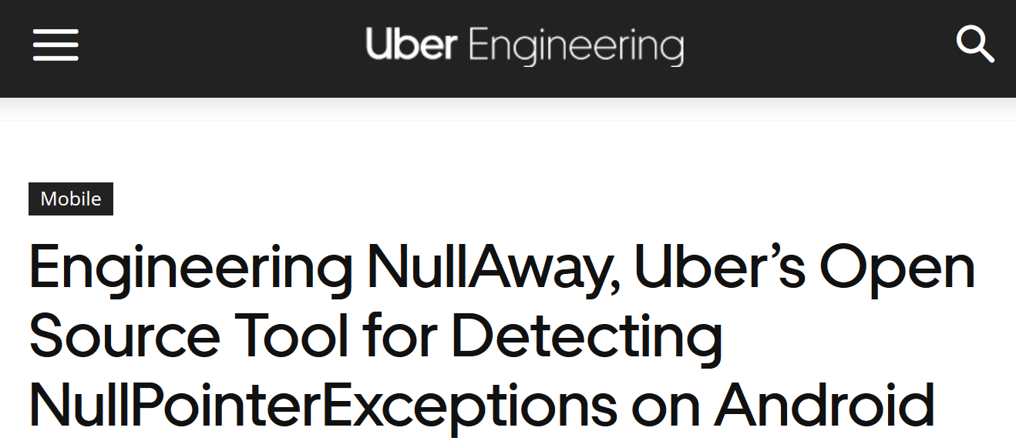
Growing Industrial Adoption
SonarSource
Synopsis
Amazon
Facebook
Uber
Astrée
Airbus
Microsoft

Slide 15
Verifying a Simple Program
Does this program ever crash?
Invariant: At the beginning of the loop body, in every iteration,
0 < i < j < hi
Does the invariant originally hold?
Does the loop preserve the invariant?
algorithm countBy2(hi) is
i := 1, j := 2
while j < hi do
i := i + 1
j := j + 2
if i >= hi, crash!

Slide 16
Verifying a Simple Program
Does this program always terminate?
Ranking function: The program will never run for more than (hi – j) / 2 iterations
Is the ranking function always positive?
Does it strictly decrease in every iteration?
algorithm countBy2(hi) is
i := 1, j := 2
while j < hi do
i := i + 1
j := j + 2
if i >= hi, crash!

Slide 17
Course Outline
❷ Program Synthesis
Proof synthesis
Program
❸
Verification Conditions
❶
Proof
❹ Abstract Interpretation

Slide 18
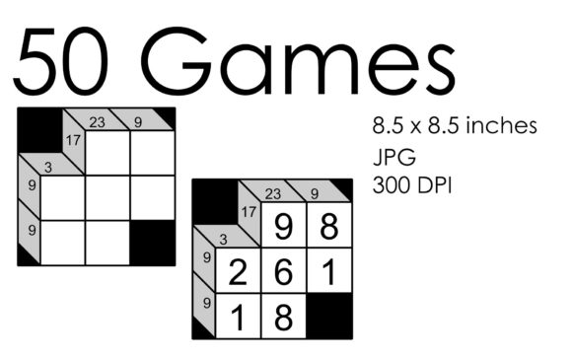
Using Constraint Solvers for Pleasure and Profit
Kakuro
Fill in with digits, 1—9
Digits in row / column add up to the value indicated in the corner
Digits don’t repeat in any given row / column

Slide 19
A Simple Synthesis Problem
How to fill in the blank so the program never crashes?
Does i := 0 work?
No? Crashes in the first iteration
Does i := 1 work?
Passes the first iteration, at least!
Is it more generally true?
algorithm countBy2(hi) is
i := ____
j := 2 * i
while j < hi do
if j = 3 * i, crash!
i := i + 1
j := j + 2

Slide 20
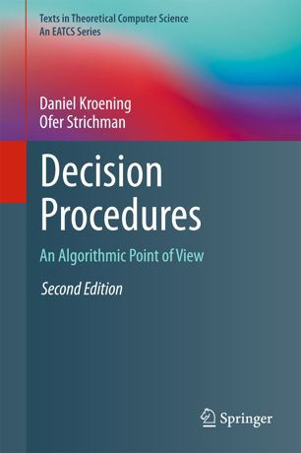
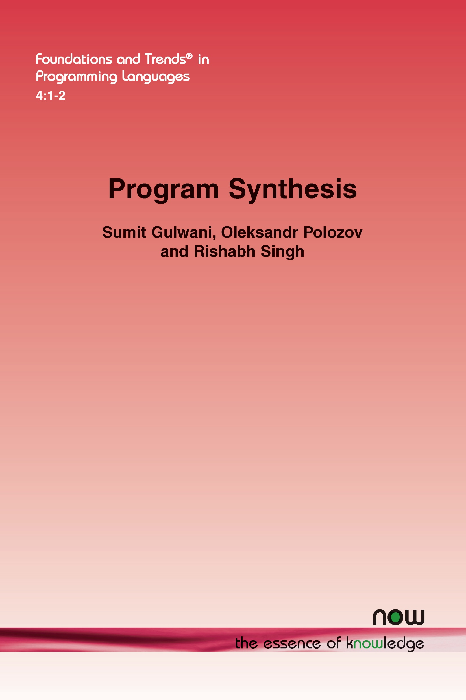

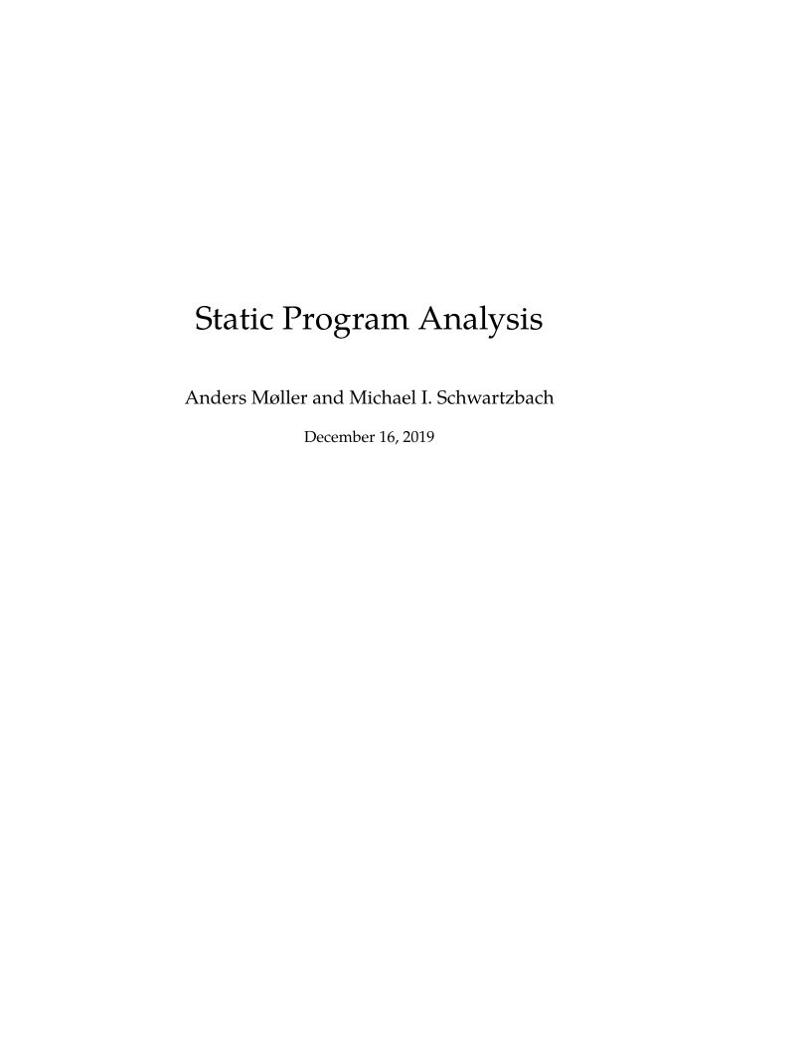
Reading

Slide 21
Reading (First two weeks)
Kroening and Strichman, Chapters 1, 2
De Millo, et al., Social Processes and Proofs of Theorems and Programs. CACM 1979.
Ken Thompson, Reflections on Trusting Trust. Turing Award Lecture, 1984.

Slide 22
Related Courses
Işıl Dillig, Automated Logical Reasoning. UT Austin.
https://www.cs.utexas.edu/~isil/cs389L/
Armando Solar-Lezama, Introduction to Program Synthesis. MIT.
https://people.csail.mit.edu/asolar/SynthesisCourse/
Rajeev Alur. Computer Aided Verification. Penn.
https://www.cis.upenn.edu/~alur/cis673.html
Nadia Polikarpova. Program Synthesis. UCSD.
https://github.com/nadia-polikarpova/cse291-program-synthesis/wiki
Loris D’Antoni. Program Verification and Synthesis. Wisconsin.
https://pages.cs.wisc.edu/~loris/cs703/

Slide 23
Logistics
Web: https://r-mukund.github.io/teaching/sp2025-csci625/
Piazza: https://piazza.com/usc/spring2025/csci625
Watch website and Piazza regularly!
Class: 3:30pm—5:20pm, Mondays and Wednesdays
I will upload video recordings
Office hours: 5:30pm—6:30pm, Mondays

Slide 24
Grading
4 homework assignments + paper presentations
1 project
All graded equally
Welcome to team up with a partner
For homework assignments, write up your own solutions
Will upload Homework 1 this week

Slide 25
The Project
Any topic broadly relevant to the course
Awesome if connected to your own thesis research
Meet me to brainstorm project ideas!
Research project: Pick problem, devise solutions, write paper
Survey project: Pick area, write survey summarizing past research
Reimplementation: Pick paper (not your own!), reimplement techniques. What worked? What didn’t?

Slide 26
The Project
Proposal
  What do you plan to do?
  Why is it awesome?
  What have you already done?
  Estimate deliverables
Final Submission
  Presentation in class
  Written report

Slide 27
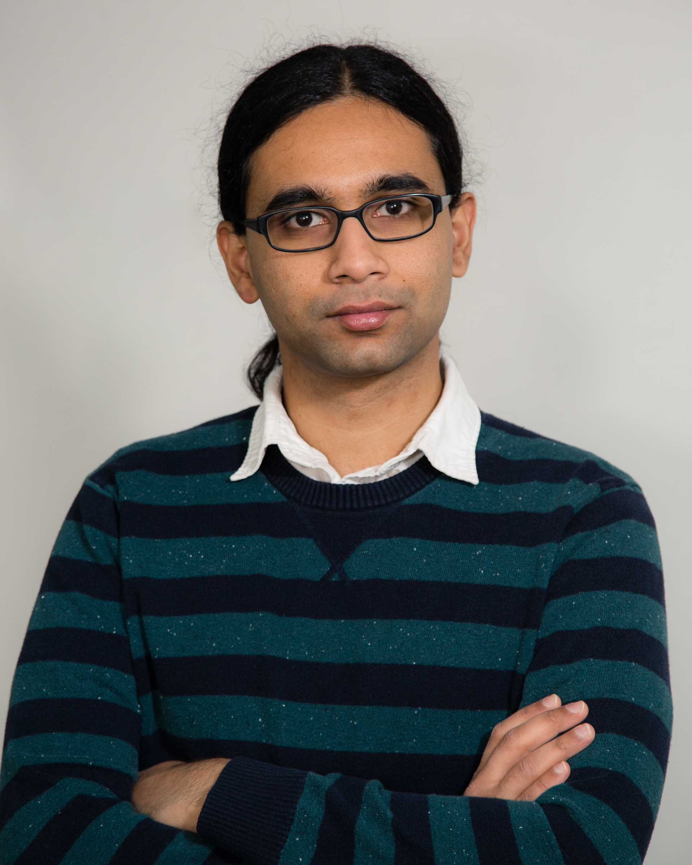
Introductions
Mukund Raghothaman
Assistant Professor of Computer Science
PhD and Postdoc from the University of Pennsylvania
Research in program verification and synthesis
Applications of machine learning and probabilistic methods

